Slide 1
Systems for Big-Graphs
Arijit Khan
Systems Group
ETH Zurich
Sameh Elnikety
Microsoft Research
Redmond, WA

Slide 2


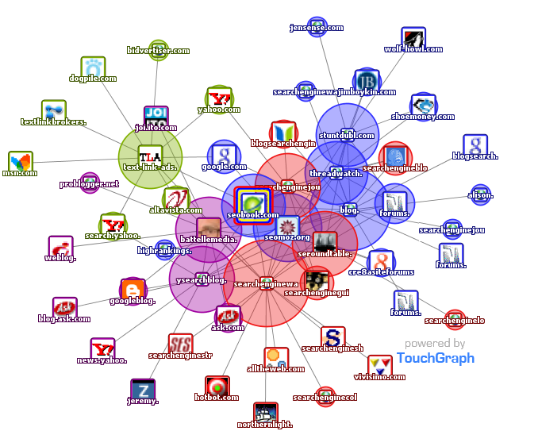

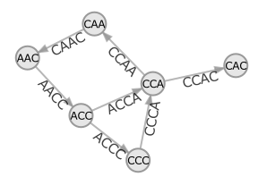

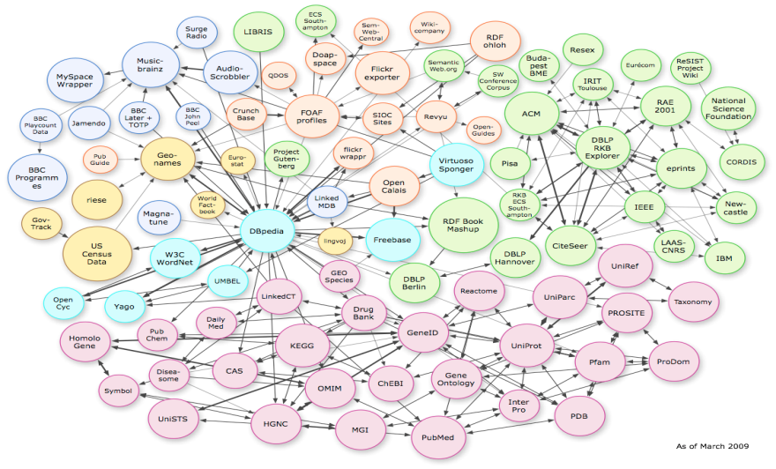
Big-Graphs
Google: > 1 trillion indexed pages
Facebook: > 800 million active users
Web Graph
Social Network
31 billion RDF triples in 2011
31 billion RDF triples in 2011
100M Ratings, 480K Users, 17K Movies
De Bruijn:
4^{k} nodes
(k = 20, … , 40)
Information Network
Biological Network
Graphs in Machine Learning
1/ 185

Slide 3
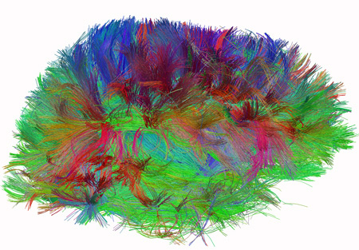
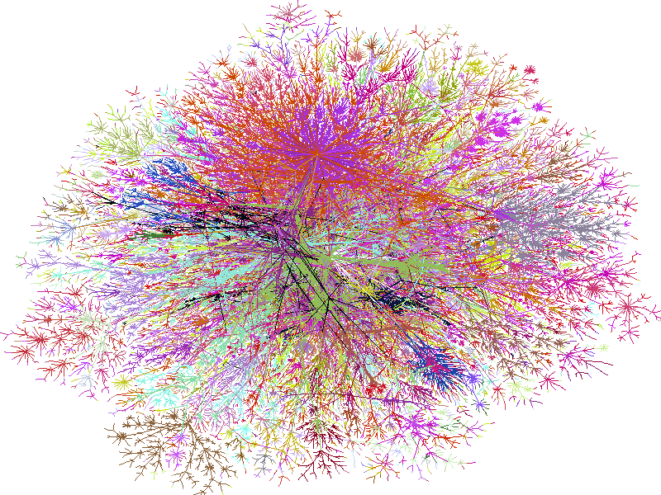
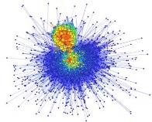





Big-Graph Scales
100M(10⁸)
Social Scale
100B (10¹¹)
Web Scale
1T (10¹²)
Brain Scale, 100T (10¹⁴)
US
Road
Internet
Knowledge
Graph
Web graph
(Google)
Human Connectome,
The Human Connectome Project, NIH
BTC
Semantic Web
Acknowledgement: Y. Wu, WSU
2/ 185

Slide 4


Graph Data: Topology + Attributes
LinkedIn

Slide 5

Graph Data: Topology + Attributes
Web Graph: 20 billion web pages × 20KB
= 400 TB
30-35 MB/sec disk data-transfer rate = 4 months to read the web
LinkedIn

Slide 6
Unique Challenges in Graph Processing
Poor locality of memory access by graph algorithms
I/O intensive – waits for memory fetches
Difficult to parallelize by data partitioning
Varying degree of parallelism over the course of execution
Recursive joins → useless large intermediate results → Not scalable (e.g., subgraph isomorphism query , Zeng et. al., VLDB ’13)
Lumsdaine et. al. [Parallel Processing Letters ‘07]
5/ 185

Slide 7
Tutorial Outline
Examples of Graph Computations
Offline Graph Analytics (Page Rank Computation)
Online Graph Querying (Reachability Query)
Systems for Offline Graph Analytics
MapReduce, PEGASUS, Pregel, GraphLab, GraphChi
Systems for Online Graph Querying
Trinity, Horton, GSPARQL, NScale
Graph Partitioning and Workload Balancing
PowerGraph, SEDGE, MIZAN
Open Problems
6/ 185

Slide 8
Tutorial Outline
Examples of Graph Computations
Offline Graph Analytics (Page Rank Computation)
Online Graph Querying (Reachability Query)
First Session (1:45-3:15PM)
Systems for Offline Graph Analytics
MapReduce, PEGASUS, Pregel, GraphLab, GraphChi
Systems for Online Graph Querying
Trinity, Horton, GSPARQL, NScale
Second Session (3:45-5:15PM)
Graph Partitioning and Workload Balancing
PowerGraph, SEDGE, MIZAN
Open Problems
7/ 185

Slide 9
This tutorial is not about …
Graph Databases: Neo4j, HyperGraphDB, InﬁniteGraph
Tutorial: Managing and Mining Large Graphs: Systems and Implementations (SIGMOD 2012)
Distributed SPARQL Engines and RDF-Stores: Triple store, Property Table, Vertical Partitioning, RDF-3X, HexaStore
Tutorials: Cloud-based RDF data management (SIGMOD 2014), Graph Data Management Systems for New Application Domains (VLDB 2011)
Other NoSQL Systems: Key-value stores (DynamoDB); Extensible Record Stores (BigTable, Cassandra, HBase, Accumulo); Document stores (MongoDB)
Tutorial: An In-Depth Look at Modern Database Systems (VLDB 2013)
Disk-based Graph Indexing, External-Memory Algorithms:
Survey: A Computational Study of External-Memory BFS Algorithms (SODA 2006)
Specialty Hardware Systems: Eldorado, BlueGene/L
8/ 185

Slide 10
Tutorial Outline
Examples of Graph Computations
Offline Graph Analytics (Page Rank Computation)
Online Graph Querying (Reachability Query)
Systems for Offline Graph Analytics
MapReduce, PEGASUS, Pregel, GraphLab, GraphChi
Systems for Online Graph Querying
Trinity, Horton, GSPARQL, NScale
Graph Partitioning and Workload Balancing
PowerGraph, SEDGE, MIZAN
Open Problems

Slide 11
Two Types of Graph Computation
Offline Graph Analytics
Iterative, batch processing over the entire graph dataset
Example: PageRank, Clustering, Strongly Connected Components, Diameter Finding, Graph Pattern Mining, Machine Learning/ Data Mining (MLDM) algorithms (e.g., Belief Propagation, Gaussian Non-negative Matrix Factorization)
Online Graph Querying
Explore a small fraction of the entire graph dataset
Real-time response, online graph traversal
Example: Reachability, Shortest-Path, Graph Pattern Matching, SPARQL queries
10/ 185

Slide 12
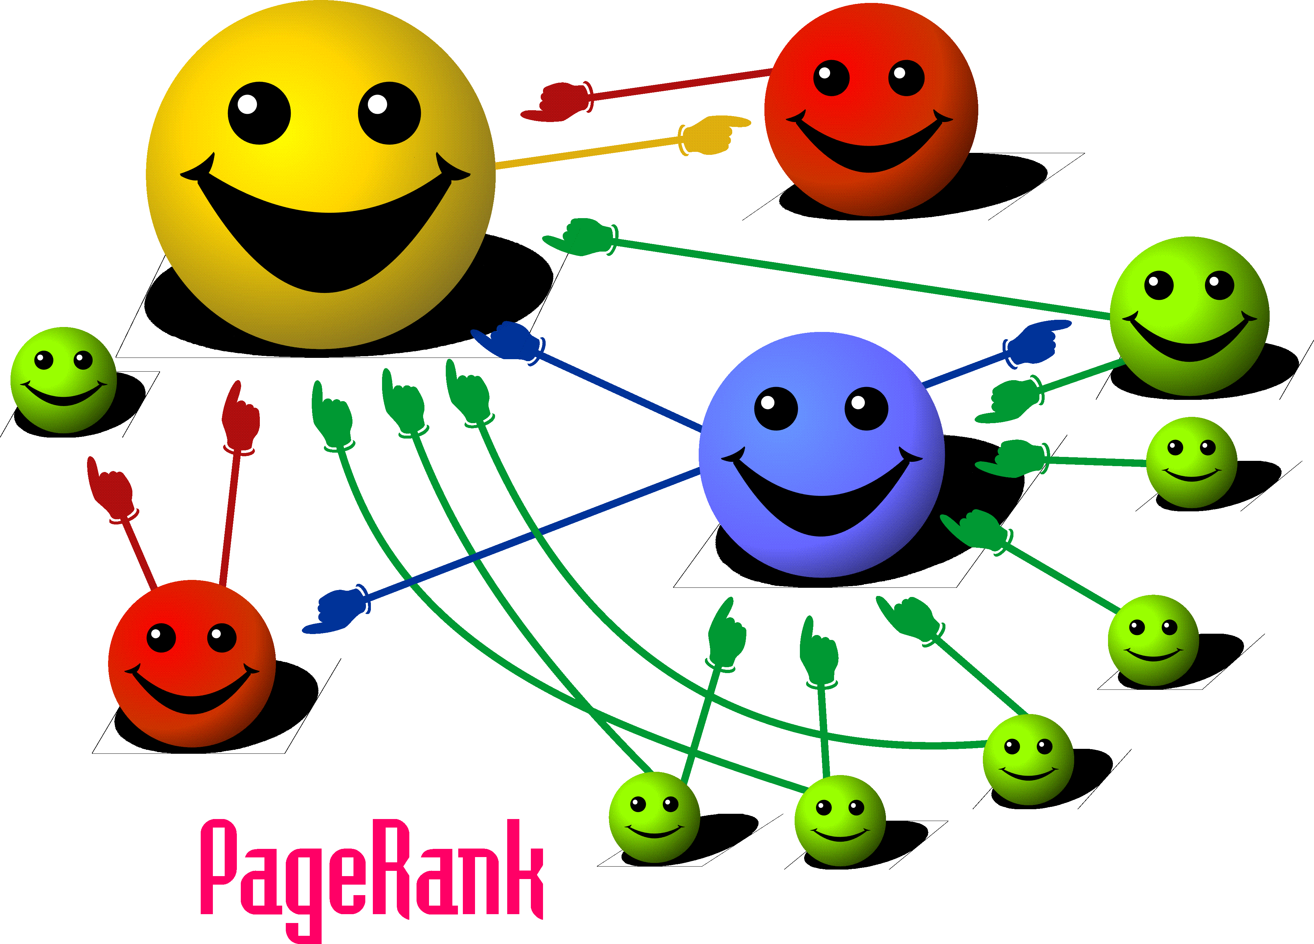
Page Rank Computation: Offline Graph Analytics
Acknowledgement: I. Mele, Web Information Retrieval
11/ 185

Slide 13
Page Rank Computation: Offline Graph Analytics
V₁
V₃
PR(u): Page Rank of node u
V₂
V₄
F_{u}: Out-neighbors of node u
B_{u}: In-neighbors of node u
Sergey Brin, Lawrence Page, “The Anatomy of Large-Scale Hypertextual Web Search Engine”, WWW ‘98
12/ 185

Slide 14
Page Rank Computation: Offline Graph Analytics
V₁
V₃
V₂
V₄
 | K=0
PR(V₁) | 0.25
PR(V₂) | 0.25
PR(V₃) | 0.25
PR(V₄) | 0.25
Sergey Brin, Lawrence Page, “The Anatomy of Large-Scale Hypertextual Web Search Engine”, WWW ‘98
13/ 185

Slide 15
Page Rank Computation: Offline Graph Analytics
V₁
V₃
V₂
V₄
 | K=0 | K=1
PR(V₁) | 0.25 | ?
PR(V₂) | 0.25
PR(V₃) | 0.25
PR(V₄) | 0.25
Sergey Brin, Lawrence Page, “The Anatomy of Large-Scale Hypertextual Web Search Engine”, WWW ‘98
14/ 185

Slide 16
Page Rank Computation: Offline Graph Analytics
0.25
V₁
V₃
0.12
0.12
V₂
V₄
 | K=0 | K=1
PR(V₁) | 0.25 | ?
PR(V₂) | 0.25
PR(V₃) | 0.25
PR(V₄) | 0.25
Sergey Brin, Lawrence Page, “The Anatomy of Large-Scale Hypertextual Web Search Engine”, WWW ‘98
15/ 185

Slide 17
Page Rank Computation: Offline Graph Analytics
0.25
V₁
V₃
0.12
0.12
V₂
V₄
 | K=0 | K=1
PR(V₁) | 0.25 | 0.37
PR(V₂) | 0.25
PR(V₃) | 0.25
PR(V₄) | 0.25
Sergey Brin, Lawrence Page, “The Anatomy of Large-Scale Hypertextual Web Search Engine”, WWW ‘98
16/ 185

Slide 18
Page Rank Computation: Offline Graph Analytics
V₁
V₃
V₂
V₄
 | K=0 | K=1
PR(V₁) | 0.25 | 0.37
PR(V₂) | 0.25 | 0.08
PR(V₃) | 0.25 | 0.33
PR(V₄) | 0.25 | 0.20
Sergey Brin, Lawrence Page, “The Anatomy of Large-Scale Hypertextual Web Search Engine”, WWW ‘98
17/ 185

Slide 19
Page Rank Computation: Offline Graph Analytics
V₁
V₃
Iterative Batch Processing
V₂
V₄
 | K=0 | K=1 | K=2
PR(V₁) | 0.25 | 0.37 | 0.43
PR(V₂) | 0.25 | 0.08 | 0.12
PR(V₃) | 0.25 | 0.33 | 0.27
PR(V₄) | 0.25 | 0.20 | 0.16
Sergey Brin, Lawrence Page, “The Anatomy of Large-Scale Hypertextual Web Search Engine”, WWW ‘98
18/ 185

Slide 20
Page Rank Computation: Offline Graph Analytics
V₁
V₃
Iterative Batch Processing
V₂
V₄
 | K=0 | K=1 | K=2 | K=3
PR(V₁) | 0.25 | 0.37 | 0.43 | 0.35
PR(V₂) | 0.25 | 0.08 | 0.12 | 0.14
PR(V₃) | 0.25 | 0.33 | 0.27 | 0.29
PR(V₄) | 0.25 | 0.20 | 0.16 | 0.20
Sergey Brin, Lawrence Page, “The Anatomy of Large-Scale Hypertextual Web Search Engine”, WWW ‘98
18/ 185

Slide 21
Page Rank Computation: Offline Graph Analytics
V₁
V₃
Iterative Batch Processing
V₂
V₄
 | K=0 | K=1 | K=2 | K=3 | K=4
PR(V₁) | 0.25 | 0.37 | 0.43 | 0.35 | 0.39
PR(V₂) | 0.25 | 0.08 | 0.12 | 0.14 | 0.11
PR(V₃) | 0.25 | 0.33 | 0.27 | 0.29 | 0.29
PR(V₄) | 0.25 | 0.20 | 0.16 | 0.20 | 0.19
Sergey Brin, Lawrence Page, “The Anatomy of Large-Scale Hypertextual Web Search Engine”, WWW ‘98
18/ 185

Slide 22
Page Rank Computation: Offline Graph Analytics
V₁
V₃
V₂
V₄
Iterative Batch Processing
 | K=0 | K=1 | K=2 | K=3 | K=4 | K=5
PR(V₁) | 0.25 | 0.37 | 0.43 | 0.35 | 0.39 | 0.39
PR(V₂) | 0.25 | 0.08 | 0.12 | 0.14 | 0.11 | 0.13
PR(V₃) | 0.25 | 0.33 | 0.27 | 0.29 | 0.29 | 0.28
PR(V₄) | 0.25 | 0.20 | 0.16 | 0.20 | 0.19 | 0.19
Sergey Brin, Lawrence Page, “The Anatomy of Large-Scale Hypertextual Web Search Engine”, WWW ‘98
18/ 185

Slide 23
Page Rank Computation: Offline Graph Analytics
V₁
V₃
FixPoint
V₂
V₄
 | K=0 | K=1 | K=2 | K=3 | K=4 | K=5 | K=6
PR(V₁) | 0.25 | 0.37 | 0.43 | 0.35 | 0.39 | 0.39 | 0.38
PR(V₂) | 0.25 | 0.08 | 0.12 | 0.14 | 0.11 | 0.13 | 0.13
PR(V₃) | 0.25 | 0.33 | 0.27 | 0.29 | 0.29 | 0.28 | 0.28
PR(V₄) | 0.25 | 0.20 | 0.16 | 0.20 | 0.19 | 0.19 | 0.19
Sergey Brin, Lawrence Page, “The Anatomy of Large-Scale Hypertextual Web Search Engine”, WWW ‘98
19/ 185

Slide 24
Reachability Query: Online Graph Querying
The problem: Given two vertices u and v in a directed graph G, is there a path from u to v ?
15
? Query(1, 10) – Yes
? Query(3, 9) - No
14
11
13
10
12
6
7
8
9
3
4
5
1
2
20/ 185

Slide 25
Reachability Query: Online Graph Querying
15
? Query(1, 10) – Yes
14
11
13
10
12
Online Graph Traversal
6
7
8
9
Partial Exploration of the Graph
3
4
5
1
2
21/ 185

Slide 26
Reachability Query: Online Graph Querying
15
? Query(1, 10) – Yes
14
11
13
10
12
Online Graph Traversal
6
7
8
9
Partial Exploration of the Graph
3
4
5
1
2
21/ 185

Slide 27

Tutorial Outline
Examples of Graph Computations
Offline Graph Analytics (Page Rank Computation)
Online Graph Querying (Reachability Query)
Systems for Offline Graph Analytics
MapReduce, PEGASUS, Pregel, GraphLab, GraphChi
Systems for Online Graph Querying
Trinity, Horton, GSPARQL, NScale
Graph Partitioning and Workload Balancing
PowerGraph, SEDGE, MIZAN
Open Problems

Slide 28
MapReduce
Cluster of commodity servers + Gigabit ethernet connection
Scale-out and Not scale-up
Distributed Computing
+ Functional Programming
Move Processing to Data
Sequential (Batch) Processing of Data
Mask hardware failure
Big Document
Input 1
Input 2
Input 3
Map 1
<k1, v1>
<k2, v2>
Map 2
<k2, v3>
<k3, v4>
Map 3
<k3, v5>
<k1, v6>
Shuffle
Reducer 1
<k1, v1>
<k1, v6>
Reducer 2
<k3, v4>
<k3, v5>
Output 1
Output 2
J. Dean and Sanjay Ghemawat, “MapReduce: Simplified
Data Processing in Large Clusters”, OSDI ‘04
22/ 185

Slide 29
PageRank over MapReduce
V₁
V₃
Multiple MapReduce iterations
Each Page Rank Iteration:
Input:
(id₁, [PR_{t}(1), out₁₁, out₁₂, …]),
(id₂, [PR_{t}(2), out₂₁, out₂₂, …]),
…
Output:
(id₁, [PR_{t+1}(1), out₁₁, out₁₂, …]),
(id₂, [PR_{t+1}(2), out₂₁, out₂₂, …]),
…
V₂
V₄
V₁, [0.25, V₂, V₃, V₄]
V₂, [0.25, V₃, V₄]
V₃, [0.25, V₁]
V₄,[0.25, V₁, V₃]
Input:
One
MapReduce
Iteration
V₁, [0.37, V₂, V₃, V₄]
V₂, [0.08, V₃, V₄]
V₃, [0.33, V₁]
V₄ ,[0.20, V₁, V₃]
Output:
Iterate until convergence → another MapReduce instance
23/ 185

Slide 30
PageRank over MapReduce (One Iteration)
Map
Input: (V₁, [0.25, V₂, V₃, V₄]);
(V₂, [0.25, V₃, V₄]); (V₃, [0.25, V₁]);
(V₄,[0.25, V₁, V₃])
Output: (V₂, 0.25/3), (V₃, 0.25/3), (V₄, 0.25/3),
……, (V₁, 0.25/2), (V₃, 0.25/2);
(V₁, [V₂, V₃, V₄]), (V₂, [V₃, V₄]), (V₃, [V₁]), (V₄, [V₁, V₃])
V₁
V₃
V₂
V₄
24/ 185

Slide 31
PageRank over MapReduce (One Iteration)
Map
Input: (V₁, [0.25, V₂, V₃, V₄]);
(V₂, [0.25, V₃, V₄]); (V₃, [0.25, V₁]);
(V₄,[0.25, V₁, V₃])
Output: (V₂, 0.25/3), (V₃, 0.25/3), (V₄, 0.25/3),
……, (V₁, 0.25/2), (V₃, 0.25/2);
(V₁, [V₂, V₃, V₄]), (V₂, [V₃, V₄]), (V₃, [V₁]), (V₄, [V₁, V₃])
V₁
V₃
V₂
V₄
24/ 185

Slide 32
PageRank over MapReduce (One Iteration)
Map
Input: (V₁, [0.25, V₂, V₃, V₄]);
(V₂, [0.25, V₃, V₄]); (V₃, [0.25, V₁]);
(V₄,[0.25, V₁, V₃])
Output: (V₂, 0.25/3), (V₃, 0.25/3), (V₄, 0.25/3),
……, (V₁, 0.25/2), (V₃, 0.25/2);
(V₁, [V₂, V₃, V₄]), (V₂, [V₃, V₄]), (V₃, [V₁]), (V₄, [V₁, V₃])
V₁
V₃
V₂
V₄
Shuffle
Output: (V₁, 0.25/1), (V₁, 0.25/2), (V₁, [V₂, V₃, V₄]); ……. ;
(V₄, 0.25/3), (V₄, 0.25/2), (V₄, [V₁, V₃])
24/ 185

Slide 33
PageRank over MapReduce (One Iteration)
Map
Input: (V₁, [0.25, V₂, V₃, V₄]);
(V₂, [0.25, V₃, V₄]); (V₃, [0.25, V₁]);
(V₄,[0.25, V₁, V₃])
Output: (V₂, 0.25/3), (V₃, 0.25/3), (V₄, 0.25/3),
……, (V₁, 0.25/2), (V₃, 0.25/2);
(V₁, [V₂, V₃, V₄]), (V₂, [V₃, V₄]), (V₃, [V₁]), (V₄, [V₁, V₃])
V₁
V₃
V₂
V₄
Shuffle
Output: (V₁, 0.25/1), (V₁, 0.25/2), (V₁, [V₂, V₃, V₄]); ……. ;
(V₄, 0.25/3), (V₄, 0.25/2), (V₄, [V₁, V₃])
Reduce
Output: (V₁, [0.37, V₂, V₃, V₄]); (V₂, [0.08, V₃, V₄]); (V₃, [0.33, V₁]); (V₄,[0.20, V₁, V₃])
24/ 185

Slide 34
Key Insight in Parallelization (Page Rank over MapReduce)
The ‘future’ Page Rank values depend on ‘current’ Page Rank values, but not on any other ‘future’ Page Rank values.
‘Future’ Page Rank value of each node can be computed in parallel.
25/ 185

Slide 35
PEGASUS: Matrix-based Graph Analytics over MapReduce
Convert graph mining operations into iterative matrix-vector multiplication
×
Matrix-Vector multiplication implemented with MapReduce
˭
Further optimized (5X) by block multiplication
M _{n×n}
V _{n×1}
V’ _{n×1}
Normalized Graph
Adjacency Matrix
Current Page
Rank Vector
Future Page
Rank Vector
U Kang et. al., “PEGASUS: A Peta-Scale Graph Mining System”, ICDM ‘09
26/ 185

Slide 36
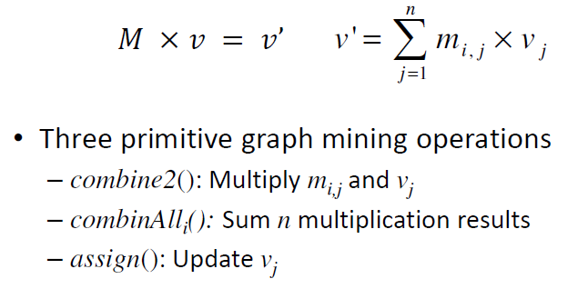
PEGASUS: Primitive Operations
Three primitive operations:
combine2(): multiply m_{i,j} and v_{j}
combinAll_{i}(): sum n multiplication results
assign(): update v_{j}
PageRank Computation: P_{k+1} = [ cM + (1-c)U ] P_{k}
combine2(): x = c ×m_{i,j} × v_{j}
combinAll_{i}(): (1-c)/n + ∑ x
assign(): update v_{j}
27/ 185

Slide 37
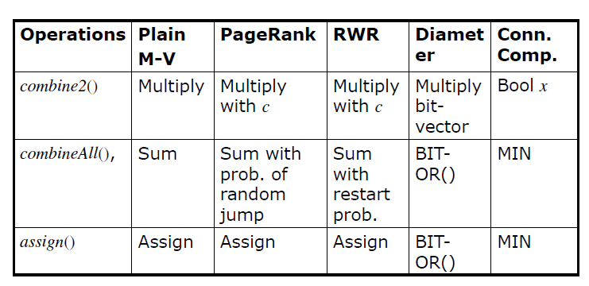
Offline Graph Analytics In PEGASUS
28/ 185

Slide 38
Problems with MapReduce for Graph Analytics
MapReduce does not directly support iterative algorithms
Invariant graph-topology-data re-loaded and re-processed at each iteration → wasting I/O, network bandwidth, and CPU
Materializations of intermediate results at every MapReduce iteration harm performance
Extra MapReduce job on each iteration for detecting if a ﬁxpoint has been reached
Each Page Rank Iteration:
Input:
(id₁, [PR_{t}(1), out₁₁, out₁₂, … ]), (id₂, [PR_{t}(2), out₂₁, out₂₂, … ]), …
Output:
(id₁, [PR_{t+1}(1), out₁₁, out₁₂, … ]), (id₂, [PR_{t+1}(2), out₂₁, out₂₂, … ]), …
29/ 185

Slide 39
Alternative to Simple MapReduce for Graph Analytics
HALOOP [Y. Bu et. al., VLDB ‘10]
TWISTER [J. Ekanayake et. al., HPDC ‘10]
Piccolo [R. Power et. al., OSDI ‘10]
SPARK [M. Zaharia et. al., HotCloud ‘10]
PREGEL [G. Malewicz et. al., SIGMOD ‘10]
GBASE [U. Kang et. al., KDD ‘11]
Iterative Dataflow-based Solutions: Stratosphere [Ewen et. al., VLDB ‘12]; GraphX [R. Xin et. al., GRADES ‘13]; Naiad [D. Murray et. al., SOSP’13]
DataLog-based Solutions: SociaLite [J. Seo et. al., VLDB ‘13]
30/ 185

Slide 40
Alternative to Simple MapReduce for Graph Analytics
HALOOP [Y. Bu et. al., VLDB ‘10]
TWISTER [J. Ekanayake et. al., HPDC ‘10]
Piccolo [R. Power et. al., OSDI ‘10]
SPARK [M. Zaharia et. al., HotCloud ‘10]
PREGEL [G. Malewicz et. al., SIGMOD ‘10]
GBASE [U. Kang et. al., KDD ’11]
Dataflow-based Solutions: Stratosphere [Ewen et. al., VLDB ‘12]; GraphX [R. Xin et. al., GRADES ‘13]; Naiad [D. Murray et. al., SOSP’13]
DataLog-based Solutions: SociaLite [J. Seo et. al., VLDB ‘13]
Bulk
Synchronous
Parallel (BSP)
Computation
30/ 185

Slide 41
BSP Programming Model and its Variants: Offline Graph Analytics
PREGEL [G. Malewicz et. al., SIGMOD ‘10]
GPS [S. Salihoglu et. al., SSDBM ‘13]
X-Stream [A. Roy et. al., SOSP ‘13]
GraphLab/ PowerGraph [Y. Low et. al., VLDB ‘12]
Grace [G. Wang et. al., CIDR ‘13]
SIGNAL/COLLECT [P. Stutz et. al., ISWC ‘10]
Giraph++ [Tian et. al., VLDB ‘13]
GraphChi [A. Kyrola et. al., OSDI ‘12]
Asynchronous Accumulative Update [Y. Zhang et. al., ScienceCloud ‘12], PrIter [Y. Zhang et. al., SOCC ‘11]
Synchronous
Asynchronous
31/ 185

Slide 42
BSP Programming Model and its Variants: Offline Graph Analytics
PREGEL [G. Malewicz et. al., SIGMOD ‘10]
GPS [S. Salihoglu et. al., SSDBM ‘13]
X-Stream [A. Roy et. al., SOSP ‘13]
GraphLab/ PowerGraph [Y. Low et. al., VLDB ‘12]
Grace [G. Wang et. al., CIDR ‘13]
SIGNAL/COLLECT [P. Stutz et. al., ISWC ‘10]
Giraph++ [Tian et. al., VLDB ‘13]
GraphChi [A. Kyrola et. al., OSDI ‘12]
Asynchronous Accumulative Update [Y. Zhang et. al., ScienceCloud ‘12], PrIter [Y. Zhang et. al., SOCC ‘11]
Synchronous
Disk-based
Asynchronous
Disk-based
31/ 185

Slide 43
BSP Programming Model and its Variants: Offline Graph Analytics
PREGEL [G. Malewicz et. al., SIGMOD ‘10]
GPS [S. Salihoglu et. al., SSDBM ‘13]
X-Stream [A. Roy et. al., SOSP ‘13]
GraphLab/ PowerGraph [Y. Low et. al., VLDB ‘12]
Grace [G. Wang et. al., CIDR ‘13]
SIGNAL/COLLECT [P. Stutz et. al., ISWC ‘10]
Giraph++ [Tian et. al., VLDB ‘13]
GraphChi [A. Kyrola et. al., OSDI ‘12]
Asynchronous Accumulative Update [Y. Zhang et. al., ScienceCloud ‘12], PrIter [Y. Zhang et. al., SOCC ‘11]
Synchronous
Disk-based
Asynchronous
Disk-based
31/ 185

Slide 44
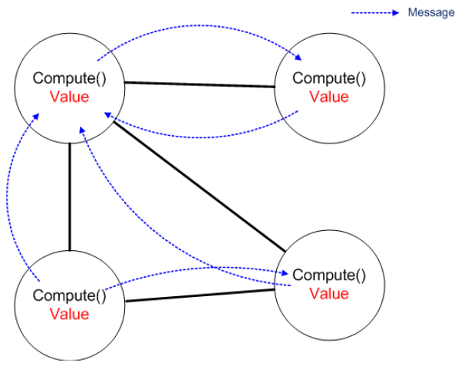
PREGEL
Inspired by Valiant’s Bulk
Synchronous Parallel (BSP) model
Communication through message
passing (usually sent along
the outgoing edges from each
vertex) + Shared-Nothing
Vertex centric computation
G. Malewicz et. al., “Pregel: A System for Large-Scale Graph Processing”, SIGMOD ‘10

Slide 45
PREGEL
Inspired by Valiant’s Bulk
Synchronous Parallel (BSP) model
Communication through message
passing (usually sent along
the outgoing edges from each
vertex) + Shared-Nothing
Vertex centric computation
Each vertex:
Receives messages sent in the previous superstep
Executes the same user-defined function
Modifies its value
If active, sends messages to other vertices (received in the next superstep)
Votes to halt if it has no further work to do → becomes inactive
Terminate when all vertices are inactive and no messages in transmit
32/ 185

Slide 46
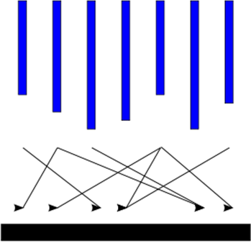
PREGEL
Input
Computation
Votes to Halt
Communication
Superstep
Synchronization
Active
Inactive
Message Received
State Machine for a Vertex in PREGEL
Output
PREGEL Computation Model
33/ 185

Slide 47
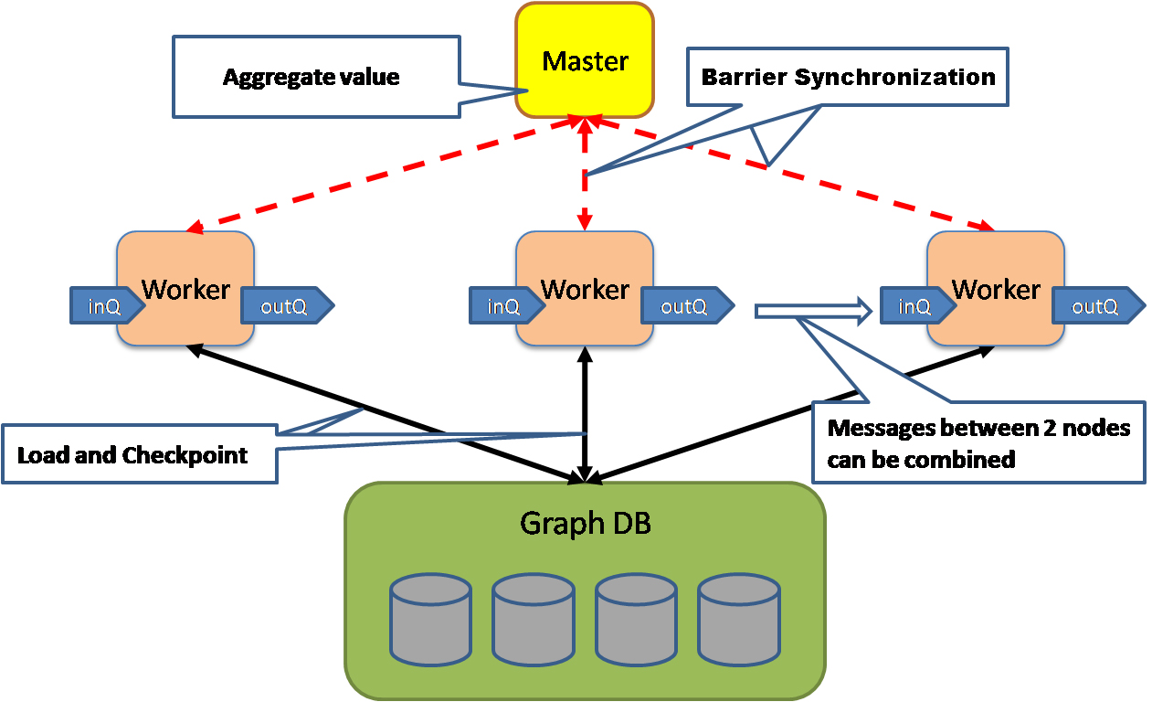
PREGEL System Architecture
Master-Slave architecture
Acknowledgement: G. Malewicz, Google
34/ 185

Slide 48
Page Rank with PREGEL
Superstep 0: PR value of each vertex 1/NumVertices()
Class PageRankVertex {
public:
virtual void Compute(MessageIterator* msgs) {
if (superstep () >= 1) {
double sum = 0;
for ( ; !msgs -> Done(); msgs->Next() )
sum += msgs -> Value();
*MutableValue () = 0.15/ NumVertices() + 0.85 * sum;
}
if(superstep() < 30) {
const int64 n = GetOutEdgeIterator().size();
SendMessageToAllNeighbors(GetValue() / n);
}
else {
VoteToHalt();
}
}
35/ 185

Slide 49
Page Rank with PREGEL
PR = 0.15/ 5 + 0.85 * SUM
0.1
0.2
0.067
0.2
0.2
0.2
0.2
0.1
0.067
0.2
0.2
0.067
0.2
Superstep = 0
36/ 185

Slide 50
Page Rank with PREGEL
PR = 0.15/ 5 + 0.85 * SUM
0.015
0.172
0.01
0.03
0.172
0.03
0.34
0.015
0.01
0.34
0.426
0.01
0.426
Superstep = 1
37/ 185

Slide 51
Page Rank with PREGEL
PR = 0.15/ 5 + 0.85 * SUM
0.015
0.051
0.01
0.03
0.051
0.03
0.197
0.015
0.01
0.197
0.69
0.01
0.69
Superstep = 2
38/ 185

Slide 52
Page Rank with PREGEL
PR = 0.15/ 5 + 0.85 * SUM
0.015
0.051
0.01
0.03
0.051
0.03
0.095
0.015
0.01
Computation converged
0.095
0.792
0.01
0.794
Superstep = 3
39/ 185

Slide 53
Page Rank with PREGEL
PR = 0.15/ 5 + 0.85 * SUM
0.015
0.051
0.01
0.03
0.051
0.03
0.095
0.015
0.01
0.095
0.792
0.01
0.794
Superstep = 4
40/ 185

Slide 54
Page Rank with PREGEL
PR = 0.15/ 5 + 0.85 * SUM
0.015
0.051
0.01
0.03
0.051
0.03
0.095
0.015
0.01
0.095
0.792
0.01
0.794
Superstep = 5
41/ 185

Slide 55

Benefits of PREGEL over MapReduce (Offline Graph Analytics)
MapReduce
PREGEL
Requires passing of entire graph topology from one iteration to the next
Each node sends its state only to its neighbors.
Graph topology information is not passed across iterations
Intermediate results after every iteration is stored at disk and then read again from the disk
Main memory based
(20X faster for k-core decomposition problem; B. Elser et. al., IEEE BigData ‘13)
Programmer needs to write a driver program to support iterations; another MapReduce program to check for fixpoint
Usage of supersteps and master-client architecture makes programming easy
42/ 185

Slide 56
Graph Algorithms Implemented with PREGEL (and PREGEL-Like-Systems)
Page Rank
Triangle Counting
Connected Components
Shortest Distance
Random Walk
Graph Coarsening
Graph Coloring
Minimum Spanning Forest
Community Detection
Collaborative Filtering
Belief Propagation
Named Entity Recognition
Not an Exclusive List
43/ 185

Slide 57
Which Graph Algorithms cannot be Expressed in PREGEL Framework?
PREGEL ≡ BSP ≡ MapReduce
Efficiency is the issue
Theoretical Complexity of Algorithms under MapReduce Model
A Model of Computation for MapReduce [H. Karloff et. al., SODA ‘10]
Minimal MapReduce Algorithms [Y. Tao et. al., SIGMOD ‘13]
Questions and Answers about BSP [D. B. Skillicorn et al., Oxford U. Tech. Report ‘96]
Optimizations and Analysis of BSP Graph Processing Models on Public Clouds [M. Redekopp et al., IPDPS ‘13]
44/ 185

Slide 58
Which Graph Algorithms cannot be Efficiently Expressed in PREGEL?
Q. Which graph problems cannot be efficiently expressed in PREGEL, because Pregel is an inappropriate/bad massively parallel model for the problem?
45/ 185

Slide 59
Which Graph Algorithms cannot be Efficiently Expressed in PREGEL?
Q. Which graph problems can't be efficiently expressed in PREGEL, because Pregel is an inappropriate/bad massively parallel model for the problem?
--e.g.,
Online graph queries – reachability, subgraph isomorphism
Betweenness Centrality
45/ 185

Slide 60
Which Graph Algorithms cannot be Efficiently Expressed in PREGEL?
Will be discussed in
the second half
Q. Which graph problems can't be efficiently expressed in PREGEL, because Pregel is an inappropriate/bad massively parallel model for the problem?
--e.g.,
Online graph queries – reachability, subgraph isomorphism
Betweenness Centrality
45/ 185

Slide 61
Theoretical Complexity Results of Graph Algorithms in PREGEL
Balanced Practical PREGEL Algorithms (BPPA)
- Linear Space Usage : O(d(v))
- Linear Computation Cost: O(d(v))
- Linear Communication Cost: O(d(v))
- (At Most) Logarithmic Number of Rounds: O(log n) super-steps
Examples: Connected components, spanning tree, Euler tour, BFS, Pre-order and Post-order Traversal
Open Area of Research
Practical PREGEL Algorithms for Massive Graphs [http://www.cse.cuhk.edu.hk]
46/ 185

Slide 62
Disadvantages of PREGEL
In Bulk Synchronous Parallel (BSP) model, performance is limited by the slowest machine
Real-world graphs have power-law degree distribution, which may lead to a few highly-loaded servers
Does not utilize the already computed partial results from the same iteration
Several machine learning algorithms (e.g., belief propagation, expectation maximization, stochastic optimization) have higher accuracy and efficiency with asynchronous updates
47/ 185

Slide 63
Disadvantages of PREGEL
In Bulk Synchronous Parallel (BSP) model, performance is limited by the slowest machine
Real-world graphs have power-law degree distribution, which may lead to a few highly-loaded servers
Does not utilize the already computed partial results from the same iteration
Several machine learning algorithms (e.g., belief propagation, expectation maximization, stochastic optimization) have higher accuracy and efficiency with asynchronous updates
Scope of Optimization
Partition the graph – (1) balance server workloads
(2) minimize communication across servers
47/ 185

Slide 64
Disadvantages of PREGEL
In Bulk Synchronous Parallel (BSP) model, performance is limited by the slowest machine
Real-world graphs have power-law degree distribution, which may lead to a few highly-loaded servers
Does not utilize the already computed partial results from the same iteration
Several machine learning algorithms (e.g., belief propagation, expectation maximization, stochastic optimization) have higher accuracy and efficiency with asynchronous updates
Will be discussed in
the second half
Scope of Optimization
Partition the graph – (1) balance server workloads
(2) minimize communication across servers
47/ 185

Slide 65
GraphLab
Asynchronous Updates
Shared-Memory (UAI ‘10), Distributed Memory (VLDB ’12)
GAS (Gather, Apply, Scatter) Model; Pull Model
Update: f(v, Scope[v]) → (Scope[v], T)
- Scope[v]: data stored in v as well as the data stored in its adjacent
vertices and edges
- T: set of vertices where an update is scheduled
Scheduler: defines an order among the vertices where an update is
scheduled
Concurrency Control: ensures serializability
Y. Low et. al., “Distributed GraphLab”, VLDB ‘12
48/ 185

Slide 66


















Properties of Graph Parallel Algorithms
Dependency
Graph
Local Updates
Iterative
Computation
My Rank
Friends Rank
Slides from: http://www.sfbayacm.org/event/graphlab-distributed-abstraction-machine-learning-cloud
49/ 185
Notes:
Slides are taken from: http://www.sfbayacm.org/event/graphlab-distributed-abstraction-machine-learning-cloud
http://graphlab.org/resources/publications.html

Slide 67
Pregel (Giraph)
Bulk Synchronous Parallel Model:
Compute
Communicate
Barrier
50/ 185

Slide 68
BSP Systems Problem
Iterations
Data
Data
Data
Data
CPU 1
CPU 1
CPU 1
Data
Data
Data
Data
Data
Data
Data
Data
CPU 2
CPU 2
CPU 2
Data
Data
Data
Data
Data
Data
Data
Data
CPU 3
CPU 3
CPU 3
Data
Data
Data
Data
Data
Data
Data
Data
Barrier
Barrier
Barrier
51/ 185

Slide 69
Problem with Bulk Synchronous
Example Algorithm: If Red neighbor then turn Red
Bulk Synchronous Computation :
Evaluate condition on all vertices for every phase
4 Phases each with 9 computations → 36 Computations
Asynchronous Computation (Wave-front) :
Evaluate condition only when neighbor changes
4 Phases each with 2 computations → 8 Computations
Time 0
Time 1
Time 2
Time 3
Time 4
52/ 185

Slide 70
Sequential Computational Structure
53/ 185
Notes:
Consider the following cyclic factor graph. For simplicity lets collapse <click> the factors the edges. Although this model is highly cyclic, hidden in the structure and factors <click> is a sequential path or backbone of strong dependences among the variables. <click>

Slide 71
Hidden Sequential Structure
54/ 185
Notes:
This hidden sequential structure takes the form of the standard chain graphical model. Lets see how the naturally parallel algorithm performs on this chain graphical models <click>.

Slide 72
Hidden Sequential Structure
Evidence
Evidence
Running Time:
Time for a single
parallel iteration
Number of Iterations
55/ 185
Notes:
Suppose we introduce evidence at both ends of the chain. Using 2n processors we can compute one iteration of messages entirely in parallel. However notice that after two iterations of parallel message computations the evidence on opposite ends has only traveled two vertices. It will take n parallel iterations for the evidence to cross the graph.
<click> Therefore, using p processors it will take 2n / p time to complete a single iteration and so it will take 2n^2/p time to compute the exact marginals.
We might now ask “what is the optimal sequential running time on the chain.”

Slide 73
BSP ML Problem: Synchronous Algorithms can be Inefficient
Theorem:
Bulk Synchronous BP O(#vertices) slower than Asynchronous BP
Bulk Synchronous (e.g., Pregel)
Asynchronous Splash BP
56/ 185
Notes:
Add picture of sad Joey. “Again, we want to avoid this type of problem-specific tedious labor”

Slide 74
The GraphLab Framework
Graph Based
Data Representation
Update Functions
User Computation
Scheduler
Consistency Model
57/ 185

Slide 75
Data Graph
Data associated with vertices and edges
Graph:
Social Network
Vertex Data:
User profile text
Current interests estimates
Edge Data:
Similarity weights
58/ 185

Slide 76
Update Functions
An update function is a user defined program which when applied to a vertex transforms the data in the scopeof the vertex
label_prop(i, scope){
// Get Neighborhood data
(Likes[i], W_{ij}, Likes[j]) ←scope;
// Update the vertex data
// Reschedule Neighbors if needed
if Likes[i] changes then
reschedule_neighbors_of(i);
}
Update function applied (asynchronously)
in parallel until convergence
Many schedulers available to prioritize computation
59/ 185

Slide 77
Page Rank with GraphLab
Page Rank Update Function
Input: Scope[v] : PR(v), for all in-neighbor u of v: PR(u), W_{u,v}
PR_{old}(v) = PR(v)
PR(v) = 0.15/n
For Each in-neighbor u of v, do
PR(v) = PR(v) + 0.85 × W_{u,v} × PR(v)
If |PR(v) - PR_{old}(v)| > epsilon // If Page Rank changed significantly
return {u: u in-neighbor of v} // schedule update at u
60/ 185

Slide 78
Page Rank with GraphLab
PR = 0.15/ 5 + 0.85 * SUM
V₁
Scheduler T: V₁, V₂, V₃, V₄, V₅
0.2
V₂
0.2
V₃
Vertex consistency model:
All vertex can be updated
simultaneously
0.2
0.2
V₄
V₅
0.2
Active Nodes
61/ 185

Slide 79
Page Rank with GraphLab
PR = 0.15/ 5 + 0.85 * SUM
V₁
Scheduler T: V₁, V₄, V₅
0.172
V₂
0.03
V₃
Vertex consistency model:
All vertex can be updated
simultaneously
0.03
0.34
V₄
V₅
0.426
Active Nodes
62/ 185

Slide 80
Page Rank with GraphLab
PR = 0.15/ 5 + 0.85 * SUM
V₁
Scheduler T: V₄, V₅
0.051
V₂
0.03
V₃
Vertex consistency model:
All vertex can be updated
simultaneously
0.03
0.197
V₄
V₅
0.69
Active Nodes
63/ 185

Slide 81
Page Rank with GraphLab
PR = 0.15/ 5 + 0.85 * SUM
V₁
Scheduler T: V₅
0.051
V₂
0.03
V₃
Vertex consistency model:
All vertex can be updated
simultaneously
0.03
0.095
V₄
V₅
0.792
Active Nodes
64/ 185

Slide 82
Page Rank with GraphLab
PR = 0.15/ 5 + 0.85 * SUM
V₁
Scheduler T:
0.051
V₂
0.03
V₃
Vertex consistency model:
All vertex can be updated
simultaneously
0.03
0.095
V₄
V₅
0.792
Active Nodes
65/ 185

Slide 83
Ensuring Race-Free Code
How much can computation overlap?
66/ 185

Slide 84
Importance of Consistency
Many algorithms require strict consistency, or performs significantly better under strict consistency.
Alternating Least Squares
67/ 185
Notes:
There are some people who have claimed that ML is resilient to “soft-computation”
-- ask me afterwards I can give a number of examples

Slide 85
GraphLab Ensures Sequential Consistency
For each parallel execution, there exists a sequential execution of update functions which produces the same result.
CPU 1
time
Parallel
CPU 2
Sequential
Single
CPU
68/ 185

Slide 86
Obtaining More Parallelism
Full Consistency
Edge Consistency
69/ 185

Slide 87
Consistency Through R/W Locks
Read/Write locks:
Full Consistency
Edge Consistency
Write
Write
Write
Read
Write
Read
Read
Write
69/ 185

Slide 88
Consistency Through Scheduling
Edge Consistency Model:
Two vertices can be Updated simultaneously if they do not share an edge.
Graph Coloring:
Two vertices can be assigned the same color if they do not share an edge.
Phase 1
Phase 2
Phase 3
Barrier
Barrier
Barrier

Slide 89
The Scheduler
The scheduler determines the order that vertices are updated.
CPU 1
b
c
d
a
b
c
Scheduler
e
f
b
e
f
g
a
i
h
i
j
h
i
j
k
CPU 2
The process repeats until the scheduler is empty.
71/ 185

Slide 90
Algorithms Implemented
PageRank
Loopy Belief Propagation
Gibbs Sampling
CoEM
Graphical Model Parameter Learning
Probabilistic Matrix/Tensor Factorization
Alternating Least Squares
Lasso with Sparse Features
Support Vector Machines with Sparse Features
Label-Propagation
…
72/ 185

Slide 91
GraphLab in Shared Memory vs. Distributed Memory
Shared Memory
Shared Data Table – to access neighbors’ information
Termination based on scheduler
Distributed Memory
Ghost Vertices
Distributed Locking
Termination based on distributed consensus algorithm
Fault Tolerance based on asynchronous Chandy-Lamport snapshot technique
73/ 185

Slide 92
PREGEL vs. GraphLab
PREGEL
GraphLab
Synchronous System
Asynchronous System
No concurrency control, no worry of consistency
Consistency of updates harder (edge, vertex, sequential)
Easy fault-tolerance, check point at each barrier
Fault-tolerance harder (need a snapshot with consistency)
Asynchronous model can make faster progress
Can load balance in scheduling to deal with load skew
Bad when waiting for stragglers or load-imbalance
74/ 185

Slide 93

PREGEL vs. GraphLab
GraphLab’s Synchronous mode (distributed memory) is up to 19X faster than PREGEL (Giraph) for Page Rank computation
GraphLab’s asynchronous mode (distributed memory) performs poorly, and usually takes longer time than the synchronous mode.
[M. Han et. al., VLDB ’14]
PREGEL
GraphLab
Synchronous System
Asynchronous System
No concurrency control, no worry of consistency
Consistency of updates harder (edge, vertex, sequential)
Easy fault-tolerance, check point at each barrier
Fault-tolerance harder (need a snapshot with consistency)
Asynchronous model can make faster progress
Can load balance in scheduling to deal with load skew
Bad when waiting for stragglers or load-imbalance
75/ 185

Slide 94
MapReduce vs. PREGEL vs. GraphLab
Aspect
MapReduce
PREGEL
GraphLab
Programming
Model
Shared
Memory
Distributed
Memory
Shared
Memory
Computation
Model
Synchronous
Bulk-Synchronous
Asynchronous
Parallelism
Model
Data Parallel
Graph Parallel
Graph Parallel
76/ 185

Slide 95
More Comparative Study (Empirical Comparisons)
M. Han et. al., “An Experimental Comparison of Pregel-like Graph Processing Systems”, VLDB ’14
N. Satish et. al., “Navigating the Maze of Graph Analytics Frameworks using Massive Graph Datasetts”, SIGMOD ‘14
B. Elser et. al., “An Evaluation Study of BigData Frameworks for Graph Processing”, IEEE BigData ‘13
Y. Guo et. al., “How Well do Graph-Processing Platforms Perform? “, IPDPS ‘14
S. Sakr et. al., “Processing Large-Scale Graph Data: A Guide to Current Technology”, IBM DevelopWorks
S. Sakr and M. M. Gaber (Editor) “Large Scale and Big Data: Processing and Management”
77/ 185

Slide 96
GraphChi: Large-Scale Graph Computation on Just a PC
Aapo Kyrölä (CMU)
Guy Blelloch (CMU)
Carlos Guestrin (UW)
Slides from: http://www.cs.cmu.edu/~akyrola/files/osditalk-graphchi.pptx
Notes:
Slides from: http://www.cs.cmu.edu/~akyrola/files/osditalk-graphchi.pptx and https://www.usenix.org/sites/default/files/conference/protected-files/kyrola_osdi12_slides.pdf

Slide 97

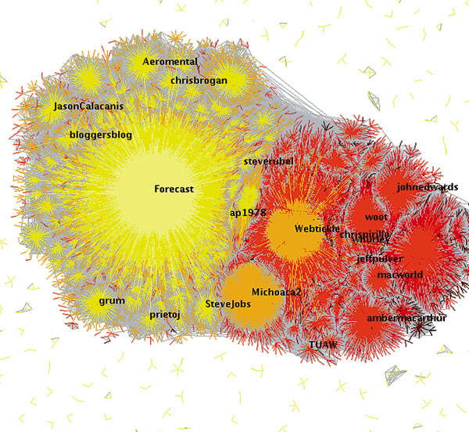
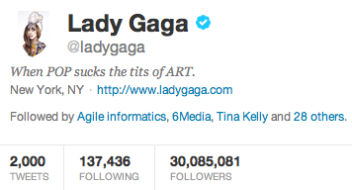
Big Graphs != Big Data
Data size:
140 billion connections
≈ 1 TB
Not a problem!
Computation:
Hard to scale
Twitter network visualization, by Akshay Java, 2009
78/ 185
Notes:
Problems with Big Graphs are really quite different than with rest of the Big Data. Why is that?
Well, when we compute on graphs, we are interested about the structure. Facebook just last week announced that their network had about 140 billion connections. I believe it is the biggest graph out there. However, storing this network on a disk would take only roughly 1 terabyte of space. It is tiny! Smaller than tiny!
The reason why Big Graphs are so hard from system perspective is therefore in the computation. Joey already talked about this, so I will be brief.
These so called natural graphs are challenging, because they very asymmetric structure. Look at the picture of the Twitter graph. Let me give an example: Lady Gaga has 30 million followers ---- I have only 300 of them --- and my advisor does not have even thirty.
This extreme skew makes distributing the computation very hard. It is hard to split the problem into components of even size, which would not be very connected to each other. PowerGraph has a neat solution to this.
But let me now introduce a completely different approach to the problem.

Slide 98
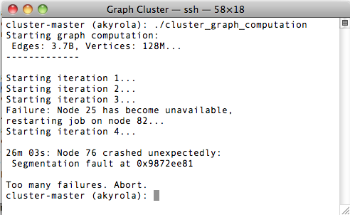
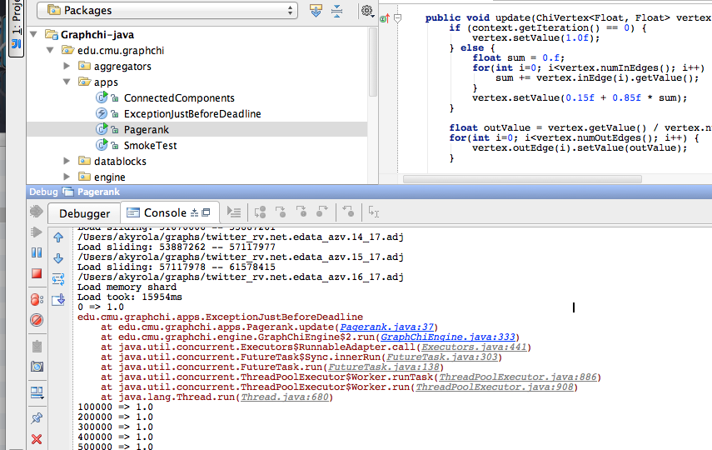
Distributed State is Hard to Program
Writing distributed applications remains cumbersome.
Cluster crash
Crash in your IDE
79/ 185
Notes:
I want to take first the point of view of those folks who develop algorithms on our systems.
Unfortunately, it is still hard, cumbersome, to write distributed algorithms. Even if you have some nice abstraction, you still need to understand what is happening.
I think this motivation is quite clear to everyone in this room, so let me give just one example.
Debugging. Some people write bugs. Now to find out what crashed a cluster can be really difficult. You need to analyze logs of many nodes and understand all the middleware.
Compare this to if you can run the same big problems on your own machine. Then you just use your favorite IDE and its debugger. It is a huge difference in productivity.

Slide 99
Efficient Scaling
Businesses need to compute hundreds of distinct tasks on the same graph
Example: personalized recommendations.
Task
Task
Task
Task
Task
Task
Complex
Simple
Task
Task
Task
Expensive to scale
2x machines = 2x throughput
Task
Task
Task
Task
Parallelize each task
Parallelize across tasks
80/ 185
Notes:
Another, perhaps a bit surprising motivation comes from thinking about scalability in large scale.
The industry wants to compute many tasks on the same graph. For example, to compute personalized
Recommendations, same task is computed for people in different countries, different interests groups, etc.
Currently: you need a cluster just to compute one single task. To compute tasks faster, you grow the cluster.
But this work allows a different way. Since one machine can handle one big task, you can dedicate one task
Per machine.
Why does this make sense?
* Clusters are complex, and expensive to scale.
* while in this new model, it is very simple as nodes do not talk to each other, and
you can double the throughput by doubling the machines
There are other motivations as well, such as reducing costs and energy. But let’s move on.

Slide 100
Computational Model
Graph G = (V, E)
directed edges: e = (source, destination)
each edge and vertex associated with a value (user-defined type)
vertex and edge values can be modified
(structure modification also supported)
A
e
B
Terms: e is an out-edge of A, and in-edge of B.
Data
Data
Data
Data
Data
Data
Data
Data
Data
Data
81/ 185
Notes:
Let’s now discuss what is the computational setting of this work. Let’s first introduce the basic computational model.

Slide 101
Vertex-centric Programming
“Think like a vertex”
Popularized by the Pregel and GraphLab projects
Historically, systolic computation and the Connection Machine
Data
Data
Data
Data
Data
Data
Data
Data
MyFunc(vertex)
{ // modify neighborhood }
Data
Data
Data
Data
Data
Data
Data
82/ 185
Notes:
Think like a vertex was used by the Google Pregel paper, and also adopted by GraphLab. Historical similar idea was used in the systolic computation or connection machine architectures, but with regular networks. Now, we had the data model where we associate a value with every vertex and edge, shown in the picture. As the primary computation model, user defines an update-function that operates on a vertex, and can access the values of the neighboring edges (shown in red). That is, we modify the data directly in the graph, one vertex a time. Of course, we can parallelize this, and take into account that neighboring vertices that share an edge should not be updated simultaneously (in general).

Slide 102
The Main Challenge of Disk-based Graph Computation:
Random Access
83/ 185
Notes:
I will now briefly demonstrate why disk-based graph computation was not a trivial problem. Perhaps we can assume it wasn’t, because no such system as stated in the goals clearly existed. But it makes sense to analyze why solving the problem required a small innovation, worthy of an OSDI publication. The main problem has been stated on the slide: random access, i.e when you need to read many times from many different locations on disk, is slow. This is especially true with hard drives: seek times are several milliseconds. On SSD, random access is much faster, but still far a far cry from the performance of RAM. Let’s now study this a bit.

Slide 103
Random Access Problem
19
5
Symmetrized adjacency file with values,
vertex | in-neighbors | out-neighbors
5 | 3:2.3, 19: 1.3, 49: 0.65,... | 781: 2.3, 881: 4.2..
....
19 | 3: 1.4, 9: 12.1, ... | 5: 1.3, 28: 2.2, ...
For sufficient performance, millions of random accesses / second would be needed. Even for SSD, this is too much.
Random write
synchronize
... or with file index pointers
vertex | in-neighbor-ptr | out-neighbors
5 | 3: 881, 19: 10092, 49: 20763,... | 781: 2.3, 881: 4.2..
....
19 | 3: 882, 9: 2872, ... | 5: 1.3, 28: 2.2, ...
Random read
read
84/ 185
Notes:
Here in the table I have snippet of a simple straightforward storage of a graph as adjacency sets. For each vertex, we have a list of its in-neighbors, and out-neighbors, with associated values. Now let’s say when update vertex 5, we change the value of its in-edge from vertex 19. As vertex 19 has the out-edge, we need to update its value in 19’s list. This incurs a random write.
Now, perhaps we can solve this as following: each vertex only stores its out-neighbors directly, but in-neighbors are stored as file pointers to their primary storage at the neighbors out-edge list. In this case, when we load vertex 5, we need to do a random read to fetch the value of the in-edge. Random read is better, much better, than random write – but, in our experiments, even on SSD, it is way too slow. One additional reason is the overhead of a system call. Perhaps a direct access to the SSD would help, but as we came up with a simpler solution that works even on a rotational hard drive, we abandonded this approach.

Slide 104
Parallel Sliding Windows: Phases
PSW processes the graph one sub-graph a time:
In one iteration, the whole graph is processed.
And typically, next iteration is started.
1. Load
2. Compute
3. Write
85/ 185
Notes:
The basic approach is that PSW loads one sub-graph of the graph a time, computes the update-functions for it, and saves the modifications back to disk. We will show soon how the sub-graphs are defined, and how we do this without doing almost no random access. Now, we usually use this for ITERATIVE computation. That is, we process all graph in sequence, to finish a full iteration, and then move to a next one.

Slide 105
PSW: Shards and Intervals
1. Load
2. Compute
3. Write
Vertices are numbered from 1 to n
P intervals, each associated with a shard on disk.
sub-graph = interval of vertices
1
v₁
v₂
n
interval(1)
interval(2)
interval(P)
shard(1)
shard(2)
shard(P)
86/ 185
Notes:
How are the sub-graphs defined?

Slide 106
PSW: Layout
1. Load
2. Compute
3. Write
Shard: in-edges for interval of vertices; sorted by source-id
Vertices 1..100
Vertices 101..700
Vertices 701..1000
Vertices 1001..10000
Shard 1
Shard 2
Shard 3
Shard 4
Shard 1
in-edges for vertices 1..100 sorted by source_id
Shards small enough to fit in memory; balance size of shards
87/ 185
Notes:
Let us show an example

Slide 107
PSW: Loading Sub-graph
1. Load
2. Compute
3. Write
Load subgraph for vertices 1..100
Vertices 1..100
Vertices 101..700
Vertices 701..1000
Vertices 1001..10000
Shard 1
Shard 2
Shard 3
Shard 4
in-edges for vertices 1..100 sorted by source_id
Load all in-edges in memory
What about out-edges?
Arranged in sequence in other shards

Slide 108
PSW: Loading Sub-graph
1. Load
2. Compute
3. Write
Load subgraph for vertices 101..700
Vertices 1..100
Vertices 101..700
Vertices 701..1000
Vertices 1001..10000
Shard 1
Shard 2
Shard 3
Shard 4
in-edges for vertices 1..100 sorted by source_id
Load all in-edges in memory
Out-edge blocks
in memory
89/ 185

Slide 109
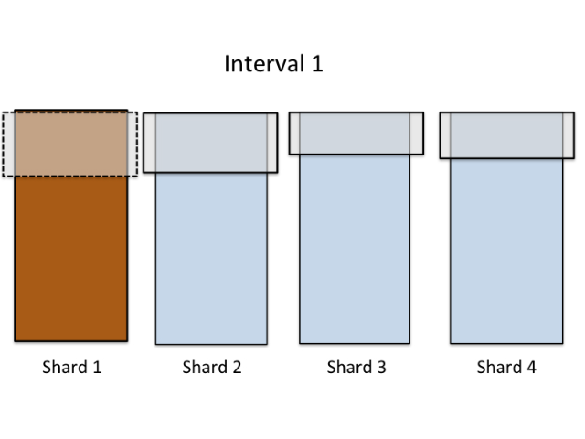
PSW Load-Phase
1. Load
2. Compute
3. Write
Only P large reads for each interval.
P² reads on one full pass.
90/ 185

Slide 110

PSW: Execute updates
1. Load
2. Compute
3. Write
Update-function is executed on interval’s vertices
Edges have pointers to the loaded data blocks
Changes take effect immediately → asynchronous.
Block X
&Data
&Data
&Data
&Data
&Data
Deterministic scheduling prevents races between neighboring vertices.
&Data
Block Y
&Data
&Data
&Data
&Data
91/ 185
Notes:
Now, when we have the sub-graph in memory, i.e for all vertices in the sub-graph we have all their in- and out-edges, we can execute the update-functions. Now comes important thing to understand: as we loaded the edges from disk, these large blocks are stored in memory. When we then create the graph objects – vertices and edges – the edge object will have a pointer to the data block. I have changed the figure to show that actually all data blocks are represented by pointers, pointing in to the blocks loaded from disk. Now: if two vertices share an edge, they will immediatelly observe change made by the other one since their edge pointers point to the same address.

Slide 111
PSW: Commit to Disk
1. Load
2. Compute
3. Write
In write phase, the blocks are written back to disk
Next load-phase sees the preceding writes → asynchronous.
In total:
P² reads and writes / full pass on the graph.
→ Performs well on both SSD and hard drive.
Block X
&Data
&Data
&Data
&Data
&Data
&Data
Block Y
&Data
&Data
&Data
&Data
92/ 185

Slide 112
Evaluation: Is PSW expressive enough?
Graph Mining
Connected components
Approx. shortest paths
Triangle counting
Community Detection
SpMV
PageRank
Generic
Recommendations
Random walks
Collaborative Filtering (by Danny Bickson)
ALS
SGD
Sparse-ALS
SVD, SVD++
Item-CF
Probabilistic Graphical Models
Belief Propagation
Algorithms implemented for GraphChi (Oct 2012)
93/ 185
Notes:
One important factor to evaluate is that is this system any good? Can you use it for anything? GraphChi is an early project, but we already have a great variety of algorithms implement on it. I think it is safe to say, that the system can be used for many purposes. I don’t know of a better way to evaluate the usability of a system than listing what it has been used for. There are over a thousand of downloads of the source code + checkouts which we cannot track, and we know many people are already using the algorithms of GraphChi and also implementing their own. Most of these algos are now available only in the C++ edition, apart from the random walk system which is only in the Java version.

Slide 113
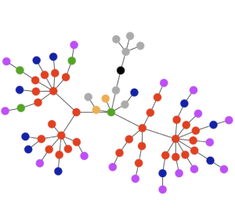

Experiment Setting
Mac Mini (Apple Inc.)
8 GB RAM
256 GB SSD, 1TB hard drive
Intel Core i5, 2.5 GHz
Experiment graphs:
Graph | Vertices | Edges | P (shards) | Preprocessing
live-journal | 4.8M | 69M | 3 | 0.5 min
netflix | 0.5M | 99M | 20 | 1 min
twitter-2010 | 42M | 1.5B | 20 | 2 min
uk-2007-05 | 106M | 3.7B | 40 | 31 min
uk-union | 133M | 5.4B | 50 | 33 min
yahoo-web | 1.4B | 6.6B | 50 | 37 min
94/ 185
Notes:
The same graphs are typically used for benchmarking distributed graph processing systems.

Slide 114
Comparison to Existing Systems
PageRank
WebGraph Belief Propagation (U Kang et al.)
On a Mac Mini:
GraphChi can solve as big problems as existing large-scale systems.
Comparable performance.
Matrix Factorization (Alt. Least Sqr.)
Triangle Counting
Notes: comparison results do not include time to transfer the data to cluster, preprocessing, or the time to load the graph from disk. GraphChi computes asynchronously, while all but GraphLab synchronously.
Notes:
Unfortunately the literature is abundant with Pagerank experiments, but not much more. Pagerank is really not that interesting, and quite simple solutions work. Nevertheless, we get some idea. Pegasus is a hadoop-based graph mining system, and it has been used to implement a wide range of different algorithms. The best comparable result we got was for a machine learning algo “belief propagation”. Mac Mini can roughly match a 100node cluster of Pegasus. This also highlights the inefficiency of MapReduce. That said, the Hadoop ecosystem is pretty solid, and people choose it for the simplicity. Matrix factorization has been one of the core Graphlab applications, and here we show that our performance is pretty good compared to GraphLab running on a slightly older 8-core server. Last, triangle counting, which is a heavy-duty social network analysis algorithm. A paper in VLDB couple of years ago introduced a Hadoop algorithm for counting triangles. This comparison is a bit stunning. But, I remind that these are prior to PowerGraph: in OSDI, the map changed totally!
However, we are confident in saying, that GraphChi is fast enough fo rmany purposes. And indeed, it can solve as big problems as the other systems have been shown to execute. It is limited by the disk space.

Slide 115
Scalability / Input Size [SSD]
Throughput: number of edges processed / second.
Conclusion: the throughput remains roughly constant when graph size is increased.
Performance →
GraphChi with hard-drive is ~ 2x slower than SSD (if computational cost low).
Graph size →
96/ 185
Notes:
Here, in this plot, the x-axis is the size of the graph as the number of edges. All the experiment graphs are presented here. On the y-axis, we have the performance: how many edges processed by second. Now the dots present different experiments (averaged), and the read line is a least-squares fit. On SSD, the throuhgput remains very closely constant when the graph size increases. Note that the structure of the graph actually has an effect on performance, but only by a factor of two. The largest graph, yahoo-web, has a challenging structure, and thus its results are comparatively worse.

Slide 116
Bottlenecks / Multicore
Computationally intensive applications benefit substantially from parallel execution.
GraphChi saturates SSD I/O with 2 threads.
Experiment on MacBook Pro with 4 cores / SSD.
97/ 185
Notes:
Amdhal’s law

Slide 117
Problems with GraphChi
30-35 times slower than GraphLab (distributed memory)
High preprocessing cost to create balanced shards and sort the edges in shards
X-Stream → Streaming Partitions [SOSP ‘13]
98/ 185

Slide 118
End of First Session

Slide 119
Tutorial Outline
Examples of Graph Computations
Offline Graph Analytics (Page Rank Computation)
Online Graph Querying (Reachability Query)
Systems for Offline Graph Analytics
MapReduce, PEGASUS, Pregel, GraphLab, GraphChi
Systems for Online Graph Querying
Horton, GSPARQL
Second Session (3:45-5:15PM)
Graph Partitioning and Workload Balancing
PowerGraph, SEDGE, MIZAN
Open Problems
99/ 185

Slide 120
Online Graph Queries: Examples
Shortest Path
Reachability
Subgraph Isomorphism
Graph Pattern Matching
SPARQL Queries
100/ 185

Slide 121
Systems for Online Graph Queries
HORTON [M. Sarwat et. al., VLDB’14]
G-SPARQL [S. Sakr et. al., CIKM’12]
TRINITY [B. Shao et. al., SIGMOD’13]
NSCALE [A. Quamar et. al., arXiv]
LIGRA [J. Shun et. al., PPoPP ‘13]
GRAPPA [J. Nelson et. al., Hotpar ‘11]
GALIOS [D. Nguyen et. al., SOSP ‘13]
Green-Marl [S. Hong et. al., ASPLOS ‘12]
BLAS [A. Buluc et. al., J. High-Perormance Comp. ‘11]
101/ 185

Slide 122
Systems for Online Graph Queries
HORTON [M. Sarwat et. al., VLDB’14]
G-SPARQL [S. Sakr et. al., CIKM’12]
TRINITY [B. Shao et. al., SIGMOD’13]
NSCALE [A. Quamar et. al., arXiv]
LIGRA [J. Shun et. al., PPoPP ‘13]
GRAPPA [J. Nelson et. al., Hotpar ‘11]
GALIOS [D. Nguyen et. al., SOSP ‘13]
Green-Marl [S. Hong et. al., ASPLOS ‘12]
BLAS [A. Buluc et. al., J. High-Perormance Comp. ‘11]
101/ 185

Slide 123
Horton+: A Distributed System for Processing Declarative Reachability Queries over Partitioned Graphs
Mohamed Sarwat (Arizona State University)
Sameh Elnikety (Microsoft Research)
Yuxiong He (Microsoft Research)
Mohamed Mokbel (University of Minnesota)
Slides from: http://research.microsoft.com/en-us/people/samehe/
Notes:
Slides from: http://research.microsoft.com/en-us/people/samehe/

Slide 124
Motivation
Social network
Queries
Find Alice’s friends
How Alice & Ed are connected
Find Alice’s photos with friends
102/ 185

Slide 125
Data Model
Attributed multi-graph
Node
Represent entities
ID, type, attributes
Edge
Represent binary relationship
Type, direction, weight, attrs
App
Horton
102/ 185

Slide 126
Horton+ Contributions
Defining reachability queries formally
Introducing graph operators for distributed graph engine
Developing query optimizer
Evaluating the techniques experimentally
103/ 185

Slide 127
Graph Reachability Queries
Query is a regular expression
Sequence of node and edge predicates
Hello world in reachability
Photo-Tags-’Alice’
Search for path with node: type=Photo, edge: type=Tags, node: id=‘Alice’
Attribute predicate
Photo{date.year=‘2012’}-Tags-’Alice’
Or
(Photo | video)-Tags-’Alice’
Closure for path with arbitrary length
‘Alice’(-Manages-Person)*
Kleene star to find Alice’s org chart
104/ 185
Notes:
Key points:
1- this much better than writing a navigational program.
2- Query is declarative, therefore we can optimize it.

Slide 128
Declarative Query Language
Declarative | Navigational
Photo-Tags-’Alice’ | Foreach( n1 in graph.Nodes.SelectByType(Photo) ) { Foreach( n2 in n1.GetNeighboursByEdgeType(Tags) { If(node2.id == ‘Alice’) { return path(node1, Tags, node2) } } }
105/ 185
Notes:
Step back

Slide 129
Comparison to SQL & SPARQL
SQL
SPARQL
Pattern matching
Find sub-graph in a bigger graph
SQL
RL
106/ 185
Notes:
No such thing as Basic SQL and RL.
SQL Extend by recursion and transitive closures
RL extended by shortest paths.

Slide 130
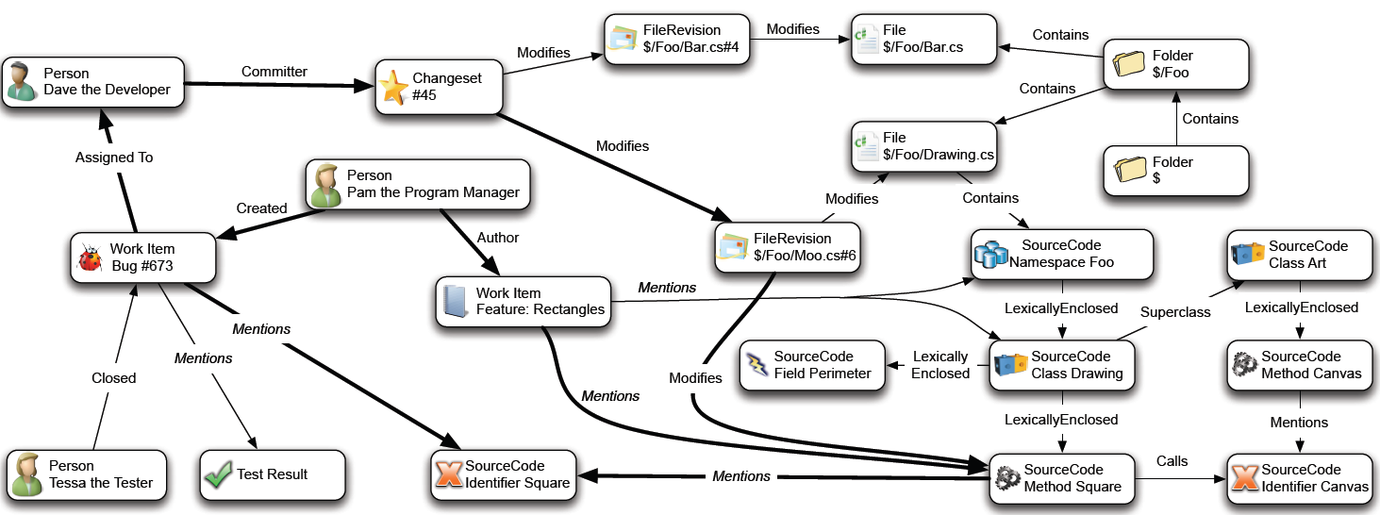
Example App: CodeBook
107/ 185

Slide 131
Example App: CodeBook – Colleague Query
Person, FileOwner>, TFSFile, FileOwner<, Person
Person, DiscussionOwner>, Discussion, DiscussionOwner<, Person
Person, WorkItemOwner>, TFSWorkItem, WorkItemOwner< ,Person
Person, Manages<, Person, Manages>, Person
Person, WorkItemOwner>, TFSWorkItem, Mentions>, TFSFile, Mentions>, TFSWorkItem, WorkItemOwner<, Person
Person, WorkItemOwner>, TFSWorkItem, Mentions>, TFSFile, FileOwner<, Person
Person, FileOwner>, TFSFile, Mentions>, TFSWorkItem, Mentions>, TFSFile, FileOwner<, Person
108/ 185
Notes:
-> Reachability Backend

Slide 132
Backend: Execution Engine
Compile into algebraic plan
Optimize query plan
Process query plan using distributed BFS
109/ 185
Notes:
Horton Arch. Figure.

Slide 133
Compile into Algebraic Query Plan
‘Alice’
Tags
Photo
‘Alice’-Tags-Photo
S0
S1
S2
S3
‘Alice’
Manages
‘Alice’(-Manages-Person)*
S0
S1
S2
Person
110/ 185
Notes:
Termination?

Slide 134


Centralized Query Execution
‘Alice’
Tags
Photo
‘Alice’-Tags-Photo
S0
S1
S2
S3
Breadth First Search
Answer Paths:
‘Alice’-Tags-Photo1 ‘Alice’-Tags-Photo8
111/ 185
Notes:
? Photo tags Alice

Slide 135
Distributed Query Execution
‘Alice’-Tags-Photo-Tags-’Bob’
Partition 1
Partition 2
112/ 185
Notes:
Batching messages
Bulk synch
Steps are computation, then communication
Message contents: which state in fsm + partial path so far

Slide 136
Distributed Query Execution
‘Alice’-Tags-Photo-Tags-‘Bob’
Partition 1
Partition 2
FSM
S0
Partition 1
Step 1
Alice
‘Alice’
S1
Tags
Step 2
S2
Photo1
Photo8
Photo
S3
Tags
S4
Step 3
Bob
‘Bob’
Partition 2
S5
113/ 185
Notes:
Steps are computation, then communication
Message contents: which state in fsm + partial path so far
Batching messages
Bulk synch

Slide 137
Algebraic Operators
Select
Find set of starting nodes
Traverse
Traverse graph to construct paths
Join
Construct longer paths
‘Alice’
Tags
Photo
‘Alice’-Tags-Photo
S0
S1
S2
S3
114/ 185
Notes:
Interface of the query engine

Slide 138
Architecture Distributed Execution Engine
115/ 185

Slide 139
Query Optimization
Input
Query plan + Graph statistics
Output
Optimized query plan
Technique
Enumerate query plans
Evaluate their costs using graph statistics
Find the plan with minimum cost
116/ 185
Notes:
Horton can perform query optimization because our queries are declarative. In Contrast, if we write a procedural program, and specify how to visit nodes and traverse graph. It would be hard to perform system-level optimization.
So having a declarative language not only makes user’s job easier but also make system-level optimization possible and help query to run more efficiently.

Slide 140
Predicate Ordering
Find Mike’s photo that is also tagged by at least one of his friends
‘Mike’-Tagged-Photo-Tagged-Person-FriendOf-‘Mike’
Execute left to right
Different predicate orders can result in different execution costs.
Execute right to left
117/ 185
Notes:
Decide execution sequence of predicates to give an efficient plan.
Same matching results, different execution cost.
We see why in next slide

Slide 141
Predicate Ordering
Find Mike’s photo that is also tagged by at least one of his friends
‘Mike’-Tagged-Photo-Tagged-Person-FriendOf-‘Mike’
Execute left to right
118/ 185

Slide 142
Predicate Ordering
Find Mike’s photo that is also tagged by at least one of his friends
‘Mike’-Tagged-Photo-Tagged-Person-FriendOf-‘Mike’
Execute left to right
119/ 185

Slide 143
Predicate Ordering
Find Mike’s photo that is also tagged by at least one of his friends
‘Mike’-Tagged-Photo-Tagged-Person-FriendOf-‘Mike’
Execute left to right
120/ 185

Slide 144
Predicate Ordering
Find Mike’s photo that is also tagged by at least one of his friends
‘Mike’-Tagged-Photo-Tagged-Person-FriendOf-‘Mike’
Execute left to right
Total cost = 14
121/ 185

Slide 145
Predicate Ordering
Find Mike’s photo that is also tagged by at least one of his friends
‘Mike’-Tagged-Photo-Tagged-Person-FriendOf-‘Mike’
Execute left to right
Different predicate orders can result in different execution costs.
Execute right to left
Total cost = 14
Total cost = 7
122/ 185
Notes:
For large graphs, the cost difference could be orders of magnitude.
Motivate us to find a good predicate order.

Slide 146
How to Decide Predicate Ordering?
Enumerate execution sequences of predicates
Estimate their costs using graph statistics
Find the sequence with minimum cost
123/ 185
Notes:
Now the question is how to do it.
to decide a good predicate order,
Basically, two parts to figure out: cost estimation and enumeration algorithm

Slide 147
Cost Estimation using Graph Statistics
Graph Statistics
Node type | #nodes
Person | 5
Photo | 7
 | FriendOf | Tagged
Person | 1.2 | 2.2
Photo | N/A | 1.6
Left to right
‘Mike’-Tagged-Photo-Tagged-Person-FriendOf-‘Mike’
EstimatedCost = ???
124/ 185
Notes:
Two types of statistics:
Selectivity of node predicates
Fanout of edges
Each person, how many friend-of edge it has.

Slide 148
Cost Estimation using Graph Statistics
Graph Statistics
Node type | #nodes
Person | 5
Photo | 7
 | FriendOf | Tagged
Person | 1.2 | 2.2
Photo | N/A | 1.6
Left to right
‘Mike’-Tagged-Photo-Tagged-Person-FriendOf-‘Mike’
EstimatedCost = 1 [find Mike]
125/ 185

Slide 149
Cost Estimation using Graph Statistics
Graph Statistics
Node type | #nodes
Person | 5
Photo | 7
 | FriendOf | Tagged
Person | 1.2 | 2.2
Photo | N/A | 1.6
Left to right
‘Mike’-Tagged-Photo-Tagged-Person-FriendOf-‘Mike
EstimatedCost = 1 [find ‘Mike’]
+ (1* 2.2) [find ‘Mike’-Tagged-Photo]
126/ 185
Notes:
Mike is a person, each person has average number of tagged edges equal to 2.2, therefore, the cost of finding Mike tagged photo is 1*2.2

Slide 150
Cost Estimation using Graph Statistics
Graph Statistics
Node type | #nodes
Person | 5
Photo | 7
 | FriendOf | Tagged
Person | 1.2 | 2.2
Photo | N/A | 1.6
Left to right
‘Mike’-Tagged-Photo-Tagged-Person-FriendOf-‘Mike’
EstimatedCost = 1 [find ‘Mike’]
+ (1* 2.2) [find ‘Mike’-Tagged-Photo]
+ (2.2 * 1.6) [find ‘Mike’-Tagged-Photo-Tagged-Person]
+ (2.2 * 1.6 * 1.2) [find ‘Mike’-Tagged-Photo-Tagged-Person-FriendOf-‘Mike’]
= 11
127/ 185
Notes:
Estimated cost can be different from actual cost. But with good statitics, good estimation.

Slide 151
Plan Enumeration
Find Mike’s photo that is also tagged by at least one of his friends
Plan1
‘Mike’-Tagged-Photo-Tagged-Person-FriendOf-‘Mike’
Plan2
‘Mike’-FriendOf-Person-Tagged-Photo-Tagged-‘Mike’
Plan3
(‘Mike’-FriendOf-Person) ⋈ (Person-Tagged-Photo-Tagged-‘Mike’)
Plan4
(‘Mike’-FriendOf-Person-Tagged-Photo) ⋈ (Photo-Tagged-‘Mike’)
.
.
.
.
.
128/ 185
Notes:
How to enumerate different predicate orders
We can also split the query into two subqueries
Join the results together
Also note that, split and join can be done recursively.
To formulate it as a mathematical model, here is how we do it.

Slide 152
Enumeration Algorithm
Query: Q[1, n] = N₁ E₁ N₂ E₂ …… N_{n-1} E_{n-1} N_{n}
Selectivity of query Q[i,j] : Sel(Q[i,j])
Minimum cost of query Q[i,j] : F(Q[i,j])
F(Q[i,j]) = min{
SequentialCost_LR(Q[i,j]),
SequentialCost_RL(Q[i,j]),
min_{i<k<j} (F(Q[i,k]) + F(Q[k,j]) + Sel(Q[i,k])*Sel(Q[k,j]))
}
Base step: F(Q_{i}) = F(N_{i}) = Cost of matching predicate N_{i}
Apply dynamic programming
Store intermediate results of all F(Q[i,j]) pairs
Complexity: O(n³)
129/ 185
Notes:
Selectivity: the number of matching paths satisfied the query, which can be estimated using statistics.
Cost: the number of nodes and edges we need to visit to answer the query.
Here we have a recursive formula to compute the minimal cost of a query
Minimal cost can be expressed as the min of three parts:
Split the query at any node and join the results together. Here the cost is the cost of subqueries pls the cost of join operation.
Recursive formula, subqueries can be divided and join again
Does not depend on the graph size
We apply dynamic programming.
Store intermediate results for the optimal cost of subqueries.
Reduce complexity to ..
Often query won’t be so long. This complexiblity is manageable. This formulation leads to an optimal solution with minimum cost.

Slide 153
Summary of Query Optimization
Dynamic programming framework
Rewrites query plan using graph statistics
Minimize number of visited nodes
130/ 185

Slide 154
Experimental Evaluation
Graphs
Real dataset (codebook graph: 4M nodes, 14M edges, 20 types)
Synthetic dataset (RMAT graph, 1024M nodes, 5120M edges)
Machines
Commodity servers
Intel Core 2 Duo 2.26 GHz, 16 GB ram
131/ 185
Notes:
To evaluate the ideas, we implemented a prototype system.
Small graph. Use it to query optimization.
The actual graph Horton manages is much larger. Andrew show us later today.

Slide 155
Query Workload
Q1: Short
Find the person who committed checkin 400 and the WorkItemRevisions it modifies:
Person-Committer-Checkin{id=400}-Modifies-WorkItemRevision
Q2: Selective
Find Dave’s checkins that modified a WorkItem create by Tim:
‘Dave’-Committer-Checkin-Modifies-WorkItem-CreatedBy-’Tim’
Q3: Report
For each checkin, find the person (and his/her manager) who committer it as well as all the work items and their WebURLs that are modified by that checkin:
Person-Manages-Person-Committer-Checkin-Modifies-WorkItemRevision-Modifies-WorkItem-Links-WebURL
Q4: Closure
Retrieve all checkins that any employee in Dave organizational chart (working under him) committed:
‘Dave’(-Manages-Person)*-Checkin
132/ 185
Notes:
To evaluate the ideas, we implemented a prototype system.
Small graph. Use it to query optimization.
The actual graph Horton manages is much larger. Andrew show us later today.

Slide 156
Query Execution Time (Small Graph)
133/ 185
Notes:
Figure 7: Query execution time (using the real graph) while varying number of partition servers from 1 to 10.
Codebook graph
Fits in one server
Vary servers from 1 to 10
Execution time
Queries Q1, Q2, Q3, Q4

Slide 157
Query Execution Time
RMAT graph
does not fit in one server, 1024 M nodes, 5120 M edges
16 partition servers
Execution time dominated by computations
Query | Total Execution | Communication | Computation
Q1 | 47.588 sec | 0.723 sec | 46.865 sec
Q2 | 06.294 sec | 0.693 sec | 05.601 sec
Q3 | 92.593 sec | 1.258 sec | 91.325 sec
134/ 185
Notes:
Table 4: Execution time for 1024 million nodes, 5120 million
edges synthetic graph deployed on 16 partition servers.

Slide 158
Query Optimization
Synthetic graphs
Vary graph size
Centralized (1 Server)
Execution time for queries Q1, Q2, Q3
135/ 185
Notes:
Figure 5: Impact of query optimization on the query execution time (using the synthetic graphs) on a single server.

Slide 159
Summary: Reachability Queries
Query language
Regular expressions
Distributed execution engine
Distributed BFS graph traversal
Graph query optimizer
Rewrite query plan
Predicate ordering
Experimental results
Process reachability queries on partitioned graphs
Query optimizer is effective
136/ 185
Notes:
Pattern matching

Slide 160
Pattern Matching v.s. Reachability
From: path
Regular language
Find paths
To: sub-graph matching
Context-sensitive language
Find sub-graphs
137/ 185
Notes:
Sameh is to extend query language.

Slide 161
Pattern Matching
Find sub-graph (with predicates) on a data graph
Sub-graph
Data graph
138/ 185
Notes:
How to execute regular expression queries,
Execute pattern matching queries
At pattern matching queries, Two graphs: the query itself is a small graph: Pattern graph, vs underlying graph, base graph
Pattern matching is to search pattern graph on the base graph.
It is a graph isomorphism problem.

Slide 162
G-SPARQL: A Hybrid Engine for Querying Large Attributed Graphs
Sherif Sakr | Sameh Elnikety | Yuxiong He
NICTA & UNSW Sydney, Australia | Microsoft Research Redmond, WA | Microsoft Research Redmond, WA
Slides from http://research.microsoft.com/en-us/people/samehe/gsparql.cikm2012.pptx
Notes:
Slides from: http://research.microsoft.com/en-us/people/samehe/

Slide 163
G-SPARQL Query Language
Extends a subset of SPARQL
Based on triple pattern:
(subject, predicate, object)
Sub-graph matching patterns on
Graph structure
Node attribute
Edge attribute
Reachability patterns on
Path
Shortest path
139/ 185

Slide 164
G-SPARQL Syntax
140/ 185

Slide 165
G-SPARQL Reachability
Path
Subject ??PathVar Object
Shortest path
Subject ?*PathVar Object
Path filters
Path length
All edges
All nodes
141/ 185

Slide 166
Hybrid Execution Engine
Reachability queries
Main memory algorithms
Example: BFS and Dijkstra’s algorithm
Pattern matching queries
Relational database
Indexing
Example: B-tree
Query optimizations,
Example: selectivity estimation, and join ordering
Recursive queries
Not efficient: large intermediate results and multiple joins
142/ 185
Notes:
Benefits of both solutions

Slide 167
Graph Representation
Node Label
age
office
location
keyword
type
established
ID | Value
1 | John
2 | Paper 2
3 | Alice
4 | Microsoft
5 | VLDB’12
6 | Paper 1
7 | UNSW
8 | Smith
ID | Value
1 | 45
3 | 42
8 | 28
ID | Value
8 | 518
ID | Value
3 | Sydney
5 | Istanbul
ID | Value
2 | XML
6 | graph
ID | Value
2 | Demo
ID | Value
4 | 1975
7 | 1949
authorOf
affiliated
published
citedBy
eID | sID | dID
1 | 1 | 2
5 | 3 | 2
6 | 3 | 6
11 | 8 | 6
eID | sID | dID
3 | 1 | 4
8 | 3 | 7
12 | 8 | 7
eID | sID | dID
4 | 2 | 5
10 | 6 | 5
eID | sID | dID
9 | 6 | 2
country
ID | Value
4 | USA
7 | Australia
order
ID | Value
1 | 2
5 | 1
6 | 2
11 | 1
title
month
know
supervise
ID | Value
3 | Senior Researcher
8 | Professor
ID | Value
4 | 3
10 | 1
eID | sID | dID
2 | 1 | 3
eID | sID | dID
7 | 3 | 8
143/ 185
Notes:
Multiple way
Fully decomposed model

Slide 168
Hybrid Execution Engine: interfaces
Traversal
operations
G-SPARQL
query
SQL commands
144/ 185

Slide 169
Intermediate Language & Compilation
Traversal
operations
Front-end compilation
Back-end compilation
G-SPARQL
query
Algebraic query plan
Physical execution plan
Step 1
Step 2
SQL commands
145/ 185
Notes:
Take home slide
Show three parts next: algebraic plan, front-end compilation, backend compilation

Slide 170
Intermediate Language
Objective
Generate query plan and chop it
Reachability part -> main-memory algorithms on topology
Pattern matching part -> relational database
Optimizations
Features
Independent of execution engine and graph representation
Algebraic query plan
146/ 185
Notes:
Halfway

Slide 171
G-SPARQL Algebra
Variant of “Tuple Algebra”
Algebra details
Data: tuples
Sets of nodes, edges, paths.
Operators
Relational: select, project, join
Graph specific: node and edge attributes, adjacency
Path operators
147/ 185
Notes:
Query plan is a tree
Not minimal set

Slide 172
Relational
148/ 185

Slide 173
Relational
NOT Relational
149/ 185
Notes:
Given a set of nodes and attribute name, it retrieves attribute values
Friends of Alice
Two sets of nodes, find connected pairs

Slide 174
Front-end Compilation (Step 1)
Input
G-SPARQL query
Output
Algebraic query plan
Technique
Map
from triple patterns
To G-SPARQL operators
Use inference rules
150/ 185

Slide 175
Front-end Compilation: Optimizations
Objective
Delay execution of traversal operations
Technique
Order triple patterns, based on restrictiveness
Heuristics
Triple pattern P1 is more restrictive than P2
P1 has fewer path variables than P2
P1 has fewer variables than P2
P1’s variables have more filter statements than P2’s variables
151/ 185

Slide 176
Back-end Compilation (Step 2)
Input
G-SPARQL algebraic plan
Output
SQL commands
Traversal operations
Technique
Substitute G-SPARLQ relational operators with SPJ
Traverse
Bottom up
Stop when reaching root or reaching non-relational operator
Transform relational algebra to SQL commands
Send non-relational commands to main memory algorithms
152/ 185

Slide 177
Back-end Compilation: Optimizations
Optimize a fragment of query plan
Before generating SQL command
All operators are Select/Project/Join
Apply standard techniques
For example pushing selection
153/ 185

Slide 178
Example: Query Plan
154/ 185

Slide 179
Results on Real Dataset
155/ 185
Notes:
We also saw similar performance patterns for the synthetic data

Slide 180
Response time on ACM Bibliographic Network
156/ 185
Notes:
Always better than Neo4j – declarative queries
Neo4j Optimized required good knowledge of graph – Hybrid is better
One case when Neo4j optimized is better is when attributes of path nodes and edges are required.

Slide 181
Tutorial Outline
Examples of Graph Computations
Offline Graph Analytics (Page Rank Computation)
Online Graph Querying (Reachability Query)
Systems for Offline Graph Analytics
MapReduce, PEGASUS, Pregel, GraphLab, GraphChi
Systems for Online Graph Querying
Trinity, Horton, GSPARQL, NScale
Graph Partitioning and Workload Balancing
PowerGraph, SEDGE, MIZAN
Open Problems
157/ 185

Slide 182
Graph Partitioning and Workload Balancing
One Time Partitioning
PowerGraph [J. Gonzalez et. al., OSDI ‘12]
LFGraph [I. Hoque et. al., TRIOS ‘13]
SEDGE [S. Yang et al., SIGMOD ‘12]
Dynamic Re-partitioning
Mizan [Z. Khayyat et. al., Eurosys ‘13]
Push-Pull Replication [J. Mondal et. al., SIGMOD ‘12]
Wind [Z. Shang et. al., ICDE ‘13]
SEDGE [S. Yang et. al., SIGMOD ‘12]
158/ 185

Slide 183
PowerGraph: Motivation
More than 10⁸ vertices have one neighbor.
High-Degree
Vertices
Top 1% of vertices are adjacent to
50% of the edges!
Number of Vertices
AltaVista WebGraph
1.4B Vertices, 6.6B Edges
Degree
Acknowledgement: J. Gonzalez, UC Berkeley
159/ 185

Slide 184

Difficulties with Power-Law Graphs
Synchronous Execution prone to stragglers (Pregel)
Sends many messages (Pregel)
Asynchronous Execution requires heavy locking (GraphLab)
Touches a large fraction of
graph (GraphLab)
Edge meta-data too large for single machine
160/ 185

Slide 185
Power-Law Graphs are Difficult to Balance-Partition
Power-Law graphs do not have low-cost balanced cuts [K. Lang. Tech. Report YRL-2004-036, Yahoo! Research]
Traditional graph-partitioning algorithms perform poorly on Power-Law Graphs [Abou-Rjeili et al., IPDPS 06]
161/ 185

Slide 186
Vertex-Cut instead of Edge-Cut
Machine 1
Machine 2
Y
Y
Vertex Cut (GraphLab)
Power-Law graphs have good vertex cuts. [Albert et al., Nature ‘00]
Communication is linear in the number of machines each vertex spans
A vertex-cut minimizes machines each vertex spans
Edges are evenly distributed over machines → improved work balance
162/ 185

Slide 187
PowerGraph Framework
Machine 1
Machine 2
Master
Gather
Y’
Y’
Y’
Y’
Σ₁
Σ
Σ₂
+ + +
Mirror
Apply
Y
Y
Y
Y
Machine 3
Machine 4
Scatter
Σ₃
Σ₄
Mirror
Mirror
J. Gonzalez et. al., “PowerGraph”, OSDI ‘12
163/ 185

Slide 188
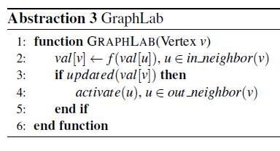
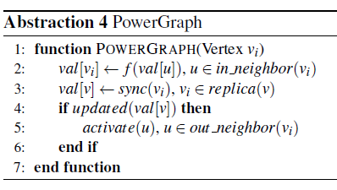
GraphLab vs. PowerGraph
PowerGraph is about 15X faster than GraphLab for Page Rank computation
[J. Gonzalez et. al., OSDI ’13]
164/ 185

Slide 189
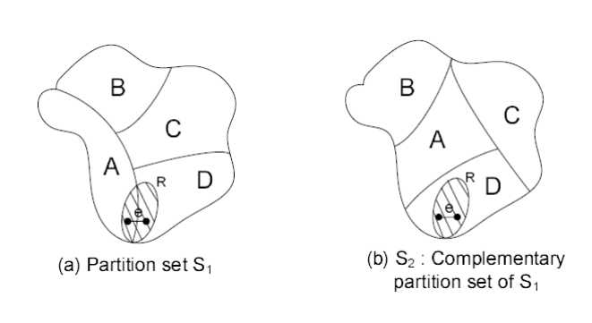
SEDGE: Complementary Partition
Complementary Graph Partitions
S. Yang et. al., “SEDGE”, SIGMOD ‘12
165/ 185

Slide 190
SEDGE: Complementary Partition
Complementary Graph Partitions
Laplacian Matrix
Lagrange Multiplier
s.t.
Cut-Edges Limited Laplacian Matrix
166/ 185

Slide 191
Mizan: Dynamic Re-Partition
Dynamic Load Balancing across supersteps in PREGEL
Worker 1
Worker 1
Worker 2
Worker 2
……
Worker n
Worker n
Computation
Communication
Adaptive re-partitioning
Agnostic to the graph structure
Requires no apriori knowledge of algorithm behavior
Z. Khayyat et. al., Eurosys ‘13
167/ 185

Slide 192
Graph Algorithms from PREGEL (BSP) Perspective
Stationary Graph Algorithms
Matrix-vector multiplication
Page Rank
Finding weakly connected components
Non-stationary Graph Algorithms:
DMST: distributed minimal spanning tree
Online Graph queries – BFS, Reachability, Shortest Path, Subgraph isomorphism
Advertisement propagation
One-time
good-partitioning is sufficient
Needs to adaptively re-partition
Z. Khayyat et. al., Eurosys ’13; Z. Shang et. al., ICDE ‘13
168/ 185

Slide 193
Mizan Technique
Monitoring:
Outgoing Messages
Incoming Messages
Response Time
Migration Planning:
Identify the source of imbalance
Select the migration objective
Pair over-utilized workers with under-utilized ones
Select vertices to migrate
Migrate vertices
Z. Khayyat et. al., Eurosys ’13
169/ 185

Slide 194
Mizan Technique
Monitoring:
Outgoing Messages
Incoming Messages
Response Time
Migration Planning:
Identify the source of imbalance
Select the migration objective
Pair over-utilized workers with under-utilized ones
Select vertices to migrate
Migrate vertices
Does workload in the current iteration an indication of workload in the next iteration?
Overhead due to migration?
Z. Khayyat et. al., Eurosys ’13
170/ 185

Slide 195
Tutorial Outline
Examples of Graph Computations
Offline Graph Analytics (Page Rank Computation)
Online Graph Querying (Reachability Query)
Systems for Offline Graph Analytics
MapReduce, PEGASUS, Pregel, GraphLab, GraphChi
Systems for Online Graph Querying
Trinity, Horton, GSPARQL, NScale
Graph Partitioning and Workload Balancing
PowerGraph, SEDGE, MIZAN
Open Problems
171/ 185

Slide 196
Open Problems
Load Balancing and Graph Partitioning
Shared Memory vs. Cluster Computing
Decoupling of Storage and Processing
Roles of Modern Hardware
Stand-along Graph Processing vs. Integration with Data-Flow Systems
172/ 185

Slide 197
Open Problem: Load Balancing
Well-balanced vertex and edge partitions do not guarantee load-balanced execution, particularly for real-world graphs
Graph partitioning methods reduce overall edge cut and communication volume, but lead to increased computational load imbalance
Inter-node communication time is not the dominant cost in bulk-synchronous parallel BFS implementation
A. Buluc et. al., Graph Partitioning and Graph Clustering ‘12
173/ 185

Slide 198
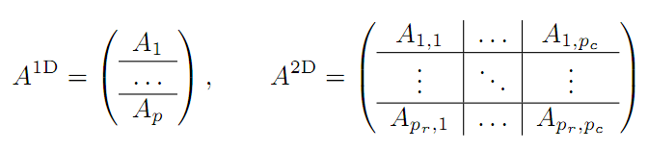
Open Problem: Graph Partitioning
Randomly permuting vertex IDs/ hash partitioning:
often ensures better load balancing [A. Buluc et. al., DIMACS ‘12 ]
no pre-processing cost of partitioning [I. Hoque et. al., TRIOS ‘13]
2D partitioning of graphs decreases the communication volume for BFS, yet all the aforementioned systems (with the exception of PowerGraph) consider 1D partitioning of the graph data
174/ 185

Slide 199
Open Problem: Graph Partitioning
What is the appropriate objective function for graph partitioning?
Do we need to vary the partitioning and re-partitioning strategy based on the graph data, algorithms, and systems?
Does one partitioning scheme fit all ?
175/ 185

Slide 200
Open Problem: Shared Memory vs. Cluster Computing
A highly multithreaded system—with shared memory programming —is efficient in supporting a large number of irregular data accesses across the memory space → orders of magnitude faster than cluster computing for graph data
Shared memory algorithms simpler than their distributed counterparts
Communication costs are much cheaper in shared memory machines
Distributed memory approaches suffer from poor load balancing due to power law degree distribution
Shared memory machines often has limited computing power, memory and disk capacity, and I/O bandwidth compared to distributed memory clusters → not scalable for very large datasets
A single multicore supports more than a terabyte of memory → can easily fits today’s big-graphs with tens or even hundreds of billions of edges
176/ 185

Slide 201
Open Problem: Shared Memory vs. Cluster Computing
For online graph queries, is shared-memory a better approach than cluster computing? [P. Gupta et. al., WWW ‘13; J. Shun et. al., PPoPP ‘13]
Threadstorm processor , Cray XMT – Hardware multithreading systems
With enough concurrency, we can tolerate long latencies
Hybrid Approaches:
Crunching Large Graphs with Commodity Processors, J. Nelson et. al., USENIX HotPar ’11
Hybrid Combination of a MapReduce cluster and a Highly Multithreaded System, S. Kang et. al., MTAAP ‘10
177/ 185

Slide 202
Open Problem: Decoupling of Storage and Computing
Dynamic workload balancing (add more query processing nodes)
Dynamic updates on graph data (add more storage nodes)
High scalability, fault tolerance
Query Processor
Graph Storage
Online Query Interface
Query Processor
Graph Update Interface
Graph Storage
Query Processor
Infiniband
Graph Storage
Query Processor
In-memory Key Value Store
J. Shute et. al., F1: A Distributed SQL Database That Scales, VLDB ‘13
178/ 185

Slide 203
Open Problem: Decoupling of Storage and Computing
Additional Benefits due to Decoupling:
A simple hash partition of the vertices is as effective as dynamically maintaining a balanced graph partition
Query Processor
Graph Storage
Online Query Interface
Query Processor
Graph Update Interface
Graph Storage
Query Processor
Infiniband
Graph Storage
Query Processor
In-memory Key Value Store
J. Shute et. al., F1: A Distributed SQL Database That Scales, VLDB ‘13
179/ 185

Slide 204
Open Problem: Decoupling of Storage and Computing
What routing strategy will be effective in load balancing as well as to capture locality in query processors for online graph queries?
Query Processor
Graph Storage
Online Query Interface
Query Processor
Graph Update Interface
Graph Storage
Query Processor
Infiniband
Graph Storage
Query Processor
In-memory Key Value Store
180/ 185

Slide 205
Open Problem: Roles of Modern Hardware
An update function often contains for-each loop operations over the connected edges and/or vertices → opportunity to improve parallelism by using SIMD technique
The graph data are too large to fit onto small and fast memories such as on-chip RAMs in FPGAs/ GPUs
Irregular structure of the graph data → difficult to partition the graph to take advantage of small and fast on-chip memories, such as cache memories in cache-based microprocessors and on-chip RAMs in FPGAs.
E. Nurvitadhi et. al., GraphGen, FCCM’14; J. Zhong et. al., Medusa, TPDS’13
181/ 185

Slide 206
Open Problem: Roles of Modern Hardware
Building graph-processing systems using GPU, FPGA,
and FlashSSD are not widely accepted yet!
An update function often contains for-each loop operations over the connected edges and/or vertices → opportunity to improve parallelism by using SIMD technique
The graph data are too large to fit onto small and fast memories such as on-chip RAMs in FPGAs/ GPUs
Irregular structure of the graph data → difficult to partition the graph to take advantage of small and fast on-chip memories, such as cache memories in cache-based microprocessors and on-chip RAMs in FPGAs.
E. Nurvitadhi et. al., GraphGen, FCCM’14; J. Zhong et. al., Medusa, TPDS’13
182/ 185

Slide 207
Open Problem: Stand-along Graph Processing vs. Integration with Data-Flow Systems
Do we need stand-alone systems only for graph processing,
such as Trinity and GraphLab? Can they be integrated with
the existing big-data and dataflow systems?
Existing graph-parallel systems do not address the challenges of graph construction and transformation which are often just as problematic as the subsequent computation
New generation of integrated systems:
GraphX [R. Xin et. al., GRADES ‘13]
Naiad [D. Murray et. al., SOSP’13]
ePic [D. Jiang et. al., VLDB ‘14]
183/ 185

Slide 208
Open Problem: Stand-along Graph Processing vs. Integration with Data-Flow Systems
Do we need stand-alone systems only for graph processing,
such as Trinity and GraphLab? Can they be integrated with
the existing big-data and dataflow systems?
Existing graph-parallel systems do not address the challenges of graph construction and transformation which are often just as problematic as the subsequent computation
New generation of integrated systems:
GraphX [R. Xin et. al., GRADES ‘13]
Naiad [D. Murray et. al., SOSP’13]
ePic [D. Jiang et. al., VLDB ‘14]
One integrated system to perform MapReduce, Relational, and Graph operations
184/ 185

Slide 209
Conclusions
Big-graphs and unique challenges in graph processing
Two types of graph-computation – offline analytics and online querying; and state-of-the-art systems for them
New challenges: graph partitioning, scale-up vs. scale-out, and integration with existing dataflow systems
185/ 185

Slide 210
Questions?
Thanks!

Slide 211
References - 1
[1] F. Bancilhon and R. Ramakrishnan. An Amateur’s Introduction to Recursive Query Processing Strategies. SIGMOD Rec., 15(2), 1986.
[2] V. R. Borkar, Y. Bu, M. J. Carey, J. Rosen, N. Polyzotis, T. Condie, M. Weimer, and R. Ramakrishnan. Declarative Systems for Large Scale Machine Learning. IEEE Data Eng. Bull., 35(2):24–32, 2012.
[3] S. Brin and L. Page. The Anatomy of a Large-scale Hypertextual Web Search Engine. In WWW, 1998.
[4] Y. Bu, B. Howe, M. Balazinska, and M. D. Ernst. HaLoop: Efficient Iterative Data Processing on Large Clusters. In VLDB, 2010.
[5] A. Buluc¸ and K. Madduri. Graph Partitioning for Scalable Distributed Graph Computations. In Graph Partitioning and Graph Clustering, 2012.
[6] R. Chen, M. Yang, X. Weng, B. Choi, B. He, and X. Li. Improving Large Graph Processing on Partitioned Graphs in the Cloud. In SoCC, 2012.
[7] J. Cheng, Y. Ke, S. Chu, and C. Cheng. Efficient Processing of Distance Queries in Large Graphs: A Vertex Cover Approach. In SIGMOD, 2012.
[8] P. Cudr-Mauroux and S. Elnikety. Graph Data Management Systems for New Application Domains. In VLDB, 2011.
[9] M. Curtiss, I. Becker, T. Bosman, S. Doroshenko, L. Grijincu, T. Jackson, S. Kunnatur, S. Lassen, P. Pronin, S. Sankar, G. Shen, G. Woss, C. Yang, and N. Zhang. Unicorn: A System for Searching the Social Graph. In VLDB, 2013.
[10] J. Dean and S. Ghemawat. MapReduce: Simplified Data Processing on Large Clusters. Commun. ACM, 51(1):107–113,

Slide 212
References - 2
[11] J. Ekanayake, H. Li, B. Zhang, T. Gunarathne, S.-H. Bae, J. Qiu, and G. Fox. Twister: A Runtime for Iterative MapReduce. In HPDC, 2010.
[12] O. Erling and I. Mikhailov. Virtuoso: RDF Support in a Native RDBMS. In Semantic Web Information Management, 2009.
[13] A. Ghoting, R. Krishnamurthy, E. Pednault, B. Reinwald, V. Sindhwani, S. Tatikonda, Y. Tian, and S. Vaithyanathan. SystemML: Declarative Machine Learning on MapReduce. In ICDE, 2011.
[14] J. E. Gonzalez, Y. Low, H. Gu, D. Bickson, and C. Guestrin. PowerGraph: Distributed Graph-parallel Computation on Natural Graphs. In OSDI, 2012.
[15] P. Gupta, A. Goel, J. Lin, A. Sharma, D. Wang, and R. Zadeh. WTF: The Who to Follow Service at Twitter. In WWW, 2013.
[16] W.-S. Han, S. Lee, K. Park, J.-H. Lee, M.-S. Kim, J. Kim, and H. Yu. TurboGraph: A Fast Parallel Graph Engine Handling Billion-scale Graphs in a Single PC. In KDD, 2013.
[17] S. Hong, H. Chafi, E. Sedlar, and K. Olukotun. Green-Marl: A DSL for Easy and Efficient Graph Analysis. In ASPLOS, 2012.
[18] S. Hong, S. Salihoglu, J. Widom, and K. Olukotun. Simplifying Scalable Graph Processing with a Domain-Specific Language. In CGO, 2014.
[19] I. Hoque and I. Gupta. LFGraph: Simple and Fast Distributed Graph Analytics. In TRIOS, 2013.
[20] J. Huang, D. J. Abadi, and K. Ren. Scalable SPARQL Querying of Large RDF Graphs. In VLDB, 2011.

Slide 213
References - 3
[21] D. Jiang, G. Chen, B. C. Ooi, K.-L. Tan, and S. Wu. epiC: an Extensible and Scalable System for Processing Big Data. In VLDB, 2014.
[22] U. Kang, H. Tong, J. Sun, C.-Y. Lin, and C. Faloutsos. GBASE: A Scalable and General Graph Management System. In KDD, 2011.
[23] U. Kang, C. E. Tsourakakis, and C. Faloutsos. PEGASUS: A Peta-Scale Graph Mining System Implementation and Observations. In ICDM, 2009.
[24] A. Khan, Y. Wu, and X. Yan. Emerging Graph Queries in Linked Data. In ICDE, 2012.
[25] Z. Khayyat, K. Awara, A. Alonazi, H. Jamjoom, D. Williams, and P. Kalnis. Mizan: A System for Dynamic Load Balancing in Large-scale Graph Processing. In EuroSys, 2013.
[26] A. Kyrola, G. Blelloch, and C. Guestrin. GraphChi: Large-scale Graph Computation on Just a PC. In OSDI, 2012.
[27] Y. Low, D. Bickson, J. Gonzalez, C. Guestrin, A. Kyrola, and J. M. Hellerstein. Distributed GraphLab: A Framework for Machine Learning and Data Mining in the Cloud. 2012.
[28] Y. Low, J. Gonzalez, A. Kyrola, D. Bickson, C. Guestrin, and J. M. Hellerstein. GraphLab: A New Framework For Parallel Machine Learning. In UAI, 2010.
[29] A. Lumsdaine, D. Gregor, B. Hendrickson, and J. W. Berry. Challenges in Parallel Graph Processing. Parallel Processing Letters, 17(1):5–20, 2007.
[30] G. Malewicz, M. H. Austern, A. J. C. Bik, J. C. Dehnert, I. Horn, N. Leiser, and G. Czajkowski. Pregel: A System for Large-scale Graph Processing. In SIGMOD, 2010.

Slide 214
References - 4
[31] J. Mendivelso, S. Kim, S. Elnikety, Y. He, S. Hwang, and Y. Pinzon. A Novel Approach to Graph Isomorphism Based on Parameterized Matching. In SPIRE, 2013.
[32] J. Mondal and A. Deshpande. Managing Large Dynamic Graphs Efficiently. In SIGMOD, 2012.
[33] K. Munagala and A. Ranade. I/O-complexity of Graph Algorithms. In SODA, 1999.
[34] D. G. Murray, F. McSherry, R. Isaacs, M. Isard, P. Barham, and M. Abadi. Naiad: a Timely Dataflow System. In SOSP, 2013.
[35] J. Nelson, B. Myers, A. H. Hunter, P. Briggs, L. Ceze, C. Ebeling, D. Grossman, S. Kahan, and M. Oskin. Crunching Large Graphs with Commodity Processors. In HotPar, 2011.
[36] J. Ousterhout, P. Agrawal, D. Erickson, C. Kozyrakis, J. Leverich, D. Mazi`eres, S. Mitra, A. Narayanan, G. Parulkar, M. Rosenblum, S. M. Rumble, E. Stratmann, and R. Stutsman. The Case for
RAMClouds: Scalable High-performance Storage Entirely in DRAM. SIGOPS Oper. Syst. Rev., 43(4):92–105, 2010.
[37] A. Roy, I. Mihailovic, and W. Zwaenepoel. X-Stream: Edge-centric Graph Processing Using Streaming Partitions. In SOSP, 2013.
[38] S. Sakr, S. Elnikety, and Y. He. G-SPARQL: a Hybrid Engine for Querying Large Attributed Graphs. In CIKM, 2012.
[39] S. Salihoglu and J. Widom. Optimizing Graph Algorithms on Pregel-like Systems. In VLDB, 2014.
[40] P. Sarkar and A. W. Moore. Fast Nearest-neighbor Search in Disk-resident Graphs. In KDD, 2010.

Slide 215
References - 5
[41] M. Sarwat, S. Elnikety, Y. He, and M. F. Mokbel. Horton+: A Distributed System for Processing Declarative Reachability Queries over Partitioned Graphs. 2013.
[42] Z. Shang and J. X. Yu. Catch the Wind: Graph Workload Balancing on Cloud. In ICDE, 2013.
[43] B. Shao, H. Wang, and Y. Li. Trinity: A Distributed Graph Engine on a Memory Cloud. In SIGMOD, 2013.
[44] J. Shun and G. E. Blelloch. Ligra: A Lightweight Graph Processing Framework for Shared Memory. In PPoPP, 2013.
[45] J. Shute, R. Vingralek, B. Samwel, B. Handy, C. Whipkey, E. Rollins, M. Oancea, K. Littlefield, D. Menestrina, S. Ellner, J. Cieslewicz, I. Rae, T. Stancescu, and H. Apte. F1: A Distributed
SQL Database That Scales. In VLDB, 2013.
[46] P. Stutz, A. Bernstein, and W. Cohen. Signal/Collect: Graph Algorithms for the (Semantic) Web. In ISWC, 2010.
[47] Y. Tian, A. Balmin, S. A. Corsten, S. Tatikonda, and J. McPherson. From “Think Like a Vertex” to “Think Like a Graph”. In VLDB, 2013.
[48] K. D. Underwood, M. Vance, J. W. Berry, and B. Hendrickson. Analyzing the Scalability of Graph Algorithms on Eldorado. In IPDPS, 2007.
[49] L. G. Valiant. A Bridging Model for Parallel Computation. Commun. ACM, 33(8), 1990.
[50] G. Wang, W. Xie, A. J. Demers, and J. Gehrke. Asynchronous Large-Scale Graph Processing Made Easy. In CIDR, 2013.

Slide 216
References - 6
[51] A. Welc, R. Raman, Z. Wu, S. Hong, H. Chafi, and J. Banerjee. Graph Analysis: Do We Have to Reinvent the Wheel? In GRADES, 2013.
[52] R. S. Xin, D. Crankshaw, A. Dave, J. E. Gonzalez, M. J. Franklin, and I. Stoica. GraphX: Unifying Data-Parallel and Graph-Parallel Analytics. CoRR, abs/1402.2394, 2014.
[53] S. Yang, X. Yan, B. Zong, and A. Khan. Towards Effective Partition Management for Large Graphs. In SIGMOD, 2012.
[54] A. Yoo, E. Chow, K. Henderson, W. McLendon, B. Hendrickson, and U. Catalyurek. A Scalable Distributed Parallel Breadth-First Search Algorithm on BlueGene/L. In SC, 2005.
[55] Y. Yu, M. Isard, D. Fetterly, M. Budiu, U. Erlingsson, P. K. Gunda, and J. Currey. DryadLINQ: A System for General-purpose Distributed Data-parallel Computing Using a High-level Language.
In OSDI, 2008.
[56] M. Zaharia, M. Chowdhury, M. J. Franklin, S. Shenker, and I. Stoica. Spark: Cluster Computing with Working Sets. In HotCloud, 2010.
[57] K. Zeng, J. Yang, H. Wang, B. Shao, and Z. Wang. A Distributed Graph Engine for Web Scale RDF Data. In VLDB, 2013.

