Slide 1
On Uncertain Graphs Modeling and Queries
Arijit Khan
Systems Group
ETH Zurich
Lei Chen
Hong Kong University of Science and Technology

Slide 2




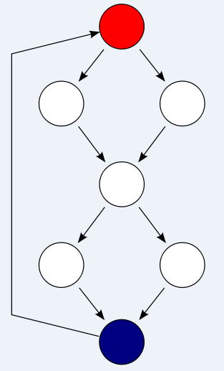
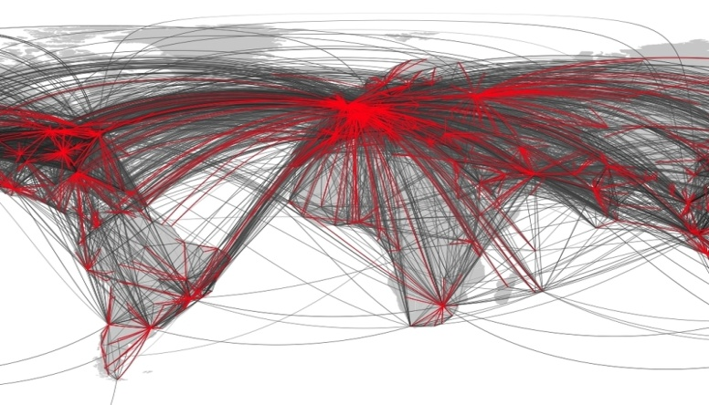
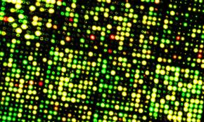







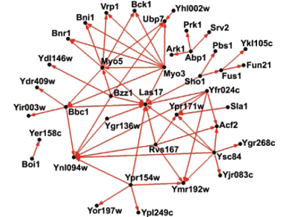


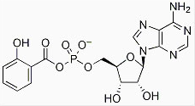

Graphs are Everywhere
Social Network
Program Flow
Transportation Network
Images
Chemical Compound
Biological Network
Graphs in Machine Learning
1/ 160

Slide 3


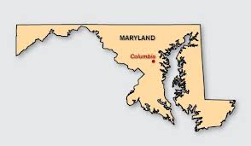


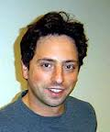


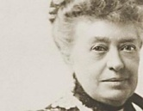

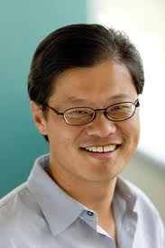





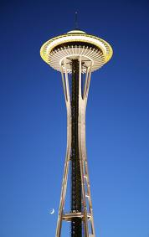

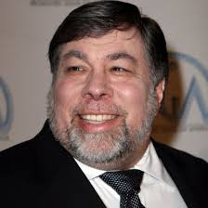
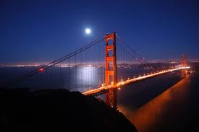
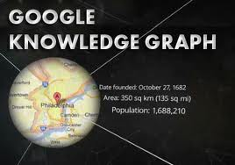


Big-Data as Big-Graph
Maryland
Stanford
Ajim Premji
Harvard
Sergey Brin
Bachelor
Of Eng.
studied at
lived
Bill Gates
founded
graduated
went to
Wipro
Microsoft
founded
Jane Stanford
founded
citizen
nationality
Jerry Yang
headquarter
founded
nationality
Yahoo!
Steve
Woznaik
Google
Founded in
Seattle
founded
founded
lives in
NeXT
Silicon Valley
Apple
Knowledge Graph
2/ 160

Slide 4

Uncertainty
“… the real world is always certain; it is our knowledge of it that is sometimes uncertain. ”
Amihai Motro [Management of Uncertainty in Database Systems]
3/ 160

Slide 5
Uncertainty in Graph Data
0.5
0.1
Social Networks
Traffic Networks
Ad-hoc Mobile Networks
Protein-interaction Networks
Knowledge Bases Constructed from Diverse Sources
U
0.2
T
S
0.5
V
0.6
0.6
0.3
0.7
W
Uncertain Graph
(Edge Uncertainty)
4/ 160

Slide 6


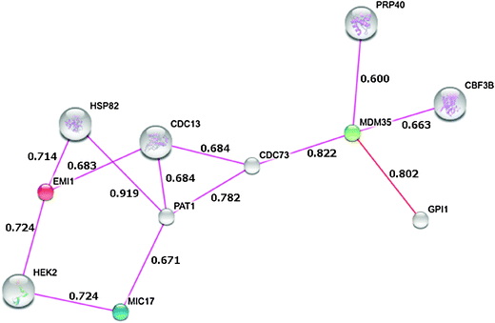


Sources of Uncertain Graphs
Biological Networks
http://string-db.org/
BIOMINE
https://www.cs.helsinki.fi/group/biomine/
Interaction network of Mic17 obtained from the STRING database. All interactions are derived from experimental evidence
http://www.ncbi.nlm.nih.gov//
Gabriele Cavallaro [Genome-wide analysis of eukaryotic twin CX₉C proteins]
5/ 160

Slide 7



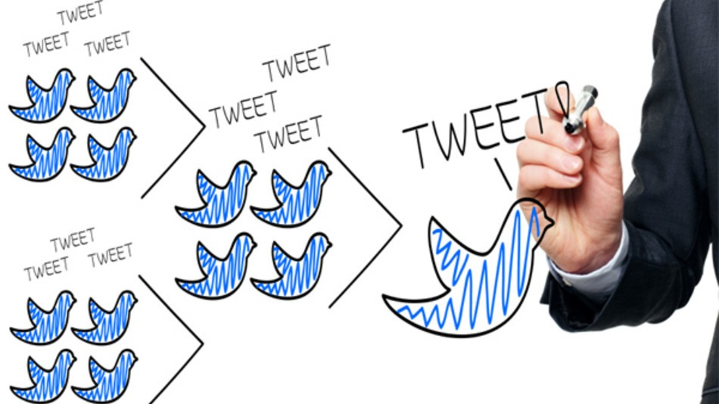









Sources of Uncertain Graphs
Social Networks
0.3
0.2
0.7
0.6
0.6
0.4
Probability of an edge (u, v) represents the likelihood that some action of u will be adopted by v
David Clarke [http://mashable.com/2012/04/03/twitter-changes-for-brands/]
6/ 160

Slide 8




Other Sources of Uncertain Graphs
0.1
0.5
0.2
0.5
0.6
0.6
0.3
Sensor Networks
Traffic Networks
Knowledge Bases
Entity Resolution via Crowd-Sourcing
Uncertain Query
Explicit Manipulation due to privacy purposes
Link Prediction
0.7
Packet Delivery Probability in Sensor Network
Wei
Wang
Works with
0.3
Jiawei
Han
Wei
Wang
Works with
Identity Uncertainty
[ICDE 2014]
Crowd-Sourced Entity Resolution
[VLDB 2012]
7/ 160

Slide 9
Why Consider Uncertainty
Considering the edge probabilities as weights
- no meaningful way to perform such a casting
- no easy way to additionally encode normal weights on the edges
Setting a threshold value to the edge probabilities and ignore any edge below that value
- deciding what the right value of the threshold
Often we are interested in the probability that a certain property holds, rather than a binary Yes/No answer
8/ 160

Slide 10
Challenges with Uncertain Graphs
Uncertainty Semantics
Computational Complexity
9/ 160

Slide 11

Challenges with Uncertain Graphs
Uncertainty Semantics
Computational Complexity
9/ 160

Slide 12
Semantics: Shortest Path in Uncertain Graphs
Social Networks
1.0 - ε
T
1.0 - ε
A
ε
B_{n}
1.0
S
B₂
B₁
1.0
1.0
What is the shortest path from S to T?
[Assume independent edge probabilities]
M. Potamias et. al. [VLDB 2010]
10/ 160

Slide 13
Semantics: Shortest Path in Uncertain Graphs
1.0 - ε
T
The probability of the shortest path (S-T) might be arbitrarily small
1.0 - ε
A
ε
B_{n}
1.0
S
B₂
B₁
1.0
1.0
What is the shortest path from S to T?
[Assume independent edge probabilities]
M. Potamias et. al. [VLDB 2010]
11/ 160

Slide 14
Semantics: Shortest Path in Uncertain Graphs
1.0 - ε
T
The probability that the most probable path (S-B₁-B₂ … B_{n}-T) is indeed the shortest path might be arbitrarily small
1.0 - ε
A
ε
B_{n}
1.0
S
B₂
The most probable path (S-B₁-B₂ … B_{n}-T) might still have an arbitrarily small probability
B₁
1.0
1.0
What is the shortest path from S to T?
[Assume independent edge probabilities]
M. Potamias et. al. [VLDB 2010]
12/ 160

Slide 15
Semantics: Shortest Path in Uncertain Graphs
Social Networks
Expected Shortest-Path Distance:
1.0 - ε
T
1.0 - ε
A
ε
B_{n}
1.0
S
B₂
B₁
1.0
Is expected shortest path distance the best metric?
1.0
What is the shortest path from S to T?
[Assume independent edge probabilities]
M. Potamias et. al. [VLDB 2010]
13/ 160

Slide 16
Semantics: Frequent Subgraphs in Uncertain Graphs
0.9
A
A
E
0.1
0.2
0.3
0.1
0.2
Is sub-graph (ABC) frequent?
Support = 6
Expected Support = 0.038
[Zou et. al., CIKM 2009; Papapetrou et. al., EDBT 2011]
F
1.0
B
0.3
C
0.5
D
B
0.1
C
0.8
D
G₁
G₄
0.1
1.0
A
E
A
E
0.2
0.3
1.0
0.2
0.2
B
0.2
C
1.0
D
F
0.8
B
0.3
C
0.5
D
G₂
G₅
1.0
A
A
E
0.1
0.1
0.1
0.1
Is expected support the best metric?
F
B
C
D
B
0.3
C
0.5
0.2
0.2
G₃
G₆
[Assume independent edge probabilities]
14/ 160

Slide 17
Semantics: Frequent Subgraphs in Uncertain Graphs
0.9
Expected support of edge (AE) = Expected support of edge (CD) = 3
How certain can we be that those edges are frequent?
Frequentness Probability
[Bernecker et. al., KDD 2009]
A
A
E
Social Networks
0.1
0.2
0.3
0.1
0.2
F
1.0
B
0.3
C
0.5
D
B
0.1
C
0.8
D
G₁
G₄
0.1
1.0
A
E
A
E
0.2
0.3
1.0
0.2
0.2
B
0.2
C
1.0
D
F
0.8
B
0.3
C
0.5
D
G₂
G₅
1.0
A
Probability that the support of a sub-graph is at least MinSup
A
E
0.1
0.1
0.1
0.1
F
B
C
D
B
0.3
C
0.5
0.2
0.2
G₃
G₆
[Assume independent edge probabilities]
15/ 160

Slide 18
Tutorial Outline
Data as Uncertain Graphs
Sources of Uncertain Graphs
Application and Challenges of Uncertain Graphs
What is Uncertain
Modeling of Uncertain Graphs
Queries over Uncertain Graphs
Reliability Queries: Reachability, Shortest Path, Nearest Neighbor
Pattern Matching Queries
Similarity-based Search
Influence Maximization
Open Problems
16/ 160

Slide 19
Tutorial Outline
Data as Uncertain Graphs
Sources of Uncertain Graphs
Application and Challenges of Uncertain Graphs
What is Uncertain
Modeling of Uncertain Graphs
Queries over Uncertain Graphs
Reliability Queries: Reachability, Shortest Path, Nearest Neighbor
Pattern Matching Queries
Similarity-based Search
Influence Maximization
Open Problems
16/ 160

Slide 20
This tutorial is not about …
Device Network Reliability: Two-terminal reliability, All-terminal reliability, k-terminal reliability (Reliability Evaluation: A Comparative Study of Different Techniques. Micro. Rel., 1975)
Generative Models for Graphs: Preferential attachment, Forest fire, Erdős–Rényi (Graphs over Time: Densification Laws, Shrinking Diameters and Possible Explanations. KDD 2005)
Uncertain Graphs Mining: Frequent pattern mining (CIKM 2009, EDBT 2011), Clustering/ Community detection (TKDE 2011, ICDM 2012), Classification (SDM 2013), Core decomposition (KDD 2014)
Uncertain Databases: Incomplete uncertain databases (MUD 2010), MayBMS (ICDE 2008), Probabilistic Queries (SIGMOD 2003), Possibilistic databases (IEEE T. Fuzzy Sys. 2005)
Probabilistic Graphical Models: Bayesian network, Markov random field, Belief propagation
Uncertainty Theory: Dempster–Shafer theory, Aleatory vs. Epistemic uncertainty, Possibilistic graphs
17/ 160

Slide 21
Tutorial Outline
Data as Uncertain Graphs
Sources of Uncertain Graphs
Application and Challenges of Uncertain Graphs
What is Uncertain
Modeling of Uncertain Graphs
Queries over Uncertain Graphs
Reliability Queries: Reachability, Shortest Path, Nearest Neighbor, Centrality
Pattern Matching Queries
Similarity-based Search
Influence Maximization
Open Problems
18/ 160

Slide 22
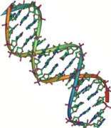
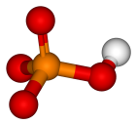


What is Uncertain?
0.8
Edge Uncertainty
Edge existence probability
Edge strength based on edge-attributes
Edge Existence
0.9
Music
0.7
Fashion
Lady Gaga
0.2
Node Uncertainty
Node existence probability
Identity uncertainty
Politics
Edge Strength based on Attributes
Wei
Wang
Works with
Attribute Uncertainty
Uncertainty about attribute values
Unknown attribute values
0.3
Jiawei
Han
Wei
Wang
Works with
Identity Uncertainty

Slide 23
Modeling of Uncertain Graphs
Uncertain Graph is a generative model for deterministic graphs
Independent Probability
Independent probability of existence on graph components
A graph with m uncertain components generates 2^{m} possible worlds
0.3
0.8
0.14
0.06
0.56
0.24
Uncertain Graph
2² = 4 Possible Worlds/ Certain Graphs
Conditional Probability
Probability conditioned on existence of other graph components
E.g., congestion probabilities on roads in an intersection
20/ 160

Slide 24
Independent Probability Model
A graph with m uncertain components generates 2^{m} possible worlds
Probability of observing any possible world G = (V, E_{G}) sampled from uncertain graph G = (V, E, p) is:
0.3
0.8
0.14
0.06
0.56
0.24
Uncertain Graph
(Edge Uncertainty)
2² = 4 Possible Worlds/ Certain Graphs
21/ 160

Slide 25
Tutorial Outline
Data as Uncertain Graphs
Sources of Uncertain Graphs
Application and Challenges of Uncertain Graphs
What is Uncertain
Modeling of Uncertain Graphs
Queries over Uncertain Graphs
Reliability Queries: Reachability, Shortest Path, Nearest Neighbor
Pattern Matching Queries
Similarity-based Search
Influence Maximization
Open Problems
22/ 160

Slide 26
Reliability Query over Uncertain Graphs
Two-Terminal Reliability: Find the probability of reaching a destination node T from a source node S
0.1
U
0.2
T
0.5
Applications:
Mobile Ad-hoc Networks: find the probability of delivering a packet from a source node to a sink node
Biological Networks: predicting co-complex memberships and new interactions requires to compute all proteins that are reachable from a source protein with higher probability
Social Networks: find the probability that a tweet by some user will be reached to another user
S
0.5
V
0.6
0.6
0.3
0.7
W
Packet Delivery Probability in Mobile Ad-hoc Networks
23/ 160

Slide 27
Formal Definition of Reliability
0.5
0.1
U
0.2
T
U
T
S
0.5
V
0.6
S
0.6
Sample Edges
V
0.3
0.7
W
W
Uncertain Graph (G)
A Certain Graph/ Possible World (G)
24/ 160

Slide 28
Complexity of Reliability Computation
Two-terminal reliability computation is a #P-complete problem
Counting Problem: Given a graph G = (V,E) together with node and/or edge weights, find the number of sub-graphs that satisfy property X.
25/ 160

Slide 29
Complexity of Reliability Computation
Two-terminal reliability computation is a #P-complete problem
Counting Problem: Given a graph G = (V,E) together with node and/or edge weights, find the number of sub-graphs that satisfy property X.
#P: Those counting problems with the property that, given a candidate sub-graph, testing whether or not it satisfies property X can be accomplished in polynomial time
The counting version of any problem in NP is in #P
25/ 160

Slide 30
Complexity of Reliability Computation
Two-terminal reliability computation is a #P-complete problem
Counting Problem: Given a graph G = (V,E) together with node and/or edge weights, find the number of sub-graphs that satisfy property X.
#P: Those counting problems with the property that, given a candidate sub-graph, testing whether or not it satisfies property X can be accomplished in polynomial time
The counting version of any problem in NP is in #P
#P-Complete: Those problems in #P with the property that if a polynomial algorithm exists for one of them, then a polynomial algorithm exists for all members of #P
#P-Complete problems are at least as hard as NP-Complete problems
25/ 160

Slide 31
Complexity of Reliability Computation
Two-terminal reliability computation is a #P-complete problem
p
p
Proof Sketch
U
p
T
S
p
Reliability Polynomial:
V
p
p
p
p
W
Uncertain Graph (G)
Coefficient f_{i} is the number of subsets of edges of cardinality i, such that when a subset is deleted, there still remains a path from S to T
By determining f_{i} , we immediately know the number of minimum cardinality (S, T)-cuts
Counting minimum cardinality (S,T)-cuts is #P-complete
L. G. Valiant [SIAM J. Comp 1979]; M. O. Ball [IEE Tran. Rel. 1986]
26/ 160

Slide 32
Complexity of Reliability Computation
Two-terminal reliability on special graph structures
Linear time over tree networks
U
Linear time over series/ parallel networks
S
T
#P-complete over planar graphs
V
#P-complete over directed acyclic
graphs
G is not series/parallel w.r.t. S and T, but is series/parallel w.r.t. U and V
J. S. Provan et. al. [SIAM J. Comp 1983]
27/ 160

Slide 33
Exact Reliability Computation
State Enumeration
A graph with m uncertain edges generates 2^{m} possible worlds → Exponential!
Pathset Enumeration
An (S,T)-pathset is a minimal set of edges whose existence ensures a path from S to T
P₁, P₂, …, P_{r} are path sets
Cutset Enumeration
An (S,T)-cutset is a minimal set of edges whose deletion leaves no path from S to T
C₁, C₂, …, C_{k} are cut sets
28/ 160

Slide 34
Exact Reliability Computation
Inclusion-Exclusion Principle
Right-hand-side contains 2^{r} terms
Number of pathsets and cutsets can be exponential in the number of nodes and edges
Polynomial-time algorithm exists to compute R(S,T) in the number of (S,T)-cutsets [Provan et. al., Operations Research 1984]
Exploiting special structures [Agrawal et. al., Operations Research , 1984], upper and lower bounds [Esary et. al., Technometrics , 1966], efficient Monte Carlo methods [Karp et. al., UC Berkeley Tech. Report , 1983]
29/ 160

Slide 35
Monte Carlo Sampling to Estimate Reliability
Basic Monte-Carlo/ Hit-and-Miss Monte-Carlo
Sample K possible graphs, G₁, G₂, …, G_{K} of uncertain graph G according to edge probabilities
Compute I_{S,T}(G_{i}) = 1 if T is reachable from S in G_{i}, and I_{S,T}(G_{i}) = 0 otherwise
Time Complexity
n = # nodes, m = # edges
30/ 160

Slide 36
Basic Monte Carlo with Breadth-First-Search
Do not sample all edges in the beginning
Only sample the outgoing edges from the currently visited vertex
Stop when T is reached, or no new vertex can be reached with the sampled edges
0.5
0.1
U
0.2
T
U
S
0.5
V
0.6
S
0.6
0.3
Sample + BFS
0.7
W
W
Uncertain Graph (G)
Start BFS from S
31/ 160

Slide 37

Basic Monte Carlo with Breadth-First-Search
Do not sample all edges in the beginning
Only sample the outgoing edges from the currently visited vertex
Stop when T is reached, or no new vertex can be reached with the sampled edges
0.5
0.1
U
0.2
T
U
T
S
0.5
V
0.6
S
V
0.6
0.3
Sample + BFS
0.7
W
W
Uncertain Graph (G)
- Continue BFS from U and W
- Terminate
32/ 160

Slide 38
Accuracy Guarantees for Basic Monte Carlo
Unbiased estimator
Variance due to binomial distribution ~ B(K, R(S,T))
G. S. Fishman [IEEE Tran. Rel. 1986]
33/ 160

Slide 39
Accuracy Guarantees for Basic Monte Carlo
Number of trials necessary to achieve an (ɛ, δ) algorithm
Having No of samples ≥ , we ensure
Follows from Chernoff bound [M. Potamias et. al. VLDB 2010]
One can also apply Chebychev’s inequality [Karp et. al., UC Berkeley Tech. Report , 1983] or Central Limit Theorem [M. Y. ATA., Applied Math. , 2006] to derive similar bounds
34/ 160

Slide 40
Asking Reliability Query Differently
Distance-Constraint Reliability
Find the probability that the distance from source node S to a destination node T is less than or equal to a user-defined threshold d [Jin et. al., VLDB 2011]
Reliable Set Query
Given a source nodes S, find all other nodes that are reachable from S with probability greater than or equal to a user-defined threshold η [Khan et. al., EDBT 2014]
35/ 160

Slide 41
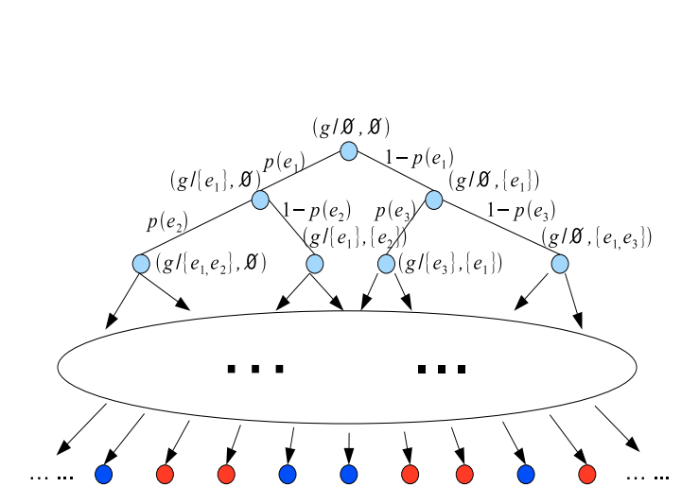
Recursive Sampling for distance-constraint Reliability [Jin et. al., VLDB 2011]
If inclusion set E₁ contains a d-path from S to T, then
If exclusion set E₂ contains a d-cut for S to T, then
Enumeration tree for recursive computation of distance-constraint reachability
36/ 160

Slide 42
Recursive Sampling for distance-constraint Reliability [Jin et. al., VLDB 2011]
When some edges are missing, the presence of some other edges are no longer relevant.
Many samples share a significant portion of existing or missing edges, the reachability checking cost could be shared among them.
Enumeration tree for recursive computation of distance-constraint reachability
Dynamic Monte-Carlo, Zhu et. al., DASFAA 2011
37/ 160

Slide 43
Recursive Sampling for distance-constraint Reliability [Jin et. al., VLDB 2011]
Selection of next edge to improve efficiency
Unequal probability sampling (Hansen-Hurwitz, Horvitz-Thompson) to reduce variance
Enumeration tree for recursive computation of distance-constraint reachability
38/ 160

Slide 44
Index for Reliable Set Query [Khan et. al., EDBT 2011]
Reliable Set Query: Given a source nodes S, find all other nodes that are reachable from S with probability greater than or equal to a user-defined threshold η
Can we quickly determine the nodes that are certainly not reachable from S with probability greater than or equal to ɳ
0.1
Indexing (offline) – RQ Tree
Filtering + Verification (Online)
0.5
U
0.2
T
S
0.5
V
0.6
0.6
0.3
0.7
W
ɳ = 0.5
Uncertain Graph
39/ 160

Slide 45
RQ-Tree Index [Khan et. al., EDBT 2011]
0.5
U_{out}(S, *)=0
U
0.1
S, U, W, V, T
0.5
0.2
T
S
U_{out}(S, *)=0.496
ɳ = 0.5
0.6
V
0.6
S, U, W
V,T
0.3
U_{out}(S, *)=0.8
W
0.7
ɳ = 0.5
S, W
U
V
T
U_{out}(S, *)=0.8
Uncertain Graph
S
W
RQ-Tree Index
40/ 160

Slide 46
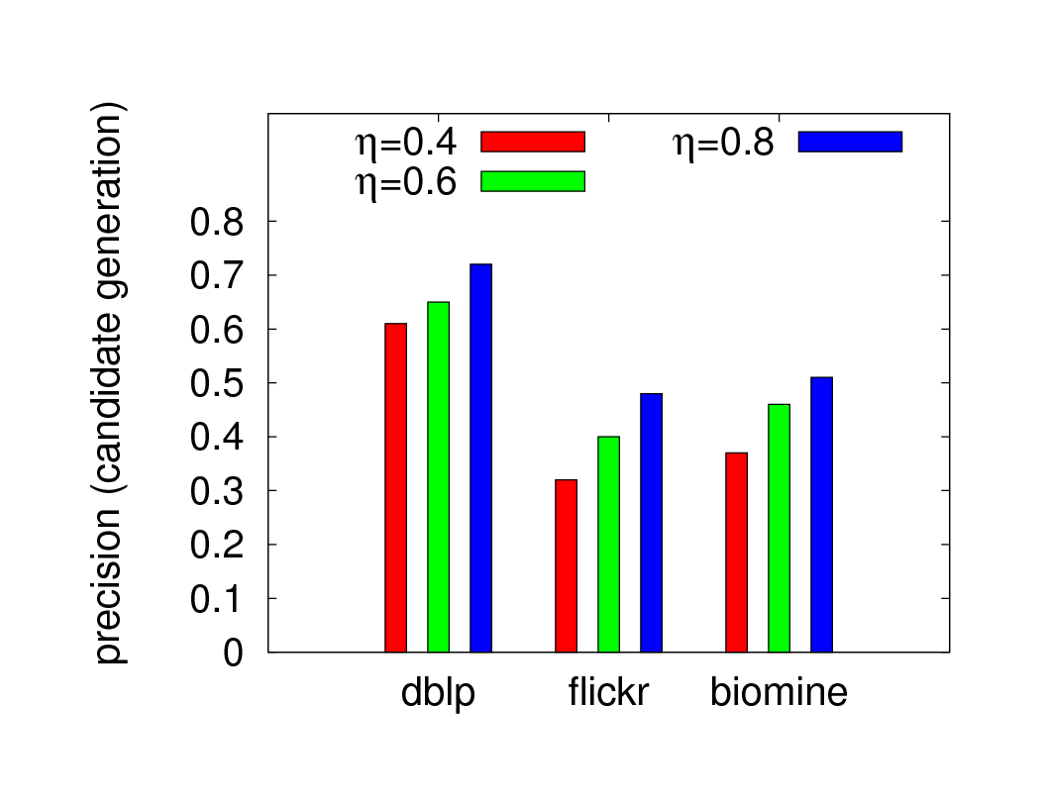
Pruning Capacity: RQ-Tree Index
 | # Nodes | # Edges | Edge Prob: Mean, SD, Quartiles
DBLP | 684 911 | 4 569 982 | 0.14 ± 0.11, {0.09, 0.09, 0.18}
Flickr | 78 322 | 20 343 018 | 0.09 ± 0.06, {0.06, 0.07, 0.09}
BioMine | 1 008 201 | 13 445 048 | 0.27 ± 0.21, {0.12, 0.22, 0.36}
Dataset Characteristics
Precision of RQ-Tree Filtering Phase
41/ 160

Slide 47
Shortest Path Query
Uncertain and edge-weighted graph G = (V, E, W, p)
20, 0.5
20
A
D
A
D
10, 0.6
15, 0.8
Shortest Path Distribution
10
5, 0.8
20, 0.8
5
S
C
T
S
C
T
5, 0.4
15
15, 0.7
10, 0.9
10
25
B
E
25, 0.4
B
E
Possible World Graph G₁
Uncertain Edge-Weighted Graph (G)
A
D
Shortest Path Distribution
S
C
T
15
10
25
B
E
Possible World Graph G₂

Slide 48
Distance Metric in Uncertain Graphs
Median Distance
Majority Distance
Expected Reliable Distance
M. Potamias et. al. [VLDB 2010]
43/ 160

Slide 49
Distance Metric in Uncertain Graphs
Median Distance
Which one is more suitable for what applications?
Distance metrics rely on one path
Majority Distance
Proximity-based Measures? – Random Walk, Personalized Page Rank!
Expected Reliable Distance
M. Potamias et. al. [VLDB 2010]
44/ 160

Slide 50
Nearest Neighbor Query
Find the top-k nearest neighbors of a given query node based on distance metrics defined previously
#P-hard
Pruning Techniques: Find top-k nearest neighbors without computing distances to all nodes from S
M. Potamias et. al. [VLDB 2010]
45/ 160

Slide 51
Pruning Algorithms for Nearest Neighbor Query
Median Distance
Distance-based Pruning
Initialize D to a small value. Only consider nodes that are within distance D from query node S
Pruning
Criteria
If k nodes found with median distance less than D, terminate
Otherwise increase D and repeat
M. Potamias et. al. [VLDB 2010]
46/ 160

Slide 52
Variations of Shortest Path Query
Threshold-based Shortest Path Query
Given a source node S, a destination node T, and a probability threshold η, find a path set {P₁, P₂, …, P_{r}} from S to T, such that each path P_{i} has a shortest path probability larger than threshold η [Cheng et. al., DASFAA 2014]
Top-k Shortest Path Query
Given a source node S and a destination node T, find a set of k paths {P₁, P₂, …, P_{r}} from S to T, such that their shortest path probabilities are the largest among all possible shortest paths from S to T [Zou et. al., WISE 2011]
52
47/ 160

Slide 53
Pruning Algorithms for Top-K Shortest Path Query
Top-r shortest paths {P₁, P₂, P₃, …, P_{r}} from S to T in certain graph G* by Yen’s algorithm [J. Y. Yen, Management Science 1971]
Probability that P_{r} is the shortest path from S to T in uncertain graph G is given by none of the paths {P₁, P₂, P₃, …, P_{r-1}} exists and P_{r} exists.
Upper bound: UB[Pr(P_{r} = SP(G))] Lower bound: LB[Pr(P_{r} = SP(G))]
𝞓 = K-th largest lower bound found so far
Pruning
Criteria
Terminate if UB[Pr(P_{r} = SP(G))] < 𝞓
Zou et. al. [WISE 2011]
48/ 160

Slide 54
Pruning Algorithms for Top-K Shortest Path Query
UB[Pr(P_{r} = SP(G))] ≤ 1 - LB[Pr(P_{j} = SP(G))]
First Lower Bound
Second Lower Bound
S_{i}: Edge-set cover for the paths { (P_{i} – P_{r}): i ∈ (1, r-1) }
S’_{i}: Pairwise independent set covers
Zou et. al. [WISE 2011]
49/ 160

Slide 55
Reliability with Edge Colors
Uncertain, edge-colored multi-graph G
Given a source node S and destination node T, find the top-k edge colors that maximize the reliability from S to T
0.6
0.7
A
C
0.2
0.8
S
0.7
T
0.4
B
0.5
Uncertain, Edge-Colored Multi-Graph:
Select at most K edge-colors
Barbieri et. al. [ICDM 2012]; Chen er. al. [DASFAA 2014]; Khan et. al. [CIKM 2015]
50/ 160

Slide 56
Reliability with Edge Colors
Uncertain, edge-colored multi-graph G
Given a source node S and destination node T, find the top-k edge colors that maximize the reliability from S to T
0.6
0.7
A
C
0.6
0.7
A
C
0.2
0.8
S
Green and Red
S
0.2
0.7
T
0.7
0.4
T
B
0.5
B
0.5
Uncertain, Edge-Colored Multi-Graph:
Select at most 2 edge-colors
Reliability: R(S,T) = 0
Khan et. al. [CIKM 2015]
51/ 160

Slide 57
Reliability with Edge Colors
Uncertain, edge-colored multi-graph G
Given a source node S and destination node T, find the top-k edge colors that maximize the reliability from S to T
0.6
0.7
0.6
A
C
A
C
0.2
0.8
0.8
S
Green and Blue
S
0.7
0.7
T
T
0.4
0.4
B
B
0.5
Uncertain, Edge-Colored Multi-Graph:
Select at most 2 edge-colors
Reliability: R(S,T) = 0.28
Khan et. al. [CIKM 2015]
52/ 160

Slide 58
Reliability with Edge Colors
Uncertain, edge-colored multi-graph G
Given a source node S and destination node T, find the top-k edge colors that maximize the reliability from S to T
0.6
0.7
0.7
A
C
A
C
0.2
0.8
0.2
0.8
S
Red and Blue
S
0.7
T
T
0.4
0.4
B
B
0.5
0.5
Uncertain, Edge-Colored Multi-Graph:
Select at most 2 edge-colors
Reliability: R(S,T) = 0.29
Khan et. al. [CIKM 2015]
53/ 160

Slide 59
Reliability with Edge Colors
Uncertain, edge-colored multi-graph G
Given a source node S and destination node T, find the top-k edge colors that maximize the reliability from S to T
0.6
0.7
A
C
Applications
0.2
0.8
S
Top-k enzymes to create pathways in biological networks
Top-k Advertisement contents for topic-aware information cascade
Top-k themes to organize a party among a group of people
0.7
T
0.4
B
0.5
Uncertain, Edge-Colored Multi-Graph:
Select at most K edge-colors
Khan et. al. [CIKM 2015]
54/ 160

Slide 60
What if Correlated Probabilities
A
D
 | state(e_{CT})=1 | state(e_{CT})=0
state(e_{AC})=1, state(e_{BC})=1 | 0.5 | 0.5
state(e_{AC})=1, state(e_{BC})=0 | 0.75 | 0.25
state(e_{AC})=0, state(e_{BC})=1 | 0.7 | 0.3
state(e_{AC})=0, state(e_{BC})=0 | 0.4 | 0.6
S
C
T
B
E
Uncertain Graph (G)
Conditional Probability Table
If DAG, sample each edge of G according to their topological order
If not a DAG, obtaining independent samples is more difficult → Gibbs sampling
Potamias et. al. [VLDB 2010]; Cheng et. al. [DASFAA 2014]
55/ 160

Slide 61
Summary: Reliability Queries
Two-terminal reliability computation over uncertain graphs is a #P-complete problem
Several variations of reliability query – shortest path, nearest neighbors, reliable set, edge-colored reliability
Application-specific semantics for shortest paths, nearest neighbors, edge-color and uncertainty
Efficient indexing and sampling techniques, pruning algorithms
56/ 160

Slide 62
Tutorial Outline
Data as Uncertain Graphs
Sources of Uncertain Graphs
Application and Challenges of Uncertain Graphs
What is Uncertain
Modeling of Uncertain Graphs
Queries over Uncertain Graphs
Reliability Queries: Reachability, Shortest Path, Nearest Neighbor
Pattern Matching Queries
Similarity-based Search
Influence Maximization
Open Problems
57/ 160

Slide 63
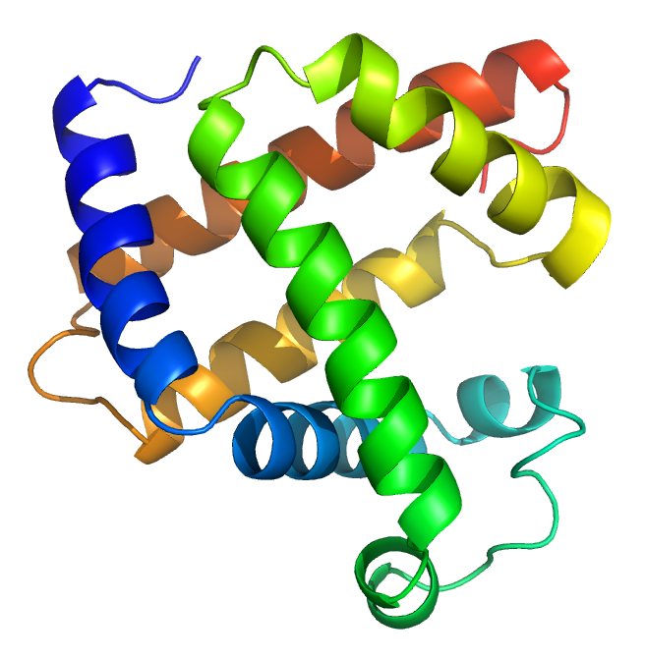

Why Uncertain Graphs
In our daily life, uncertainty is ubiquitous!
Protein-Protein Interaction Network
Social Networks
Protein-Protein Interaction Networks
False Positive > 45%
Social Networks
Probabilistic Trust/Influence Model
58/ 160

Slide 64

Why Uncertain Graphs
Uncertain graph has many applications.
In these applications, graph data is usually noisy and incomplete, which leads to uncertain graphs.
STRING database (http://string-db.org) is a data source that contains PPIs with uncertain edges provided by biological experiments.
Subjective reasons: imprecise physical instrument, network delay, complex sensing
Objective reasons: privacy-preserving, information extraction, data integration
Therefore, it is important to study query processing on large uncertain graphs.
59/ 160
Notes:
Just read one by one...
Based on the above applications, it is important to study query processing on large uncertain graphs.

Slide 65
Our Roadmap …
Pattern Matching Queries
Efficient Subgraph Search
Efficient Supergraph Search
Efficient Pattern Graph Search
60/ 160

Slide 66
Probabilistic Subgraph Search
Uncertain graph
Vertex uncertainty (existence probability)
Edge uncertainty (existence probability given its two endpoints)
Y. Yuan et. al. [VLDB 2011]
61/ 160
Notes:
The uncertain graph model has vertex and edge uncertainties which denotes the existence of vertex and edge.
See the example...
The values denotes the probablity.

Slide 67
Probabilistic Subgraph Search
Uncertain graph
Possible worlds: combination of all uncertain edges and vertices
Y. Yuan et. al. [VLDB 2011]
62/ 160
Notes:
We describe the uncertain graph using the possible world semantics. The possible worlds are the combination of all uncertain edges and vertices.
Look at the example, we can derive 18 possible worlds. The sum of the probabilities over all possible worlds is 1.

Slide 68
Probabilistic Subgraph Search
Problem Definition
Given: an uncertain graph database G={g₁, g₂,…, g_{n}}, a query graph q and probability threshold τ
Query: find all g_{i} ∈G, such that the subgraph isomorphic probability is not smaller than τ.
Subgraph isomorphic probability (SIP): The SIP between q and g_{i} = the sum of g_{i}’s possible worlds to which q is subgraph isomorphic
Y. Yuan et. al. [VLDB 2011]
63/ 160
Notes:
Just read it...

Slide 69
Probabilistic Subgraph Search
Problem Definition
Subgraph isomorphic probability (SIP)
g
q
+
+
+
+
= 0.27
It is #P-complete to calculate SIP
Y. Yuan et. al. [VLDB 2011]
64/ 160
Notes:
Let us see the example. We use q to query uncertain graph g. We can find 5 possible world graphs that contain q as a subgraph. Then we add these possible worlds’probablities. The result is SIP.
We have formally prove that it is #P-complete to calculate SIP. Therefore, in the following, we introduce how to attack the hard problem.

Slide 70
Probabilistic Subgraph Search
Probabilistic Subgraph Query Processing Framework
Naïve method：sequence scan D, and decide if the SIP between q and gi is not smaller than threshold τ.
g1 graph isomorphic to g2 : NP-hard?
g1 subgraph isomorphic to g2 : NP-Complete
Calculating SIP: #P-Complete
Naïve method: very costly, infeasible！
Y. Yuan et. al. [VLDB 2011]
65/ 160
Notes:
A naïve method is ... (just read it). In the naïve approach, we are inloved with graph isomorphic problems (just read the two) and hard problem of computing SIP.
Therefore, naïve method is very costly and infeasible！

Slide 71
Probabilistic Subgraph Search
A Filtering-and-Verification Query Processing Framework
{g₁,g₂,..,g_{n}}
{g’₁,g’₂,..,g’_{m}}
Filtering
Candidates
Query q
{g”₁,g”₂,..,g”_{k}}
Answers
Verification
Y. Yuan et. al. [VLDB 2011]
66/ 160
Notes:
Our query processing framework consists of three steps, namely structural pruning, probabilistic pruning and verification.

Slide 72
Probabilistic Subgraph Search
Filtering: Structural Pruning
Principle: if we remove all the uncertainty from g, and the resulting graph still does not contain q, then the original uncertain graph cannot contain q.
Theorem: if q⊄g^{c}，then Pr(q⊆g)=0
g
q
Y. Yuan et. al. [VLDB 2011]
67/ 160
Notes:
Just read the principle...

Slide 73
Probabilistic Subgraph Search
Filtering: Probabilistic Pruning
Let f be a feature of gc i.e., f⊆gc
Rule 1:
if f ⊆ q , UpperB(Pr(f ⊆ g))<τ，then g is pruned.
∵ f ⊆ q, ∴ Pr(q ⊆ g)≤Pr(f ⊆ g)<τ
Uncertain Graph
Feature
Query & τ
Y. Yuan et. al. [VLDB 2011]
68/ 160
Notes:
G^c is the resulting graph after removing uncertainty from G. Then we can derive two probabilistic pruning rules. Explain the rules..
Then we have two main issues for the rules.

Slide 74
Probabilistic Subgraph Search
Filtering: Probabilistic Pruning
Rule 2：
if q ⊆ f, LowerB(Pr(f ⊆ g))≥τ，then g is an answer.
∵ q ⊆ f, ∴ Pr(q ⊆ g)≥Pr(f ⊆ g)≥τ
Query & τ
Uncertain Graph
Feature
Two main issues for probabilistic pruning
How to derive lower and upper bounds of SIP?
How to select features with great pruning power?
Y. Yuan et. al. [VLDB 2011]
69/ 160
Notes:
G^c is the resulting graph after removing uncertainty from G. Then we can derive two probabilistic pruning rules. Explain the rules..
Then we have two main issues for the rules.

Slide 75
Probabilistic Subgraph Search
Technique 1: calculation of lower and upper bounds
Lemma: Let Bf₁,…,Bf_{|Ef|}be all embeddings of f in g^{c}, then
Pr(f⊆g)=Pr(Bf₁∨…∨Bf_{|Ef|}).
UpperB(Pr(f⊆g)):
Y. Yuan et. al. [VLDB 2011]
70/ 160
Notes:
Now we solve the issue 1—upper bounds. Then explain the principle.

Slide 76
Probabilistic Subgraph Search
Technique 1: calculation of lower and upper bounds
LowerB(Pr(f⊆g)):
Tightest LowerB(f)
Converting into computing the maximum clique of graph bG
Y. Yuan et. al. [VLDB 2011]
71/ 160
Notes:
For the second issue-lower bound, we can find a group of disjoint embeddings. Then we can use the equ to derive a lower bound. But there are many groups of disjoint embeddings, which leads to large number of lower bounds. We want the tightest bound. It is a 组合问题. We convert it into computing the maximum clique.
IN is set of disjoint embeddings.
In the example, we first find embeddings of f_2 in 002. They are the left figure.. Transform it into a graph shown in bG. Then apply the maximum clique algorithm on the bG.

Slide 77
Probabilistic Subgraph Search
Technique 1: calculation of lower and upper bounds
Exact value V.S. Upper and lower bound
Value
Computing Time
Y. Yuan et. al. [VLDB 2011]
72/ 160
Notes:
We shows the values and calculation time of lower and upper bounds. The result shows that values are tight and computing is efficient.
On the real uncertain graph data set (stringDB)

Slide 78
Probabilistic Subgraph Search
Technique2: Optimal Feature Selection
If we index all features, we will have the most pruning power index. But it is also very costly to query such index. Thus we would like a small number of features but with the greatest pruning power.
Cost model:
Max gain = sequence scan cost– query index cost
Integer programming→maximum set coverage: NP-complete.
Use the greedy algorithm to approximate it.
Y. Yuan et. al. [VLDB 2011]
73/ 160
Notes:
Just read “if we index…”
To obtain the optimal features, we devise a cost model (read it).
We have formally prove that it is NP-hard problem. Our solution is “integer…” (read it)

Slide 79
Probabilistic Subgraph Search
Technique2: Optimal Feature Selection
Integer programming：greedy algorithm
Approximate optimal index within 1-1/e
Feature Matrix
Y. Yuan et. al. [VLDB 2011]
Probabilistic Index
74/ 160
Notes:
Let us see an example. We build a matrix with row indexing initial features (f_1, f_2, f_3 )and column indexing uncertain graphs (001 and 002) . The entries gives the lower and upper bounds of features in uncertain graphs.
Then for a set of queries (q1,q2,q3), if a query s.t. probabilistic pruning rules, then keep the contents of entries, otherwise gives 0. Finally we select features containing most non-zero entries.
This scheme can approximate optimal index within 1-1/e.

Slide 80
Probabilistic Subgraph Search
Probabilistic Index
Construct a string for each feature
Construct a prefix tree for all feature strings
Construct an invert list for all leaf nodes
Y. Yuan et. al. [VLDB 2011]
75/ 160
Notes:
Finally using the optimal features, we can build probabilistic index. The construction consists of three steps.. (just read it)

Slide 81
Probabilistic Subgraph Search
Verification: Iterative bound pruning
Lemma： Pr(q⊆g)=Pr(Bq₁∨…∨Bq_{|Eq|})
Unfolding: ⇒
Let
Based on Inclusion-Exclusion Principle
Iterative Bound Pruning
Y. Yuan et. al. [VLDB 2011]
76/ 160
Notes:
Finally using the optimal features, we can build probabilistic index. The construction consists of three steps.. (just read it)

Slide 82
Our Roadmap …
Pattern Matching Queries
Efficient Subgraph Search
Efficient Supergraph Search
Efficient Pattern Graph Search
77/ 160

Slide 83
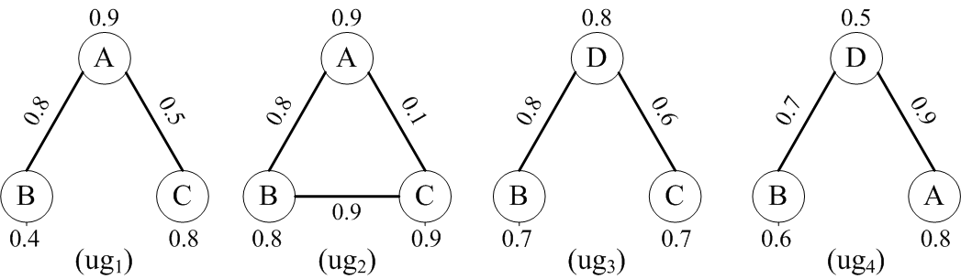
Probabilistic Supergraph Search
Back to our example of the uncertain graph database
The existing probability of the specific vertex A.
The conditional probability of the edge B-C appears when the nodes B and C already exist.
Figure 1: An Uncertain Graph Database
Y. Tong et. al. [CIKM 2014]
78/ 160
Notes:
The uncertain graph model has vertex and edge uncertainties which denotes the existence of vertex and edge.
See the example...
The values denotes the probability.

Slide 84
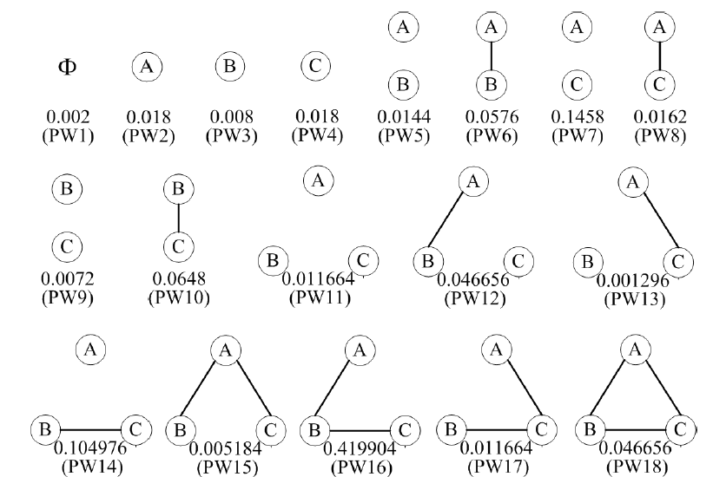
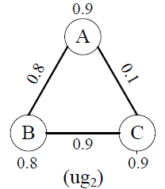
Probabilistic Supergraph Search
Back to our example of the uncertain graph database
Pr(PW6)=0.9*0.8*0.8*(1-0.9)=0.0576
The condition probabilities of A-C and B-C are not considered since the node C does not exist.
We derive 18 possible world graphs
Y. Tong et. al. [CIKM 2014]
Notes:
just read it…

Slide 85
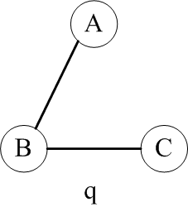
Probabilistic Supergraph Search
Back to our example of the uncertain graph database
SIP(q, ug2)=0.419904+0.046656= 0.46656
Y. Tong et. al. [CIKM 2014]
Notes:
just read it…

Slide 86
Probabilistic Supergraph Search
Supergraph Containment Probability (SCP)
Given an uncertain graph ug and a query graph q, the SCP between q and ug is equal to the sum of the probabilities of ug’s possible worlds where ug is subgraph of q
Probabilistic Supergraph Containment Search
Given an uncertain graph database G={g₁,g₂,…,g_{n}}, a query graph q and probability threshold τ.
Query: find all g_{i} ∈G, such that such that the supergraph containment probability is not smaller than τ.
Y. Tong et. al. [CIKM 2014]
81/ 160
Notes:
Just read it...

Slide 87
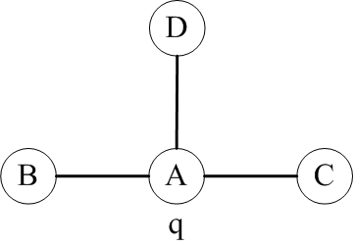
Probabilistic Supergraph Search
Supergraph Containment Probability (SCP)
SCP(q, ug2)=0.002+0.018+…+0.001296+0.005184
=0.352
Y. Tong et. al. [CIKM 2014]
Notes:
just read it…

Slide 88
Probabilistic Supergraph Search
Whether the existing approach of probabilistic subgraph search can be extended to solve the issue of probabilistic supergraph?
The answer set of q in the corresponding deterministic graph database
The final answer set of q in the uncertain graph database
D_{q}
UGD_{q}
The answer set of q in the corresponding deterministic graph database
The final answer set of q in the uncertain graph database
The framework of probabilistic subgraph search is not suitable for the problem of probabilistic supergraph search!
UGD_{q}
D_{q}
Subgraph Search
Supergraph Search
Y. Tong et. al. [CIKM 2014]
Notes:
just read it…

Slide 89
Probabilistic Supergraph Search
Complexity Analysis
However, we prove that it is #P-hard to calculate the supergraph containment probability (SCP) of a given uncertain graph and a query graph.
How to compute this hard problem?
Y. Tong et. al. [CIKM 2014]
84/ 160
Notes:
Just read it...

Slide 90
Probabilistic Supergraph Search
A Filtering-and-Verification Query Processing Framework
Offline Index Construction (Using Existing Work)
Mining probabilistic frequent subgraphs, which are considered as feature set to build index
Filtering Phase
Probabilistic-supergraph-filtering-logic-based pruning
Verification Phase
Sampling-based algorithm (Unequal-Probability Sampling)
Y. Tong et. al. [CIKM 2014]
85/ 160
Notes:
Just read it...

Slide 91
Probabilistic Supergraph Search
Filtering: Probabilistic Pruning
Principle: If a feature graph and ,
then
Theorem: If a feature graph and , where τ
is the probabilistic threshold, then ug can be pruned safely!
Y. Tong et. al. [CIKM 2014]
86/ 160
Notes:
Just read it..., ug is a given uncertain graph

Slide 92
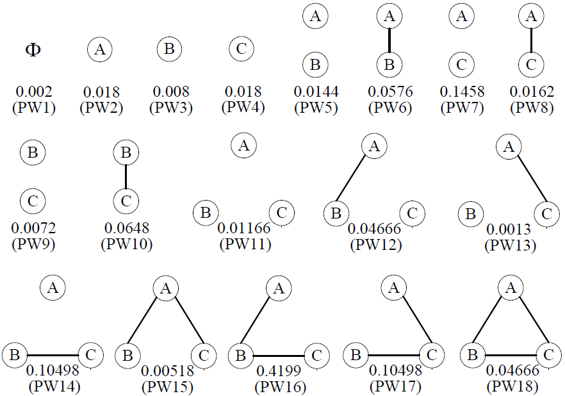
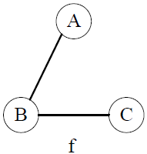
Probabilistic Supergraph Search
The Example of Probabilistic Pruning
SIP(f, ug2)=0.4199+0.0466=0.46656>1-0.7=0.3, SCP(q, ug2) must be lower than the given threshold. Thus, ug2 can be pruned safely.
Y. Tong et. al. [CIKM 2014]
Notes:
just read it…

Slide 93
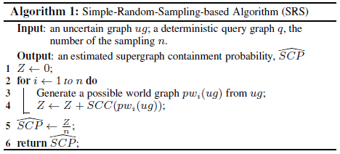

Probabilistic Supergraph Search
Verification Solutions
Simple-Random-Sampling-based Approach
Analysis of Simple-Random-Sampling-based Approach
This method is unbiased.
However, its variance is , which is larger.
Y. Tong et. al. [CIKM 2014]
88/ 160
Notes:
Just read it...

Slide 94
Probabilistic Supergraph Search
Verification Solutions: Simple-Random-Sampling-based Approach
Simple-Random-Sampling-based Approach
Analysis of Simple-Random-Sampling-based Approach
This method is unbiased.
However, its variance is , which is larger.
Y. Tong et. al. [CIKM 2014]
89/ 160
Notes:
Just read it...

Slide 95
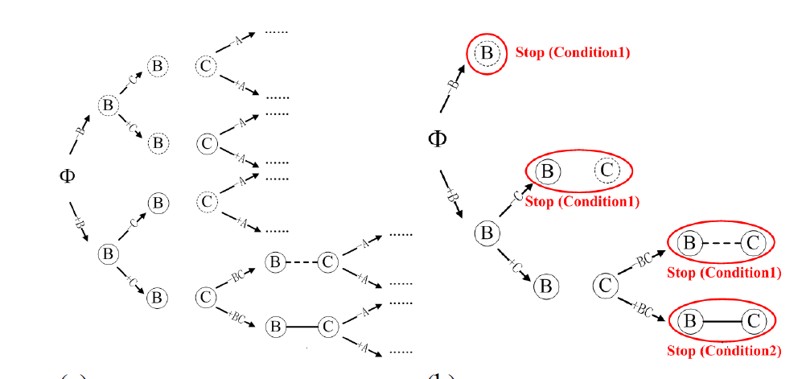
Probabilistic Supergraph Search
Verification Solutions: Unequal-Probability-Sampling-based Approach
The stopping condition 1 means that all subsequent sampled possible world graphs must be contained by the given query graph
Early Pruning
The stopping condition 2 means that all subsequent sampled possible world graphs must NOT be contained by the given query graph
Simple-Random-Sampling
Unequal-Probability Sampling
Y. Tong et. al. [CIKM 2014]
Notes:
Just read it...

Slide 96
Our Roadmap …
Pattern Matching Queries
Efficient Subgraph Search
Efficient Supergraph Search
Efficient Pattern Graph Search
91/ 160

Slide 97
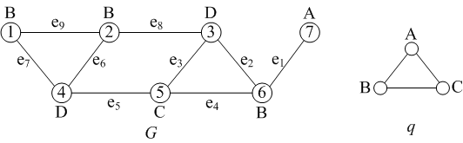
Probabilistic Pattern Graph Matching
Deterministic Graph Pattern Matching
Given a graph G and a query q with distance constraint γ
Vertex labeled G and q
An answer m is a set of vertices in G：
A vertex in m has the same label as a vertex in G
Any pair of vertices has a shortest path distance ≤ γ
Y. Yuan et. al. [CIKM 2014]
92/ 160
Notes:
The uncertain graph model has vertex and edge uncertainties which denotes the existence of vertex and edge.
See the example...
The values denotes the probablity.

Slide 98
Probabilistic Pattern Graph Matching
Deterministic Graph Pattern Matching
Distance constraint γ=3
Correct answer: {2, 5, 7}, {5, 6, 7}
Incorrect answer: {1, 5, 7}: distance between 1 and 7=4> γ
Y. Yuan et. al. [CIKM 2014]
93/ 160
Notes:
The uncertain graph model has vertex and edge uncertainties which denotes the existence of vertex and edge.
See the example...
The values denotes the probablity.

Slide 99
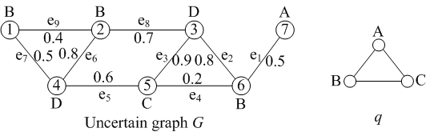
Probabilistic Pattern Graph Matching
Probabilistic Graph Pattern Matching
Distance constraint γ=3
Vertex is deterministic
Edge uncertainty (existence probability)
Y. Yuan et. al. [CIKM 2014]
94/ 160
Notes:
The uncertain graph model has vertex and edge uncertainties which denotes the existence of vertex and edge.
See the example...
The values denotes the probablity.

Slide 100
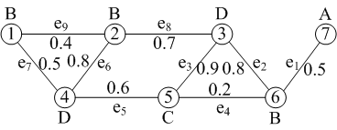
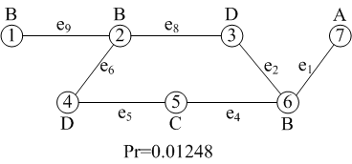
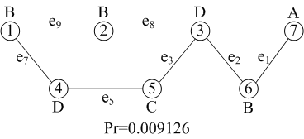
Probabilistic Pattern Graph Matching
Probabilistic Graph Pattern Matching
Possible worlds: combination of all uncertain edges
Uncertain Graph
2⁹ =512 possible worlds
Y. Yuan et. al. [CIKM 2014]
95/ 160
Notes:
We desrcibe the uncertain graph using the possible world semantics. The possible worlds are the combination of all uncertain edges and vertices.
Look at the example, we can derive 18 possible worlds. The sum of the probabilities over all possible worlds is 1.

Slide 101
Probabilistic Pattern Graph Matching
Problem Definitions
Given: an uncertain graph G, a query graph q and a probability
threshold τ
Query: find all matches {m} in G, such that the pattern matching
probability is not smaller than τ.
Pattern matching probability (PMP): The PMP of m in G = the sum of G’s possible worlds in which m is a valid match.
For example, m={2, 5, 7} : PMP of m in G= 0.01248+0.009126+...=0.65.
It is #P-complete to calculate PMP
Y. Yuan et. al. [CIKM 2014]
96/ 160
Notes:
Just read it...

Slide 102
Probabilistic Pattern Graph Matching
Probabilistic Pattern Graph Matching Framework
Naïve method：in G enumerate all vertex sets {m} with size of V(q), and decide if the PMP of m in G is not smaller than threshold τ.
Number of {m}= Comb(|G |, |V(q)|)
Calculating PMP: #P-Complete
Naïve method: very costly, infeasible！
Y. Yuan et. al. [CIKM 2014]
97/ 160
Notes:
A naïve method is ... (just read it). In the naïve approach, we are inloved with graph isomorphic problems (just read the two) and hard problem of computing SIP.
Therefore, naïve method is very costly and infeasible！

Slide 103
Probabilistic Pattern Graph Matching
A Filtering-and-Verification Query Processing Framework
G: {m₁,m₂,..,m_{a}}
{m’₁,m’₂,..,m’_{b}}
Filtering
Candidates
Query q
{m”₁,m”₂,..,m”_{c}}
Answers
Verification
Y. Yuan et. al. [CIKM 2014]
98/ 160
Notes:
Our query processing framework consists of three steps, namely structural pruning, probabilistic pruning and verification.

Slide 104
Probabilistic Pattern Graph Matching
Filtering: Structural Pruning
We remove all the uncertainty from G, and obtain the resulting vertex sets {m} after certain pattern matching on G, then the vertex sets {m} is input for the uncertain filtering.
{2, 5, 7}, {5, 6, 7}, {1, 2, 4}, …
Y. Yuan et. al. [CIKM 2014]
99/ 160
Notes:
Just read the principle...

Slide 105
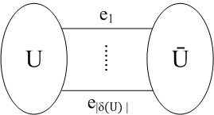

Probabilistic Pattern Graph Matching
Probabilistic Index
Edge cut: a set of edges whose removing results in a partition of G
Edge cut: {e₁, e₂,…,e_{f}}
Connected probability:
Y. Yuan et. al. [CIKM 2014]
100/ 160
Notes:
G^c is the resulting graph after removing uncertainty from G. Then we can derive two probabilistic pruning rules. Explain the rules..
Then we have two main issues for the rules.

Slide 106
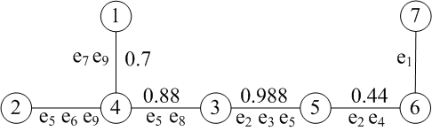
Probabilistic Pattern Graph Matching
Probabilistic Index
Structure: PI is a tree structure. Each node of PI is a vertex of G, and each edge of PI indexes a edge cut. In PI, suppose a path (s, t) has an edge, then the indexed edge cut is a cut of (s, t) in G.
G
Index
Y. Yuan et. al. [CIKM 2014]
101/ 160
Notes:
G^c is the resulting graph after removing uncertainty from G. Then we can derive two probabilistic pruning rules. Explain the rules..
Then we have two main issues for the rules.

Slide 107
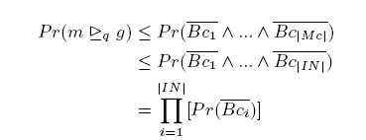
Probabilistic Pattern Graph Matching
Filtering: Probabilistic Pruning
Lemma: Let Bc₁,…,Bc_{|Mc|} be the cuts of m in G^{c}, and Bc1,…,Bc|IN| be the disjoint cuts, then
Many groups of disjoint cuts→ Many upper bounds → Best upper bound → Maximum packing set problem.
Y. Yuan et. al. [CIKM 2014]
102/ 160
Notes:
Now we solve the issue 1—upper bounds. Then explain the principle..

Slide 108
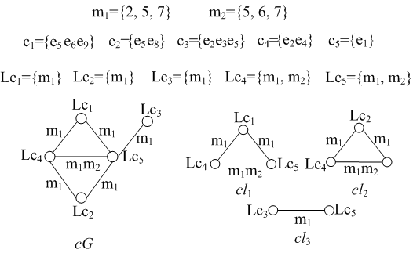
Probabilistic Pattern Graph Matching
Filtering: Probabilistic Pruning
One-by-one algorithm: scan the candidate match set {m₁, m₂,…,m_{k}}, and for m_{i}, if UpperB(m_{i}) ≤ γ, mi can be pruned.
Collective algorithm:
Y. Yuan et. al. [CIKM 2014]
103/ 160
Notes:
Now we solve the issue 1—upper bounds. Then explain the principle..

Slide 109
Tutorial Outline
Data as Uncertain Graphs
Sources of Uncertain Graphs
Application and Challenges of Uncertain Graphs
What is Uncertain
Modeling of Uncertain Graphs
Queries over Uncertain Graphs
Reliability Queries: Reachability, Shortest Path, Nearest Neighbor
Pattern Matching Queries
Similarity-based Search
Influence Maximization
Open Problems
104/ 160

Slide 110
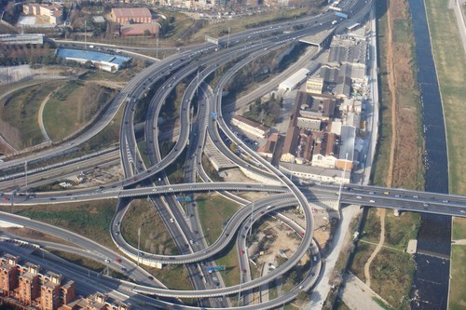
Probabilistic Subgraph Similarity Search
Probabilistic Subgraph Similarity Search
Uncertain graph：
Vertices are deterministic
Edge uncertainty: neighbor edges are corrected
Road Network
Y. Yuan et. al. [VLDB 2012]
105/ 160
Notes:
Just read it...

Slide 111
Probabilistic Subgraph Similarity Search
Probabilistic Subgraph Similarity Search
Possible worlds: combination of all uncertain edges
Y. Yuan et. al. [VLDB 2012]
106/ 160
Notes:
Just read it...

Slide 112
Probabilistic Pattern Graph Matching
Problem Definitions
Given: an uncertain graph database G={g₁,g₂,…,g_{n}}, a query graph q and
probability threshold ε
Query: find all g_{i} ∈G, such that the subgraph similarity probability is
not smaller than ε.
Subgraph similarity probability (SSP):
The SSP between q and gi = the sum of gi’s possible worlds g’ to which q is subgraph similar
q is subgraph similar to g’: the distance between g’ and q is not larger than a distance threshold τ
Subgraph distance between q and g’= |q|-|MCS(q,g)| where MCS(q,g) is the maximum common subgraph of q and g’.
Y. Yuan et. al. [VLDB 2012]
107/ 160
Notes:
Just read it...

Slide 113
Probabilistic Subgraph Similarity Search
Problem Definitions
Subgraph similar probability (SSP)
g
q
+
……
+
+
= 0.45
It is #P-complete to calculate SSP
Y. Yuan et. al. [VLDB 2012]
Notes:
Just read it...

Slide 114
Probabilistic Subgraph Similarity Search
Probabilistic Subgraph Similarity Query Processing Framework
Naïve method：sequence scan D, and decide if the SSP between q and gi is not smaller than threshold ε.
g1 subgraph isomorphic to g2 : NP-Complete
the distance between g1 and g2 : NP-Complete
Calculating SSP: #P-Complete
Naïve method: very costly, infeasible！
Y. Yuan et. al. [VLDB 2012]
109/ 160
Notes:
A naïve method is ... (just read it). In the naïve approach, we are inloved with graph isomorphic problems (just read the two) and hard problem of computing SIP.
Therefore, naïve method is very costly and infeasible！

Slide 115
Probabilistic Subgraph Similarity Search
A Filtering-and-Verification Query Processing Framework
{g₁,g₂,..,g_{n}}
{g’₁,g’₂,..,g’_{l}}
{g’’₁,g’’₂,..,g’’_{m}}
Structure pruning
Prob. pruning
(two rules)
Candidates
Query q
{g”’₁,g”’₂,..,g’”_{k}}
Answers
Verification
Y. Yuan et. al. [VLDB 2012]
110/ 160
Notes:
Our query processing framework consists of three steps, namely structural pruning, probabilistic pruning and verification.

Slide 116
Probabilistic Subgraph Similarity Search
Filtering: Structural Pruning
Principle: if we remove all the uncertainty from g, and the resulting graph is still not subgraph similar to q, then the original uncertain graph cannot approximately contain q.
g
q
Theorem: if q⊄simgc，then Pr(q⊆_{sim}g)=0
Y. Yuan et. al. [VLDB 2012]
111/ 160
Notes:
Just read the principle...

Slide 117
Probabilistic Subgraph Similarity Search
Filtering: Probabilistic Pruning
Probabilistic index: Each column of the matrix corresponds to an uncertain graph, and each row corresponds to an indexed feature. The entry gives the upper and lower bounds of the subgraph isomorphism probability (SIP) of feature f to g.
Y. Yuan et. al. [VLDB 2012]
112/ 160
Notes:
Just read it...

Slide 118
Probabilistic Subgraph Similarity Search
Filtering: Probabilistic Pruning
let U={rq₁,…,rq_{a}} be a graph set after q relaxing τ edges. For each rq_{i}, in the index, we find a graph feature f_{i}¹ such that f_{i}¹⊇rq_{i}.
Rule 1：If U_{sim}=UpperB(Pr(q ⊆_{sim} g))=UpperB(f_{i}¹) +…+ UpperB(f_{a}¹) < ε，then g is pruned.
g
q
U _{sim} =0.4+0.1=0.5
Y. Yuan et. al. [VLDB 2012]
113/ 160
Notes:
Just read the princple.
In the example, we relax 1 edge, then the remaning set is rq1, rq2 and rq3. We add the upper bounds of SIP 0.4+0.1=0.5.

Slide 119
Probabilistic Subgraph Similarity Search
Filtering: Probabilistic Pruning
let U={rq₁,…,rq_{a}} be a graph set after q relaxing τ edges. For each rq_{i}, we find two graph features (f_{i}¹, f_{i}²) such that f_{i}¹ ⊇rq_{i} and rq_{i} ⊆ f_{i}²
Rule 2：If L_{sim}=LowerB(Pr(q ⊆_{sim} g))=Σ₁ªLowerB(f_{i}²)–Σ_{1≤i,j≤a} UpperB(f_{i}²) UpperB(f_{j}²) >ε，then g is an answer.
L_{sim}=0.28+0.09-0.36*0.15=0.31
Y. Yuan et. al. [VLDB 2012]
114/ 160
Notes:
Just read the principle.
In the example, we relax 1 edge, then the remaining set is rq1, rq2 and rq3. Based on rule 2, We get the bound of SSP 0.31.

Slide 120
Probabilistic Subgraph Similarity Search
Tightest Upper Bound of SSP
If there are 10 features and 10 graphs after relaxation, we get 10¹⁰ U_{sim}
Solution: converting it into the set cover problem
U _{sim} =(0.4+0.1=0.5) or (0.1+0.5=0.6) or (0.4+0.5=0.9)
Y. Yuan et. al. [VLDB 2012]
115/ 160
Notes:
In pruning rule, we only need one pair (f1, f2), but there are a lot of such pairs in the index.. so we can get huge number of upper bounds. We want the tightest one to increase the pruning power.
In the example, based on rule1, we can obtain 0.5, 0.6 and 0.9 upper bounds. We select the smallest one 0.5.
原理：
We solve this by transforming into set cover problem: Given a set U = {rq1,rq2, rq3} and 3 features, we compute a collection S = {s1, s2 , s3} such that f_j ⊆ rq for each s_j, and attach each s_j a weight w_{s_j}=UpperB(f_i) , we want to compute a subsect C ⊆ S to minimize Σs_j∈C w(sj) s.t. ∪sj∈C sj =U. The minimization is the tightest upper bound
In the example, we relax 1 edge, then the remaning set is rq1, rq2 and rq3. We add the upper bounds of SIP 0.4+0.1=0.5.

Slide 121
Probabilistic Subgraph Similarity Search
Tightest Lower Bound of SSP
Solution: Converting it into the quadratic programming
Y. Yuan et. al. [VLDB 2012]
116/ 160
Notes:
We solve the tightest lower bound by transforming into the quadratic programming :
In the example, based on rule2, we can obtain lower bounds, 0.31, 0.41…. We select the largest one 0.41.
原理：
Given a set U = {rq1,rq2, rq3} and 2 features, we compute a collection S = {s1, s2} such that rq ⊆ f_j for each s_j, and attach each s_j a weight {(w{s_1) w(s_2),}={UpperB(f_j), LowerB(f_j)} we want to compute a subsect C ⊆ S to to maximize Σs_j∈C w(sj)-Σw(sj) w(si) s.t. ∪sj∈C sj =U. The maximization is the tightest upper bound

Slide 122
Tutorial Outline
Data as Uncertain Graphs
Sources of Uncertain Graphs
Application and Challenges of Uncertain Graphs
What is Uncertain
Modeling of Uncertain Graphs
Queries over Uncertain Graphs
Reliability Queries: Reachability, Shortest Path, Nearest Neighbor
Pattern Matching Queries
Similarity-based Search
Influence Maximization
Open Problems
117/ 160

Slide 123





Information Diffusion in Social Networks
2008 U.S. Presidential Election
Emergencies such as Hurricanes Ike and Gustav in 2008
Demonstration in Egypt, 2011
Death of Michael Jackson in 2009
0.3
0.2
0.7
0.6
0.6
0.4
118/ 160

Slide 124


Influence Maximization in Social Networks
Find a small subset of influential individuals in a social network, such that they can influence the largest number of people in the network
0.6
0.7
0.8
0.9
0.8
0.4
Viral Marketing
119/ 160

Slide 125
Influence Maximization in Social Networks
Find a small subset of influential individuals in a social network, such that they can influence the largest number of people in the network
0.6
0.7
0.8
0.9
0.8
0.4
Viral Marketing
120/ 160

Slide 126
Influence Maximization in Social Networks
Find a small subset of influential individuals in a social network, such that they can influence the largest number of people in the network
0.6
0.7
0.8
0.9
0.8
0.4
Viral Marketing
121/ 160

Slide 127
Influence Maximization in Social Networks
Find a small subset of influential individuals in a social network, such that they can influence the largest number of people in the network
0.6
0.7
0.8
0.9
0.8
0.4
Viral Marketing
122/ 160

Slide 128
Related Tutorials
Information and Influence Spread in Social Networks – Motivation, Applications, Challenges, Data, and Tools for Information diffusion and Influence Maximization [Castillo et. al., KDD 2012]
Information Diffusion In Social Networks: Observing and Affecting What The Society Cares About – Effect on Network Structure on Information Diffusion [Agrawal et. al., CIKM 2011]
Information Diffusion In Social Networks: Observing and Influencing Societal Interests – Various Information Diffusion Models [Agrawal et. al., VLDB 2011]
123/ 160

Slide 129
Our Roadmap …
Influence Maximization Problem and its Variations
Influence Maximization Problem
Targeted Influence Maximization
Maximizing Product Adoption
Topic-Aware Influence Maximization
Preventing the Spread of an Existing Negative Campaign
Competitive Influence Maximization
Influence Maximization by Social Network Host
Complementary Influence Maximization
124/ 160

Slide 130
Influence Maximization Problem
The first influence maximization problem: Markov random fields formulation [Domingos et. al., KDD 2001]
[Kempe et. al., KDD 2003]
Social network G = (V, E, p)
Seed set 𝑺: initial set of nodes influenced directly by the campaigner
Influence cascade: Nodes are influenced starting from the seed nodes, in discrete steps and following certain probabilistic influence cascading model
Influence spread: Number of influenced nodes when the cascading process starting from the seed set 𝑆 ends
The Problem: Given a user-defined budget K, find the top-K seed nodes that maximize the expected influence spread
Influence Maximization with Discrete Diffusion Model
125/ 160

Slide 131

Influence Cascading Models
Independent cascade (IC) model, Linear threshold (LT) model [Kempe et. al., KDD 2003]
IC Model
0.5
0.6
0.3
0.8
0.4
0.6
1.0
0.7
0.2
0.7
0.2
126/ 160

Slide 132
Influence Cascading Models
Independent cascade (IC) model, Linear threshold (LT) model [Kempe et. al., KDD 2003]
IC Model
0.5
0.6
0.3
0.8
0.4
0.6
1.0
0.7
0.2
0.7
0.2
127/ 160

Slide 133
Influence Cascading Models
Independent cascade (IC) model, Linear threshold (LT) model [Kempe et. al., KDD 2003]
IC Model
0.5
0.6
0.3
0.8
0.4
0.6
1.0
0.7
0.2
0.7
0.2
128/ 160

Slide 134
Influence Cascading Models
Independent cascade (IC) model, Linear threshold (LT) model [Kempe et. al., KDD 2003]
IC Model
0.5
0.6
0.3
0.8
0.4
0.6
1.0
0.7
0.2
0.7
0.2
129/ 160

Slide 135
Influence Cascading Models
Independent cascade (IC) model, Linear threshold (LT) model [Kempe et. al., KDD 2003]
LT Model
0.5
0.3
0.9
0.1
0.7
0.4
0.2
0.1
0.1
0.2
0.7
0.4
0.3
0.2
0.3
0.5
0.1
130/ 160

Slide 136
Influence Cascading Models
Independent cascade (IC) model, Linear threshold (LT) model [Kempe et. al., KDD 2003]
LT Model
0.5
0.3
0.9
0.1
0.7
0.4
0.2
0.1
0.1
0.2
0.7
0.4
0.3
0.2
0.3
0.5
0.1
131/ 160

Slide 137
Influence Cascading Models
Independent cascade (IC) model, Linear threshold (LT) model [Kempe et. al., KDD 2003]
LT Model
0.5
0.3
0.9
0.1
0.7
0.4
0.2
0.1
0.1
0.2
0.7
0.4
0.3
0.2
0.3
0.5
0.1
132/ 160

Slide 138
Influence Cascading Models
Independent cascade (IC) model, Linear threshold (LT) model [Kempe et. al., KDD 2003]
LT Model
0.5
0.3
0.9
0.1
0.7
0.4
0.2
0.1
0.1
0.2
0.7
0.4
0.3
0.2
0.3
0.5
0.1
133/ 160

Slide 139
Influence Cascading Models
Independent cascade (IC) model, Linear threshold (LT) model [Kempe et. al., KDD 2003]
LT Model
0.5
0.3
0.9
0.1
0.7
0.4
0.2
0.1
0.1
0.2
0.7
0.4
0.3
0.2
0.3
0.5
0.1
134/ 160

Slide 140
Influence Maximization: Complexity and Approximation Algorithm
Influence maximization under both IC and LT models is NP-hard
Expected influence spread is sub-modular and increases monotonically with inclusion of seed nodes
Iterative hill-climbing algorithm produces solution with approximation guarantee:
Iterative hill-climbing algorithm:
Time Complexity:
Kempe et. al. [KDD 2003]
135/ 160

Slide 141
More on Influence Maximization
Scalable Influence Maximization
[Castillo et. al., KDD 2012]
Exact Methods (CELF, CELF++, TIM, …)
Heuristic Methods (MIA, Community-based approach, Sparsification, Degree Discount IC, …)
Other Information Diffusion Models
[Agrawal et. al., VLDB 2011]
General Threshold Model
Susceptible-Infected-Removed Model
Continuous-Time Diffusion
………
136/ 160

Slide 142

Targeted Influence Maximization
A campaigner often promotes her product with a group of target customers in mind
Target marketing by maximizing the influence over a region of the social network
k-effectors — identify k seed nodes such that a given activation pattern can be established
[Aggarwal et. al., SDM 2011, Li et. al., SocialCom 2011]
[Lappas. al., KDD 2010]
137/ 160

Slide 143
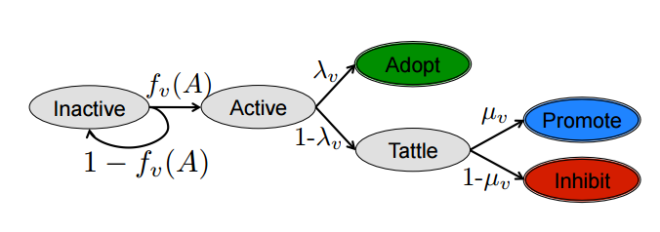
Maximizing Product Adoption
Influence ≠ Adoption
Conformity-Aware Influence Maximization
U
+
[Li et. al., VLDB J. 2015]
-
If both U and V adopted, the probability that T will also adopt is:
V
T
Signed Network: Each User has a Influence index and a Conformity Index
LT-C Model
[Bhagat et. al., WSDM 2012]

Slide 144
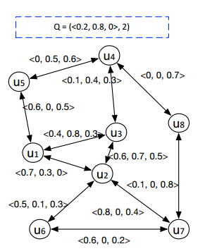
Topic-Aware Influence Maximization
Topic-aware Social Influence Propagation Models [Barbieri et. al., ICDM 2012]
Online Topic-aware Influence Maximization Queries [Aslay et. al., EDBT 2014]
Online Topic-Aware Influence Maximization [Chen et. al., VLDB 2015]
Topic-aware Influence Maximization
[Chen et. al., VLDB 2015]
139/ 160

Slide 145
Competitive and Complementary Influence Maximization
Competitive Influence Maximization
Preventing the spread of an existing negative campaign
[Bharathi et. al., WINE 2007]
[Borodin et. al., WINE 2007]
[Budak et. al., WWW 2011]
Non-cooperative campaigns who select seeds alternatively
[Fazeli et. al., CDC 2012]
[Tzoumas et. al., WINE 2012]
Competing campaigners promote their products at the same time (e.g., Nintendo’s Wii vs. Sony’s Playstation vs. Microsoft’s X-Box)
[Li et. al., SIGMOD 2015]
Complementary Influence Maximization
iPhone 6 and Apple Watch are complementary products
[Lu et. al., VLDB 2016]
140/ 160

Slide 146
Influence Maximization as a Service: Social Network Host’s Perspective
Challenges for Campaigners
Social Network graph is hidden by the host of the social network (e.g., Facebook, Twitter, LinkedIn)
A campaigner (e.g., AT&T, Sony, Microsoft, Samsung) is unable to identify the top-k seed sets for maximizing her campaign
Challenges for Hosts
Social network host sells influence maximization service to its client campaigners
How does the host select the seed nodes for each of its client campaigners so that the spread of each campaign remains balanced?
Lu et. al. [KDD 2013]
141/ 160

Slide 147
Open Problems
Finding one good possible world instead of sampling
Trade-off between accuracy vs. efficiency
Semantics of classical graph queries over uncertain graphs, e.g., centrality, partitioning, summarization, visualization
System design issues for uncertain graphs processing
Availability of benchmark datasets, ground-truths, and query results
142/ 160

Slide 148
Open Problem: One Good Possible World
Find one deterministic representative instance that maintains the underlying graph properties
0.51
+ 0.97
- 0.01
S
W
S
W
0.52
0.50
- 0.50
U
V
+ 0.48
U
V
Uncertain Graph
One Possible Graph
(Discrepancy in Degree Distribution)
Representative instance for more complex graph properties – Reachability, Subgraph containment ?
Parchas et. al. [SIGMOD 2013]
143/ 160

Slide 149
Open Problem: Accuracy vs. Efficiency
Parameters controlling accuracy vs. efficiency, false positive vs. false negative rates
Reliable Set Computation
0.7
S
W
0.6
0.7
Most probable path provides a lower bound of reliability
U
T
0.8
Actual Reliable Set of S with threshold 0.5 = {W,U,T}
Reliable Set via Most Probable Path = {W,U}
No false positive; but can have false negatives
Khan et. al. [EDBT 2014]
144/ 160

Slide 150
Open Problem: Semantics of Classical Queries over Uncertain Graphs
Centrality over uncertain graphs – influential nodes are one type of central nodes
[Pfeiffer et. al., Purdue Tech. Report 2011]
Partition an uncertain graph
Uncertain graph summarization
[Hassanlou et. al., WAIM 2011]
Uncertain graph visualization
[Cesario et. al., SPIE 2011]
145/ 160

Slide 151
Open Problem: System Issues
Are uncertain databases (DeepDive, BayesStore, PrDB) good for processing uncertain graphs?
Should graph databases (Neo4J, OrientDB) support uncertainty?
146/ 160

Slide 152
Open Problem: Benchmark Datasets, Ground-Truths
Benchmark datasets
Open-source software
Ground-truths – how to measure the effectiveness of influence maximization algorithms in real-world?
[Castillo et. al., KDD 2012]
147/ 160

Slide 153
Questions?

Slide 154
References - 1
[1] E. Adar and C. Re. Managing Uncertainty in Social Networks. IEEE Data Eng. Bull., 30(2):15–22, 2007.
[2] C. C. Aggarwal. Managing and Mining Uncertain Data. Springer, 2009.
[3] C. C. Aggarwal, A. Khan, and X. Yan. On Flow Authority Discovery in Social Networks. In SDM, 2011.
[4] K. K. Aggarwal, K. B. Misra, and J. S. Gupta. Reliability Evaluation A Comparative Study of Different Techniques. Micro. Rel., 1975.
[5] S. Auer, C. Bizer, G. Kobilarov, J. Lehmann, R. Cyganiak, and Z. Ives. DBpedia: A Nucleus for a Web of Open Data. In ISWC, 2007.
[6] N. Barbieri, F. Bonchi, and G. Manco. Topic-Aware Social Influence Propagation Models. In ICDM, 2012.
[7] S. Bharathi, D. Kempe, and M. Salek. Competitive Influence Maximization in Social Networks. In WINE, 2007.
[8] P. Boldi, F. Bonchi, A. Gionis, and T. Tassa. Injecting Uncertainty in Graphs for Identity Obfuscation. PVLDB, 2012.
[9] K. Bollacker, C. Evans, P. Paritosh, T. Sturge, and J. Taylor. Freebase: A Collaboratively Created Graph Database for Structuring Human Knowledge. In SIGMOD, 2008.
[10] C. Borgs, M. Brautbar, J. T. Chayes, and B. Lucier. Maximizing Social Influence in Nearly Optimal Time. In SODA, 2014.

Slide 155
References - 2
[11] C. Budak, D. Agrawal, and A. E. Abbadi. Limiting the Spread of Misinformation in Social Networks. In WWW, 2011.
[12] C. Castillo, W. Chen, and L. V. S. Lakshmanan. Information and Influence Spread in Social Networks. In KDD, 2012.
[13] L. Chen and X. Lian. Query Processing over Uncertain and Probabilistic Databases. In DASFAA, 2012.
[14] L. Chen and C. Wang. Continuous Subgraph Pattern Search over Certain and Uncertain Graph Streams. IEEE TKDE, 22(8):1093–1109, 2010.
[15] W. Chen, C. Wang, and Y. Wang. Scalable Influence Maximization for Prevalent Viral Marketing in Large-Scale Social Networks. In KDD, 2010.
[16] Y. Chen and D. Z. Wang. Knowledge Expansion over Probabilistic Knowledge Bases. In SIGMOD, 2014.
[17] J. B. Collins and S. T. Smith. Network Discovery For Uncertain Graphs. In Fusion, 2014.
[18] P. Cudre-Mauroux and S. Elnikety. Graph Data Management Systems for New Application Domains. In VLDB, 2011.
[19] P. Domingos and M. Richardson. Mining the Network Value Customers. In KDD, 2001.
[20] G. S. Fishman. A Comparison of Four Monte Carlo Methods for Estimating the Probability of s-t Connectedness. IEEE Tran. Rel., 1986.

Slide 156
References - 3
[21] L. Foschini, J. Hershberger, and S. Suri. On the Complexity of Time-Dependent Shortest Paths. In SODA, 2011.
[22] J. Ghosh, H. Q. Ngo, S. Yoon, and C. Qiao. On a Routing Problem Within Probabilistic Graphs and its Application to Intermittently Connected Networks. In INFOCOM, 2007.
[23] A. Goyal, F. Bonchi, and L. V. S. Lakshmanan. A Data-Based Approach to Social Influence Maximization. PVLDB, 5(1):73–84, 2011.
[24] A. Goyal, W. Lu, and L. V. S. Lakshmanan. CELF++: Optimizing the Greedy Algorithm for Influence Maximization in Social Networks. In WWW, 2011.
[25] M. Han, K. Daudjee, K. Ammar, M. T. ¨Ozsu, X. Wang, and T. Jin. An Experimental Comparison of Pregel-like Graph Processing Systems. PVLDB, 7(12):1047–1058, 2014.
[26] G. Hardy, C. Lucet, and N. Limnios. K-Terminal Network Reliability Measures With Binary Decision Diagrams. IEEE Tran. Rel., 2007.
[27] M. Hua and J. Pei. Probabilistic Path Queries in Road Networks: Traffic Uncertainty aware Path Selection. In EDBT, 2010.
[28] H. Huang and C. Liu. Query Evaluation on Probabilistic RDF Databases. In WISE, 2009.
[29] R. Jin, L. Liu, B. Ding, and H. Wang. Distance-Constraint Reachability Computation in Uncertain Graphs. PVLDB, 4(9):551–562, 2011.
[30] R. Jin, L. Liu, B. Ding, and H. Wang. Distance-Constraint Reachability Computation in Uncertain Graphs. PVLDB, 2011.

Slide 157
References - 4
[31] Z. Kaoudi and I. Manolescu. Cloud-based RDF Data Management. In SIGMOD, 2014.
[32] D. Kempe, J. M. Kleinberg, and E. Tardos. Maximizing the Spread of Influence through a Social Network. In KDD, 2003.
[33] A. Khan, F. Bonchi, A. Gionis, and F. Gullo. Fast Reliability Search in Uncertain Graphs. In EDBT, 2014.
[34] A. Khan and S. Elnikety. Systems for Big-Graphs. PVLDB, 7(13):1709–1710, 2014.
[35] A. Khan, Y. Wu, and X. Yan. Emerging Graph Queries in Linked Data. In ICDE, 2012.
[36] E. Kharlamov and P. Senellart. Modeling, Querying, and Mining Uncertain XML Data. In A. Tagarelli, editor, XML Data Mining: Models, Methods, and Applications, pages 29–52. IGI Global,
2011.
[37] J. Kim, S.-K. Kim, and H. Yu. Scalable and Parallelizable Processing of Influence Maximization for Large-Scale Social Networks? In ICDE, 2013.
[38] D. L.-Nowell and J. Kleinberg. The Link Prediction Problem for Social Networks. In CIKM, 2003.
[39] T. Lappas, E. Terzi, D. Gunopulos, and H. Mannila. Finding Effectors in Social Networks. In KDD, 2010.
[40] J. Leskovec, A. Krause, C. Guestrin, C. Faloutsos, J. VanBriesen, and N. Glance. Cost-effective Outbreak Detection in Networks. In KDD, 2007.

Slide 158
References - 5
[41] F.-H. Li, C.-T. Li, and M.-K. Shan. Labeled Influence Maximization in Social Networks for Target Marketing. In SocialCom/PASSAT, 2011.
[42] J. Li. Algorithms for Mining Uncertain Graph Data. In KDD, 2012.
[43] R.-H. Li, J. X. Yu, R. Mao, and T. Jin. Efficient and Accurate Query Evaluation on Uncertain Graphs via Recursive Stratified Sampling. In ICDE, 2014.
[44] X. Lian and L. Chen. Efficient Query Answering in Probabilistic RDF Graphs. In SIGMOD, 2011.
[45] J. C. Liu, X. Q. Shang, Y. Meng, and M. Wang. Mining Maximal Dense Subgraphs in Uncertain PPI Network. Applied Mechanics and Materials, 135:609–615, 2011.
[46] W. E. Moustafa, A. Kimmig, A. Deshpande, and L. Getoor. Subgraph Pattern Matching over Uncertain Graphs with Identity Linkage Uncertainty. In ICDE, 2014.
[47] P. Parchas, F. Gullo, D. Papadias, and F. Bonchi. The Pursuit of a Good Possible World: Extracting Representative Instances of Uncertain Graphs. In SIGMOD, 2014.
[48] J. Pei, M. Hua, Y. Tao, and X. Lin. Query Answering Techniques on Uncertain and Probabilistic Data: Tutorial Summary. In SIGMO, 2008.
[49] M. Potamias, F. Bonchi, A. Gionis, and G. Kollios. k-Nearest Neighbors in Uncertain Graphs. PVLDB, 2010.
[50] M. Renz, R. Cheng, H.-P. Kriegel, A. Zufle, and T. Bernecker. Similarity Search and Mining in Uncertain Databases. PVLDB, 3(2):1653–1654, 2010.

Slide 159
References - 6
[51] P. Sevon, L. Eronen, P. Hintsanen, K. Kulovesi, and H. Toivonen. Link Discovery in Graphs Derived from Biological Databases. In DILS, 2006.
[52] A. Sharafat and O. Ma’rouzi. All-Terminal Network Reliability Using Recursive Truncation Algorithm. IEEE Tran. on Rel., 2009.
[53] D. Suciu, D. Olteanu, R. Christopher, and C. Koch. Probabilistic Databases. 2011.
[54] Y. Tang, X. Xiao, and Y. Shi. Influence Maximization: Near-Optimal Time Complexity Meets Practical Efficiency. In SIGMOD, 2014.
[55] L. G. Valiant. The Complexity of Enumeration and Reliability Problems. SIAM J. on Computing, 1979.
[56] J. Wang, T. Kraska, M. J. Franklin, and J. Feng. CrowdER: Crowdsourcing Entity Resolution. In VLDB, 2012.
[57] Y. Yuan, L. Chen, and G. Wang. Efficiently Answering Probability Threshold-Based Shortest Path Queries over Uncertain Graphs. In DASFAA, 2010.
[58] Y. Yuan, G. Wang, and L. Chen. Pattern Match Query in a Large Uncertain Graph. In CIKM, 2014.
[59] Y. Yuan, G. Wang, L. Chen, and H. Wang. Efficient Subgraph Similarity Search on Large Probabilistic Graph Databases. In VLDB, 2012.
[60] Y. Yuan, G. Wang, H. Wang, and L. Chen. Efficient Subgraph Search over Large Uncertain Graphs. PVLDB, 4(11), 2011.

Slide 160
References - 7
[61] H. Zhou, A. A. Shaverdian, H. V. Jagadish, and G. Michailidis. Querying Graphs with Uncertain Predicates. In MLG, 2010.
[62] K. Zhu, W. Zhang, G. Zhu, Y. Zhang, and X. Lin. BMC: An Efficient Method to Evaluate Probabilistic Reachability Queries. In DASFAA, 2011.
[63] Z. Zou, H. Gao, and J. Li. Discovering Frequent Subgraphs over Uncertain Graph Databases under Probabilistic Semantics. In KDD, 2010.
[64] Z. Zou, J. Li, H. Gao, and S. Zhang. Frequent Subgraph Pattern Mining on Uncertain Graph Data. In CIKM, 2009.
[65] Z. Zou, J. Li, H. Gao, and S. Zhang. Mining Frequent Subgraph Patterns from Uncertain Graph Data. IEEE Trans. Knowl. Data Eng., 22(9):1603–1218, 2010.
[66] Y. Tong, X. Zhang, C. Cao and L. Chen. Efficient Probabilistic Supergraph Search over Large Uncertain Graphs. In CIKM, 2014.

