Slide 1
Revenue Maximization by Viral Marketing: A Social Network Host’s Perspective
Arijit Khan
Nanyang Technological University
Singapore
Benjamin Zehnder Donald Kossmann
ETH Zurich Microsoft Research
Switzerland Redmond, USA

Slide 2


Viral Marketing in Social Networks
A. Khan, B. Zehnder, D. Kossmann
1/20

Slide 3

Viral Marketing in Social Networks
Find a small subset of influential individuals in a social network, such that they can influence the largest number of people in the network. [Domingos et. al. KDD 2001, Kempe et. al. KDD 2003]
A. Khan, B. Zehnder, D. Kossmann
1/20

Slide 4







Viral Marketing in Social Networks
Find a small subset of influential individuals in a social network, such that they can influence the largest number of people in the network. [Domingos et. al. KDD 2001, Kempe et. al. KDD 2003]
A. Khan, B. Zehnder, D. Kossmann

Slide 5


Viral Marketing as a Service
Challenges for Campaigners
Social network graph is hidden by the host of the social network (e.g., Facebook, Twitter, LinkedIn)
A campaigner (e.g., AT&T, Sony, Microsoft, Samsung) is unable to identify the top-k seed sets for maximizing her campaign
A. Khan, B. Zehnder, D. Kossmann
2/20

Slide 6
Viral Marketing as a Service
Challenges for Campaigners
Social network graph is hidden by the host of the social network (e.g., Facebook, Twitter, LinkedIn)
A campaigner (e.g., AT&T, Sony, Microsoft, Samsung) is unable to identify the top-k seed sets for maximizing her campaign
Social network host sells viral marketing campaigns – selects seed nodes for its client campaigners.
[Lu et. al., KDD 2013]
2/20

Slide 7
Viral Marketing as a Service
Challenges for Social Network Host
multiple companies compete and they launch comparable products around the same time
e.g., Microsoft’s Surface vs. Apple’s iPad vs. Samsung Note 3
Host needs to run multiple competing viral marketing campaigns together.
3/20

Slide 8
Viral Marketing as a Service
Constraints
Each campaigner spends her budget in two parts:
- (a) her budget on the seed-
set size (i.e., the number of
seed users, k),
- (b) how much money she is
willing to pay to the host for
each of her target users if
that user adopts her product.
An average user will purchase only one of the competing products ➔ seed sets are mutually exclusive.
4/20

Slide 9


Our Problem: Host’s Revenue Maximization
A. Khan, B. Zehnder, D. Kossmann
5/20

Slide 10
Our Problem: Host’s Revenue Maximization
How the campaigner selects the seed set for each of her client campaigner so that the host’s expected revenue is maximized?
5/20

Slide 11
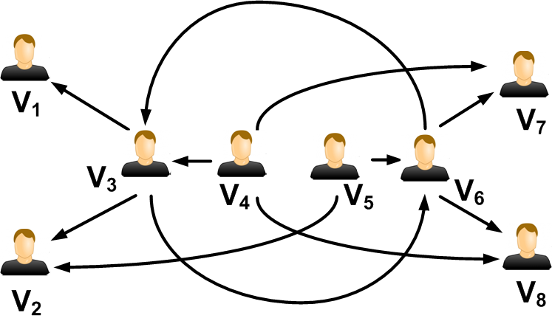
Why Classical Viral Marketing May Not Work?
[10$, 1$]
[1$, 10$]
[10$, 1$]
[1$, 10$]
[10$, 1$]
[1$, 10$]
[10$, 1$]
[1$, 10$]
Two campaigners C₁, C₂: seed set size for each campaigner is 1
A. Khan, B. Zehnder, D. Kossmann
6/20

Slide 12
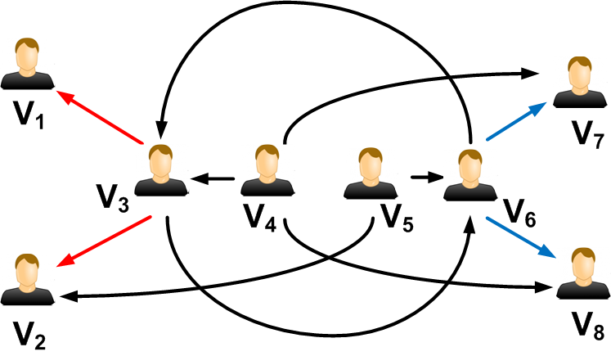
Why Classical Viral Marketing May Not Work?
[10$, 1$]
[1$, 10$]
C₁
C₂
[1$, 10$]
[10$, 1$]
[1$, 10$]
[10$, 1$]
[10$, 1$]
[1$, 10$]
Best Solution: V₃ → C₁, V₆ → C₂ . Host’s total revenue = 60$
A. Khan, B. Zehnder, D. Kossmann
6/20

Slide 13
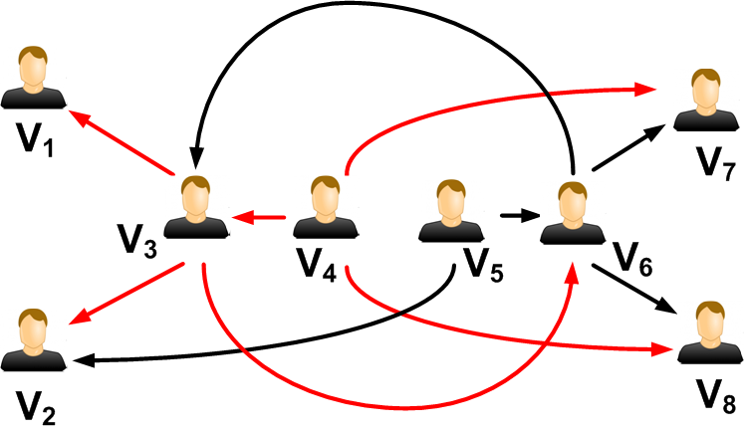
Why Classical Viral Marketing May Not Work?
[10$, 1$]
[1$, 10$]
C₁
[10$, 1$]
[1$, 10$]
[10$, 1$]
[1$, 10$]
[10$, 1$]
[1$, 10$]
Best seed node for C₁ (individually): V₄
Host’s maximum possible revenue from C₁ (individually): 43$
A. Khan, B. Zehnder, D. Kossmann
6/20

Slide 14
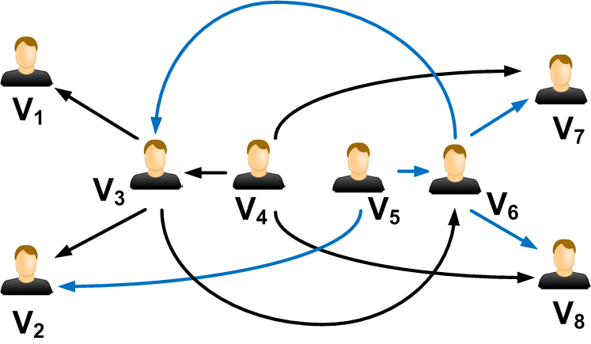
Why Classical Viral Marketing May Not Work?
[10$, 1$]
[1$, 10$]
[10$, 1$]
[1$, 10$]
[10$, 1$]
[1$, 10$]
C₂
[10$, 1$]
[1$, 10$]
Best seed node for C₂ (individually): V₅
Host’s maximum possible revenue from C₂ (individually): 43$
A. Khan, B. Zehnder, D. Kossmann
6/20

Slide 15
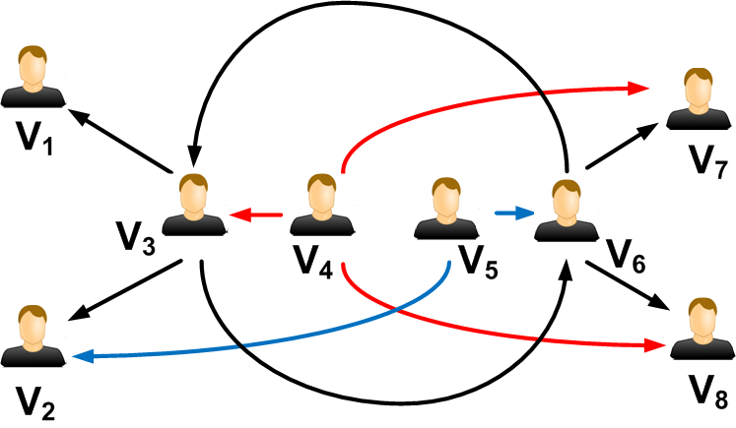
Why Classical Viral Marketing May Not Work?
[10$, 1$]
[1$, 10$]
C₁
C₂
[10$, 1$]
[1$, 10$]
[10$, 1$]
[1$, 10$]
[10$, 1$]
[1$, 10$]
V₄ → C₁, V₅ → C₂ . Host’s total revenue = 44$
Suboptimal Solution!
6/20

Slide 16

Roadmap
Motivation
Related Work
Influence Diffusion Models
Approximate Algorithms
Greedy Heuristics
Experimental Results
Conclusion
A. Khan, B. Zehnder, D. Kossmann
7/20

Slide 17
Related Work
Influence Maximization
Domingos et. al. KDD 2001
Kempe et. al. KDD 2003
Competitive Viral Marketing
Preventing the spread of an existing negative campaign
[Bharathi et. al., WINE 2007] [Borodin et. al., WINE 2007]
Non-cooperative campaigns who select seeds alternatively
[Fazeli et. al., CDC 2012] [Tzoumas et. al., WINE 2012]
Competing campaigners promote their products at the same time
[Li et. al., SIGMOD 2015]
Viral Marketing by Social Network Host
Lu et. al. KDD 2013
8/20

Slide 18
Related Work
Influence Maximization
Domingos et. al. KDD 2001
Kempe et. al. KDD 2003
Competitive Viral Marketing
Host’s revenue maximization by viral marketing is a novel problem.
Preventing the spread of an existing negative campaign
[Bharathi et. al., WINE 2007] [Borodin et. al., WINE 2007]
Non-cooperative campaigns who select seeds alternatively
[Fazeli et. al., CDC 2012] [Tzoumas et. al., WINE 2012]
Competing campaigners promote their products at the same time
[Li et. al., SIGMOD 2015]
Viral Marketing by Social Network Host
Lu et. al. KDD 2013
A. Khan, B. Zehnder, D. Kossmann
8/20

Slide 19
Influence Diffusion Models
Multi-Campaigner Independent Cascade Model (MCIC)
Budak et. al. [WWW 2011]
Similar to Single-Campaigner IC model
When node u first becomes active with campaign of C_{i}, it gets a single chance to activate each of its currently inactive out-neighbors v with campaign of C_{i} .It succeeds with probability p(u,v).
An activated node v adopts one campaign uniform at random from all its in-neighbors which were successfully activated in the last round.
Each node can be activated only once and by only one of the campaigns; also the node stays activated with that campaign until the end
A. Khan, B. Zehnder, D. Kossmann
9/20

Slide 20
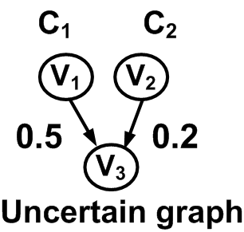
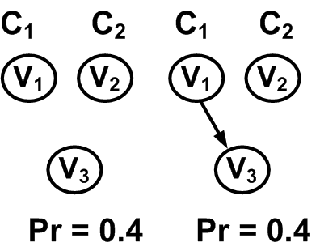
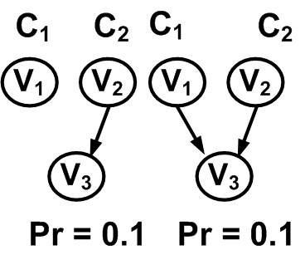
Influence Diffusion Models
Multi-Campaigner Independent Cascade Model (MCIC)
Budak et. al. [WWW 2011]
Similar to Single-Campaigner IC model
All Possible Worlds
Pr(v₃, C₁) = 0.4 + ½ (0.1) = 0.45
Pr(v₃, C₂) = 0.1 + ½ (0.1) = 0.15
A. Khan, B. Zehnder, D. Kossmann
9/20

Slide 21
Influence Diffusion Models
Multi-Campaigner Independent Cascade Model (MCIC)
Budak et. al. [WWW 2011]
Similar to Single-Campaigner IC model
All Possible Worlds
People adopt a product when they come in direct contact with their friends who very recently adopted that product.
Pr(v₃, C₁) = 0.4 + ½ (0.1) = 0.45
Pr(v₃, C₂) = 0.1 + ½ (0.1) = 0.15
9/20

Slide 22
Influence Diffusion Models
Multi-Campaigner Linear Threshold Model (K-LT)
Lu et. al. [KDD 2013]
Similar to Single-Campaigner LT model
If the sum of the probabilities of the incoming edges from all active nodes is greater than or equal to the activation threshold of an inactive node, then the node gets activated in the next round
Let us consider all nodes u that were activated in the last round and contributed to the activation of a node v in the current round. Then, v will adopt the same campaign as that of u with probability p(u,v)/ ∑_{u} p(u,v)
Each node can be activated only once and by only one of the campaigns; also the node stays activated with that campaign until the end
A. Khan, B. Zehnder, D. Kossmann
10/20

Slide 23
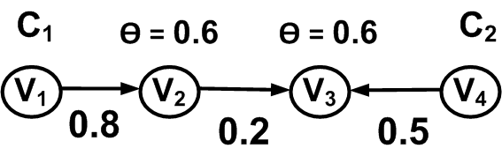
Influence Diffusion Models
Multi-Campaigner Linear Threshold Model (K-LT)
Lu et. al. [KDD 2013]
Similar to Single-Campaigner LT model
Time step t₁: v₂ becomes active with C₁
Time step t₂: v₃ becomes active also with C₁
A. Khan, B. Zehnder, D. Kossmann
10/20

Slide 24
Influence Diffusion Models
Multi-Campaigner Linear Threshold Model (K-LT)
Lu et. al. [KDD 2013]
Similar to Single-Campaigner LT model
Time step t₁: v₂ becomes active with C₁
Time step t₂: v₃ becomes active also with C₁
A user adopts a technology only when more than a threshold number of her neighbors adopted a similar technology. However, once the user decides to adopt, she selects the specific product only based on her neighbors who most recently adopted it.
10/20

Slide 25
Our Contribution: Complexity Results
Host’s revenue maximization problem is NP-hard under MCIC and K-LT models.
Host’s revenue maximization problem is neither monotonic, nor sub-modular under MCIC and K-LT models.
A. Khan, B. Zehnder, D. Kossmann
11/20

Slide 26
Our Contribution: Complexity Results
Host’s revenue maximization problem is NP-hard under MCIC and K-LT models.
Host’s revenue maximization problem is neither monotonic, nor sub-modular under MCIC and K-LT models.
1.0
[3$, 5$]
u
v
[8$, 9$]
Counter-example of monotonicity
C₂ → v, Host’s revenue = 14$
C₂→ v, C₁→ u, Host’s revenue = 12$
C₁ → u, Host’s revenue = 11$
C₁→ u, C₂→ v, Host’s revenue = 12$
A. Khan, B. Zehnder, D. Kossmann

Slide 27
Our Contribution: Theoretical Results
Polynomial-time exact solution over tree dataset under both MCIC and K-LT models
Polynomial-time approximate solution over graph dataset under K- LT model*, and theoretical performance guarantee:
* with an additional constraint that each campaigner has the same number of seed nodes. Here, m is the number of campaigners.
A. Khan, B. Zehnder, D. Kossmann
12/20

Slide 28
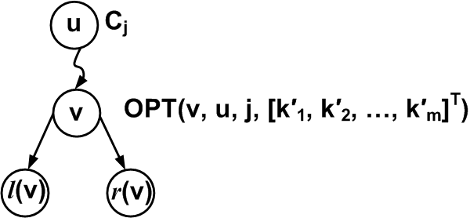

Algorithm: MCIC Model [RevMax-C]
Exact Algorithm over Tree Dataset
Dynamic programming over
binary tree
A. Khan, B. Zehnder, D. Kossmann
13/20

Slide 29
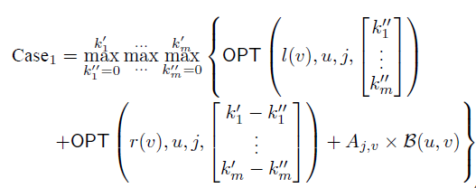
Algorithm: MCIC Model [RevMax-C]
Exact Algorithm over Tree Dataset
Dynamic programming over
binary tree
13/20

Slide 30
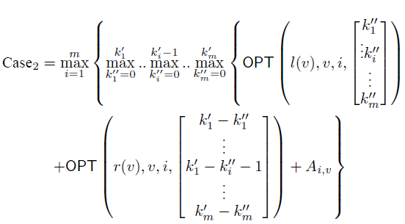
Algorithm: MCIC Model [RevMax-C]
Exact Algorithm over Tree Dataset
Dynamic programming over
binary tree

Slide 31
Algorithm: MCIC Model [RevMax-C]
Exact Algorithm over Tree Dataset
Dynamic programming over
binary tree
Time Complexity: O(ndm²k^{2m})
n = no of nodes
d = depth of tree
m = no of campaigners
k = seed nodes per campaigner
13/20

Slide 32
Algorithm: MCIC Model [RevMax-C]
Heuristic Algorithm over Graph Dataset
Find most influential tree from graph dataset
Convert most influential tree to an equivalent binary tree
Apply dynamic algorithm over binary tree
A. Khan, B. Zehnder, D. Kossmann
14/20

Slide 33
Algorithm: K-LT Model [RevMax-C]
Approximate Algorithm over Graph Dataset
Two-step method with overall performance guarantee:
Find km best seed nodes optimistically assuming that there is only one campaigner
Optimally partition the seed nodes among m campaigners
Time Complexity: O(mkn(n+e)t + m²k + mk^{m})
n = no of nodes, e = no of edges
t = no of MC Samples
m = no of campaigners
k = seed nodes per campaigner
15/20

Slide 34
Efficient Heuristic Algorithm [RevMax-S]
Sort the campaigners in descending order of the expected revenue from that campaigner.
Apply classical viral marketing algorithms to find the seed set for each campaigner in order.
Delete already selected seed nodes of previous campaigners before deciding seed nodes for the current campaigner.
Time Complexity: O(mkn(n+e)t )
n = no of nodes, e = no of edges
t = no of MC Samples
m = no of campaigners
k = seed nodes per campaigner
16/20

Slide 35

List of Experiments
Datasets:
Revenue Distribution Models:
- Uniform (U)
- Not Equal (NE)
- Clustering with Low Competition (CLC)
- Clustering with High Competition (CHC)
- Clustering with Not Equal Competition (CNC)
Algorithms (RevMax-C, RevMax-S): host’s expected revenue, running time, and scalability under MCIC and K-LT models
Revenue Improvement Rate (RIR): ratio of the host’s expected revenue obtained from the seed sets identified by RevMax-C (or, RevMax-S) with respect to the host’s revenue obtained from a random seed sets.

Slide 36
List of Experiments
Datasets:
Revenue Distribution Models:
- Uniform (U)
- Not Equal (NE)
- Clustering with Low Competition (CLC)
- Clustering with High Competition (CHC)
- Clustering with Not Equal Competition (CNC)
We vary the number of campaigners and the number of seed nodes per campaigner
Algorithms (RevMax-C, RevMax-S): host’s expected revenue, running time, and scalability under MCIC and K-LT models
Revenue Improvement Rate (RIR): ratio of the host’s expected revenue obtained from the seed sets identified by RevMax-C (or, RevMax-S) with respect to the host’s revenue obtained from a random seed sets.

Slide 37
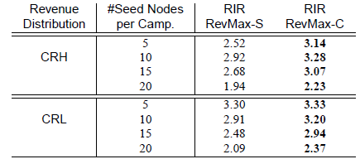
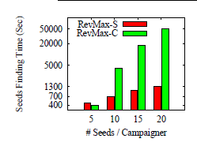
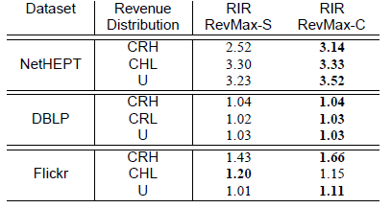
Experimental Results: MCIC Influence Cascade
Efficiency of Seeds Finding
Effectiveness in terms of Host’s Revenue
18/20

Slide 38
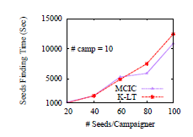
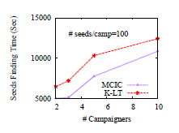
Experimental Results: Scalability of RevMax-S
Varying Number of Seed Nodes
Varying Number of Campaigners
A. Khan, B. Zehnder, D. Kossmann
19/20

Slide 39
Conclusions
Host’s revenue maximization by viral marketing – novel problem
NP-hard, neither monotonic, nor sub-modular
Algorithms
- RevMax-C [approximation guarantees under additional constraints]
- RevMax-S [more efficient greedy heuristic]
RevMax-C usually outperforms RevMax-S by 5~10% in terms of host’s revenue.
RevMax-S scalable for more number of seeds and campaigners
Future Work: more efficient algorithms, how the campaigner divides her budget optimally?
A. Khan, B. Zehnder, D. Kossmann
20/20

Slide 40
Questions?
A. Khan, B. Zehnder, D. Kossmann

