Slide 1

Neighborhood Based Fast Graph Search In Large Networks
Arijit Khan, Nan Li, Xifeng Yan, Ziyu Guan
Computer Science
UC Santa Barbara
{arijitkhan, nanli, xyan, ziyuguan}@cs.ucsb.edu
Supriyo Chakraborty
UC Los Angeles
supriyo@ee.ucla.edu
Shu Tao
IBM TJ Watson
shutao@us.ibm.com

Slide 2
Motivation (RDF Query)
Which actors have appeared in both a “John Waters” movie and a “Steven Spielberg” movie?
SELECT ?actorName WHERE {
?actor <actor/actor_Name> ?actorName.
?director1 <director/director_name> “S. Spielberg”.
?director1Movie <movie/actor> ?actor;
<movie/director> ?director1.
?director2 <director/director_name> “J. Waters”.
?director2Movie <movie/actor> ?actor;
<movie/director> ?director2.
}
Name
Name
Writing of a SPARQL query requires to know how the entities are connected in the graph data.
Actor
Director
act
direct
Movie
Title
ER Diagram
SPARQL Query

Slide 3
RDF QUERY
?
Name
Name
Actor
Director
J. Waters
S. Spielberg
How the entities are connected is less important than how closely they are connected.
Query Graph
act
direct
Darren E. Burrows
Movie
Title
Cry-Baby
Amistad
ER Diagram
J. Waters
S. Spielberg
Matching Subgraph

Slide 4
Approximate Graph Matching
Find the athlete who is from ‘Romania’ and won ‘gold’ in ‘3000m’ and ‘bronze’ in ‘1500m’ in ‘1984’ Olympics?
Romania
?
Graph Edit Distance: 7
# Missing Edges: 4
Maximum Common Subgraph Size: 3
Still a close approximate match of the query graph !!!
Bronze
1500m
1984
3000m
Gold
Query Graph
Maricica Puica
Romania
Bronze
1500m
1984
3000m
Gold
Matching Subgraph

Slide 5
Graph Alignment
Align the nodes of two graphs based on their attributes.
Linked In
Twitter
Graph Alignment
Name Disambiguation and Database Schema Matching.

Slide 6
Roadmap
Problem Formulation
Search Algorithm
Indexing
Query Optimization
Experimental Results
Conclusion

Slide 7
Problem Formulation
f₁
# Missing Edges: 1 (both for f₁ and f₂)
Graph Edit Distance: 2 (for f₁), 1 (for f₂)
Graph Edit distance, # of Missing Edges are not scalable for large graphs.
a
c
b
a
b
c
f₂
a
b
c
Q
G
Difficulties with the # of Edge Mismatch or Graph Edit Distance
f₁ is a better match than f₂ considering the proximity of the labels.

Slide 8
Problem Formulation
Approximate query matching techniques, that preserve the shape of the query graph, might not be appropriate.
Problem with Shape Preserving
Approx. Query Matching
If two labels are close in the query graph, they should also be close in the matching subgraph.

Slide 9
A Good SubGraph Matching Algorithm Should Have …
If the query graph Q is subgraph isomorphic to target graph G, then the cost of matching Q in G must be 0.
The farther the labels are in G compared to that in Q, the higher will be the cost of matching.
f
Random Walk Based Models (i.e. Personalized Page Rank) does not satisfy these requirements.
 | G | Q
Green → Yellow | 0.75 | 0.67
Green → Blue | 0.25 | 0.33
G
Q
Problem with Random Walk Based Methods
Random Walk Probabilities

Slide 10
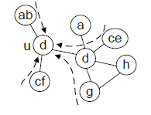


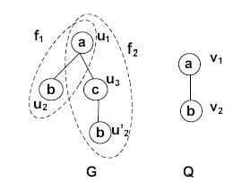
Information Propagation Model
Convert the label distribution in the neighborhood of each node u into a multi-dimensional vector R(u)={<u, A(u,l)>}.
Information Propagation Model
h = 2, α = 0.5
R_{Q}(v₁)= {<b, 0.5>} , R_{Q}(v₂)={<a, 0.5>}
R_{f1}(u₁)= {<b, 0.5>}, R_{f1}(u₂)= {<a, 0.5>}
R_{f2}(u₁)= {<b, 0.25>}, R_{f2}(u’₂)= {<a, 0.25>}
Example of Neighborhood Vectorization

Slide 11



Problem Definition
Neighborhood Based Cost Function:
- Positive difference between the
neighborhood vectors.
Neighborhood Based Cost Function
h = 2, α = 0.5
R_{Q}(v₁)= {<b, 0.5>} , R_{Q}(v₂)={<a, 0.5>}
R_{f1}(u₁)= {<b, 0.5>}, R_{f1}(u₂)= {<a, 0.5>}
R_{f2}(u₁)= {<b, 0.25>},
R_{f2}(u’₂)= {<a, 0.25>}
C_{N}(f₁) = 0
C_{N}(f₂) = (0.5-0.25)+(0.5-0.25)=0.5
Neighborhood Based Top-k Similarity Search: Given a target graph G and a query graph Q, find the top-k embeddings with respect to cost C_{N}.

Slide 12
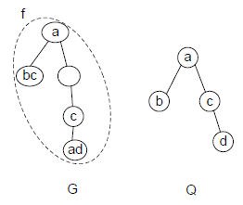
Cost Function Properties
For an exact embedding f_{e}, C_{N}(f_{e} )=0.
Neighborhood Based Cost Function can have False Positives.
False Positive, C_{N}(f )=0, for h=1.
Given a graph G and a query graph Q, if each of their nodes has a distinct label, for any inexact embedding f, C_{N}(f )>0, for all h>0, α > 0

Slide 13
Cost Function Properties
Neighborhood Based Top-k Similarity Search is NP-hard.
Given two graphs Q and G of same number of nodes, it can be determined in polynomial time if G itself is an embedding f of Q with C_{N}(f )=0.

Slide 14
Roadmap
Problem Formulation
Search Algorithm
Indexing
Query Optimization
Experimental Results
Conclusion

Slide 15
Search Algorithm
Step 1: Match a node u of target graph G with some node v of query graph Q, if L(v) ⊆ L(u) and cost(u,v) is less than a predefined cost threshold ε.
Step 2: Discard the labels of the unmatched nodes in the target graph.
Step 3: Propagate the labels only among the matched nodes from the previous step. Repeat steps 1 and 2 until no node can be discarded further.
u₁
u₂
v₁
f
u₃
v₂
v₃
u₄
u₅
v₄
u₆
G
Q
Search Algorithm
h=1, α=0.5, ε=0
1st Round:
cost(u₁, v₁)=0
cost(u₅,v₁)=0
cost(u₂,v₃)=0.5
.
.
match(v₁) = {u₁, u₅}
match(v₂) = {u₃}
match(v₃) = {u₆}
match(v₄) = {u₄}
2nd Round:
cost(u₁, v₁)=0.5
cost(u₅,v₁)=0
.
.
match(v₁) = {u₅}
match(v₂) = {u₃}
match(v₃) = {u₆}
match(v₄) = {u₄}

Slide 16
Roadmap
Problem Formulation
Search Algorithm
Indexing
Query Optimization
Experimental Results
Conclusion

Slide 17
Indexing
Index the neighborhood vectors for the first round of
matching.
Two Types of Indexing:
- Label Based (Hashing of Node Labels)
- Neighborhood Based
v₁
R_{Q}(v₁) ={<a, 0.75>, <b,0.5> }
R_{G}(u₁)= {<a, 1.0>, <b, 0.75> }
R_{G}(u₂)={<a, 1.25>, <b,0.5>, <c,0.5>}
R_{G}(u₃)={ <b,0.25>, <c,0.5>}
R_{G}(u₄)={<a,0.5>, <b,0.25>, <c,0.25>}
R_{G}(u₅)={<a,0.25>, <b,0.75>, <c,0.25>}
R_{G}(u₆)={<a,0.25>, <b,0.75>, <c,0.25>}
Neighborhood Vectors
R_{G}(u₁)= {<a, 1.0>, <b, 0.75> }
R_{G}(u₂)={<a, 1.25>, <b,0.5>, <c,0.5>}
R_{G}(u₃)={ <b,0.25>, <c,0.5>}
R_{G}(u₄)={<a,0.5>, <b,0.25>, <c,0.25>}
R_{G}(u₅)={<a,0.25>, <b,0.75>, <c,0.25>}
R_{G}(u₆)={<a,0.25>, <b,0.75>, <c,0.25>}
u₁
a, 0.75
b, 0.5
a
u₂
u₁
u₄
u₆
u₅
u₃
b
u₁
u₅
u₆
u₂
u₃
u₄
u₂
c
u₃
v₂
?
v₃
cost = 0
b
a
a
b
a, 1.0
b, 0.75
cost = 0
v₄
a
a, 1.25
b
a
a
cost = 0.25 > ε
u₄
u₅
u₆
G
Q
a, 0.5
h=2, α=0.5, ε=0
b, 0.75
Threshold Algorithm
b, 0.75
Index Structure

Slide 18
Dynamic Update
Insertion/ deletion of nodes/ edges incur local changes in the neighborhood vectors of only a few nodes.
Index structure consists of sorted list of nodes based on the label association values in their neighborhood vectors.
Index can be implemented using Priority Queue. Easy to perform local updates.

Slide 19
Roadmap
Problem Formulation
Search Algorithm
Indexing
Query Optimization
Experimental Results
Conclusion

Slide 20
Query Optimization
Non-discriminative labels increase the number of node matches in the initial rounds of search algorithm.
Eliminate non-discriminative labels initially; add them in the final stage of search algorithm.
Labels with Heavy-head distribution are more discriminative than those with Heavy-tail distribution.
|u|
|u|
Pruned
Not
Pruned
A_{u}(l)
A_{u}(l)
Heavy Head
(Discriminative)
Distribution
Heavy Tail
(Non-Discriminative)
Distribution

Slide 21
Roadmap
Problem Formulation
Search Algorithm
Indexing
Query Optimization
Experimental Results
Conclusion

Slide 22
Experimental Results
Data Sets:
Efficiency:
 | # of Node | # of Edges | # of Labels | Avg. # of Labels/ Node
FreeBase | 172,015 | 579,869 | 159,514 | 1
Intrusion | 200,858 | 703,020 | 1,000 | 25
DBLP | 684,911 | 7,764,604 | 683,927 | 1
WebGraph | 10M | 213M | 10,000 | 1
 | FreeBase | Intrusion | DBLP | WebGraph
2-hop Indexing (Off-line) | 280.0 sec | 227.0 sec | 1733.0 sec | 5,125.0 sec
Top-1 Search* (On-line) | 0.06 sec | 1.6 sec | 0.02 sec | 0.11 sec
*Query graph is a subgraph of the target graph; # of nodes in Query
Graph = 50

Slide 23
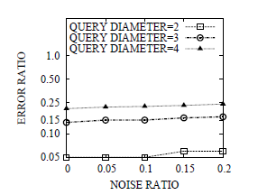
Robustness Results
Diameter 2 ≡ 100 nodes
Diameter 3 ≡ 150 nodes
Diameter 4 ≡ 200 nodes
Robustness Results (FreeBase)
Error Ratio: # of incorrectly identified nodes of the target graph in all top-1 matches divided by the # of nodes in all the query graphs in a query set.
Noise Ratio: # of edges added divided by total number of nodes in query graphs.

Slide 24
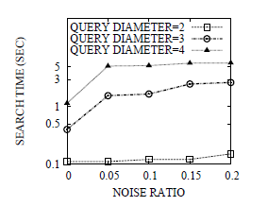
Convergence Results
Diameter 2 ≡ 100 nodes
Diameter 3 ≡ 150 nodes
Diameter 4 ≡ 200 nodes
Convergence Results (DBLP)
Noise Ratio: # of edges added divided by total number of nodes in query graphs.

Slide 25
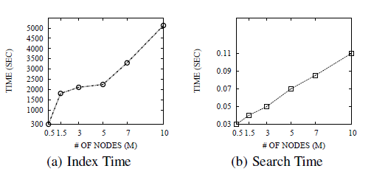
Scalability Results
Scalability Results (WebGraph)
Query graph is a subgraph of the target graph.
# of nodes in Query Graph = 50
Indexing is performed for h=2 hops.

Slide 26
Roadmap
Problem Formulation
Search Algorithm
Indexing
Query Optimization
Experimental Results
Conclusion

Slide 27
Conclusion
New Measure of Graph Similarity based on Neighborhood structure.
Information Propagation Model to convert a large graph into multi-dimensional vectors.
Iterative pruning based efficient and scalable search algorithm using the neighborhood vectors.
Efficient Indexing and Query Optimization Techniques.
How to match the labels when they are not exactly same in two graphs?

Slide 28
Thank You!!!
Questions?

