Slide 1
Summarizing Static and Dynamic
Big Graphs
Arijit Khan
Nanyang Technological University, Singapore
Sourav S. Bhowmick
Nanyang Technological University, Singapore
Francesco Bonchi
ISI Foundation, Italy

Slide 2
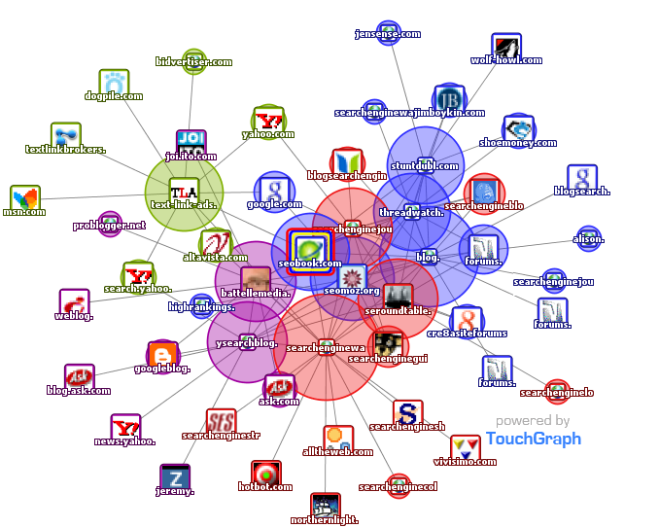

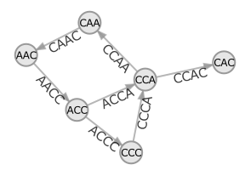

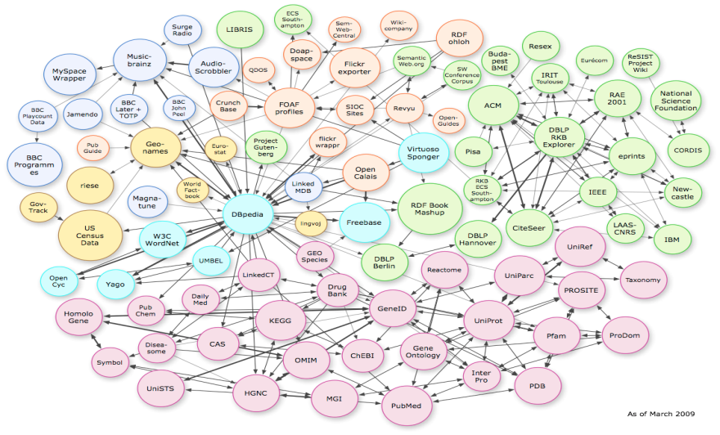
Big-Graphs
Google: > 1 trillion indexed pages
Facebook: > 800 million active users
Web Graph
Social Network
31 billion RDF triples in 2011
31 billion RDF triples in 2011
100M Ratings, 480K Users, 17K Movies
De Bruijn:
4^{k} nodes
(k = 20, … , 40)
Information Network
Biological Network
Graphs in Machine Learning
1/140

Slide 3
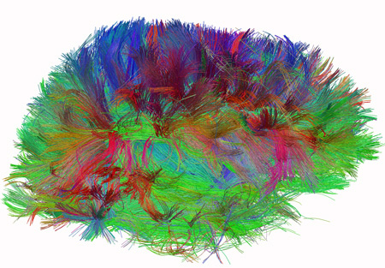
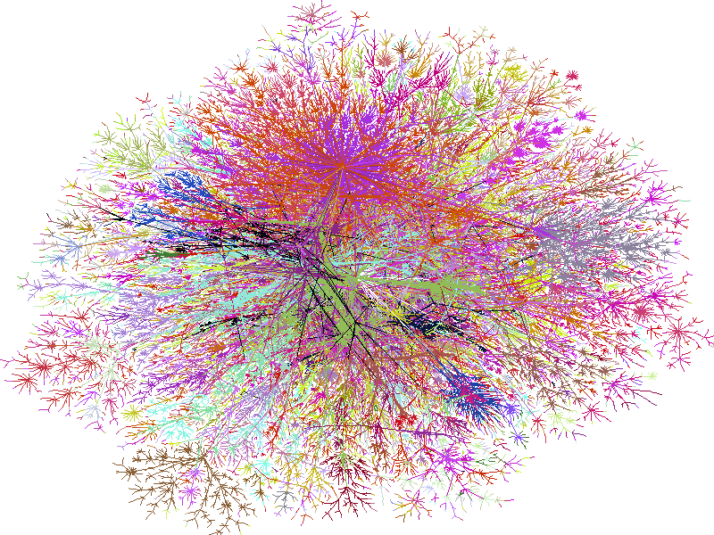
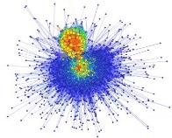





Big-Graph Scales
100M(10⁸)
Social Scale
100B (10¹¹)
Web Scale
1T (10¹²)
Brain Scale, 100T (10¹⁴)
US
Road
Internet
Knowledge
Graph
Web graph
(Google)
Human Connectome,
The Human Connectome Project, NIH
BTC
Semantic Web
2/140

Slide 4


Complex Graphs: Topology + Attributes
LinkedIn

Slide 5


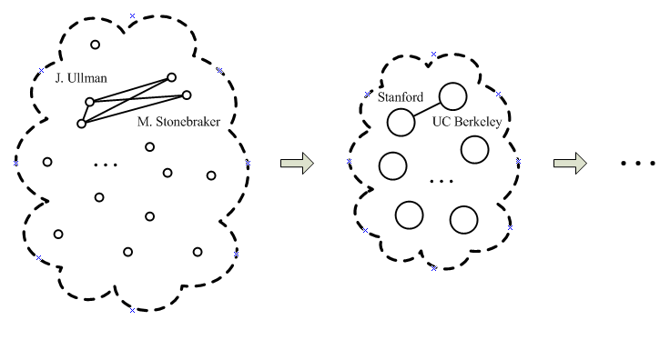

Why Graph Summarization
Large-scale graph data
- Summarization is critical
Complex graph data
- Interactive and exploratory analysis
- e.g., visualization, pattern mining, anomaly detection
4/140

Slide 6
Why Graph Summarization
1. Memory is getting cheaper
2. Distributed clusters, multi-cores
Large-scale graph data
- Summarization is critical
Fast/ online query processing
Fewer I/O operations
Less data transfer over network
Complex graph data
- Interactive and exploratory analysis
- e.g., visualization, pattern mining, anomaly detection
5/140

Slide 7
Why Graph Summarization
Interactive and exploratory analysis
Approximate query processing
Visualization and visual query interface
Distributed graph processing systems
Processing in modern hardware
6/140

Slide 8
Roadmap
Introduction
Summarizing Static Graphs
Summarizing Dynamic Graphs
Summarizing Heterogeneous Graphs
Summarizing Graph Streams
Domain-dependent Graph Summarization
Future Work and Conclusion
7/140

Slide 9
Categories of
Graph Summarization
Lossless vs. Lossy
Graph Summarization
Overlapping vs. Non-overlapping
Categories of graphs
Summarization techniques
Evaluation Metrics
8/140

Slide 10
Categories of
Graph Summarization
Lossless vs. Lossy
Static graphs
Dynamic graphs
Stream graphs
Graph Summarization
Overlapping vs. Non-overlapping
Homogeneous graphs
Heterogeneous graphs
Categories of graphs
Statistical methods
Aggregation-based
Attribute-based
Compression
Application-oriented
Summarization techniques
Evaluation Metrics
9/140

Slide 11
Categories of
Graph Summarization
Lossless vs. Lossy
Static graphs
Dynamic graphs
Stream graphs
Graph Summarization
Overlapping vs. Non-overlapping
Homogeneous graphs
Heterogeneous graphs
Categories of graphs
Statistical methods
Aggregation-based
Attribute-based
Compression
Application-oriented
Summarization techniques
Evaluation Metrics
Summarization for graph workloads
Domain-specific
summarization

Slide 12
Categories of
Graph Summarization
Lossless vs. Lossy
Static graphs
Dynamic graphs
Stream graphs
Graph Summarization
Overlapping vs. Non-overlapping
Homogeneous graphs
Heterogeneous graphs
Categories of graphs
Statistical methods
Aggregation-based
Attribute-based
Compression
Application-oriented
Summarization techniques
Space
Efficiency
Accuracy
Interestingness
Evaluation Metrics
Summarization for graph workloads
Domain-specific
summarization

Slide 13
Graph Summary: Varieties of Graphs
Homogeneous graphs
- summarize only topology information (nodes + edges)
Heterogeneous graphs
- nodes and edges have different types and attributes
- summarization happens at both structural and semantic levels
12/140

Slide 14
Graph Summary: Varieties of Graphs
Homogeneous graphs
- summarize only topology information (nodes + edges)
Heterogeneous graphs
- nodes and edges have different types and attributes
- summarization happens at both structural and semantic levels
Static graphs
Types of Temporal/ Evolving Networks
Dynamic graphs
Stream graphs
13/140

Slide 15
Graph Summary: Varieties of Graphs
Homogeneous graphs
- summarize only topology information (nodes + edges)
Heterogeneous graphs
- nodes and edges have different types and attributes
- summarization happens at both structural and semantic levels
Snapshots of graph over time
Snapshots are given apriori
can perform many passes over snapshots to build summary
Static graphs
Types of Temporal/ Evolving Networks
Dynamic graphs
Edge-streams arriving in real-time
One pass over the stream to incrementally build/ update the summary
Stream graphs

Slide 16
Graph Summarization Techniques
Statistical methods
- degree distribution, hop-plot, clustering coefficient
Aggregation-based
- grouping of nodes and edges into super-nodes/ super-edges
Attribute-based
- summary considering both topology and attributes (heterogeneous graphs)
Compression
- reducing storage space by smartly encoding nodes and edges
Application-oriented
- summarization for efficient graph querying (e.g., shortest path, graph pattern matching)
- domain-specific (e.g., bioinformatics, visual querying)
15/140

Slide 17
Challenges in Graph Summarization
Varieties of graph data
- static vs. dynamic vs. stream
- homogeneous vs. heterogeneous
- numerical vs. categorical attributes
No unique graph summarization technique!
Different objectives
- OLAP vs. compression
- Lossy vs. lossless summary
- Accuracy vs. efficiency vs. space
Different applications/ workloads/ systems
- shortest path vs. graph pattern matching
- main-memory vs. distributed
16/140

Slide 18
This tutorial is not about …
Other related graph analytics, e.g.,
- Clustering
- Sampling
- Sparsification
- Community detection
- Graph embedding
- Partitioning
- Dense subgraph mining
- Frequent subgraph mining
……
Graph compression
- Webgraph compression [Boldi & Vigna, WWW 2004; Raghavan & Molina, ICDE 2003]
- Shingle ordering [Chierichetti et al., KDD 2009]
- Layered label propagation [Boldi et al., WWW 2011]
- k2 Tree [Brisaboa et al., SPIRE 2009]
Summarization for graph workloads
- Reachability and subgraph pattern matching [Fan et al., SIGMOD 2012]
- Keyword search [Wu et al., VLDB 2013]
- Neighborhood query [Maserrat et al., KDD 2010]
- Entity resolution/ Deduplication [Zhu et al., ISWC 2016]
……
17/140

Slide 19
This tutorial is not about …
Other related graph analytics, e.g.,
- Clustering
- Sampling
- Sparsification
- Community detection
- Graph embedding
- Partitioning
- Dense subgraph mining
- Frequent subgraph mining
……
Distributed graph summarization
- Liu et al., CIKM 2014
- Junghanns et al., BTW 2017
……
Statistical methods
- Degree distribution, hop-plot, clustering coefficient
- Graph generative models
[Chakrabarti et al., ACM Comp. Survey 2006]
……
Graph compression
- Webgraph compression [Boldi & Vigna, WWW 2004; Raghavan & Molina, ICDE 2003]
- Shingle ordering [Chierichetti et al., KDD 2009]
- Layered label propagation [Boldi et al., WWW 2011]
- k2 Tree [Brisaboa et al., SPIRE 2009]
We shall not discuss them ☹
Summarization for graph workloads
- Reachability and subgraph pattern matching [Fan et al., SIGMOD 2012]
- Keyword search [Wu et al., VLDB 2013]
- Neighborhood query [Maserrat et al., KDD 2010]
……
18/140

Slide 20
Other Related Tutorials/ Surveys
[Tutorial] S.-D. Lin, M.-Y. Ych, and C.-T. Li, Sampling and Summarizing for Social Networks, in SDM 2013
[Tutorial] D. Koutra, Summarizing Large-Scale Graph Data, in SDM 2017
[Survey] Y. Liu, A. Dighe, T. Safavi, and D. Koutra, A Graph Summarization: A Survey, in ArXiv
19/140

Slide 21
Other Related Tutorials/ Surveys
Our New Materials:
Summarizing dynamic and stream graphs
Domain-dependent graph summaries
[Tutorial] S.-D. Lin, M.-Y. Ych, and C.-T. Li, Sampling and Summarizing for Social Networks, in SDM 2013
[Tutorial] D. Koutra, Summarizing Large-Scale Graph Data, in SDM 2017
[Survey] Y. Liu, A. Dighe, T. Safavi, and D. Koutra, A Graph Summarization: A Survey, in ArXiv
20/140

Slide 22
Other Related Tutorials/ Surveys
Our New Materials:
Summarizing dynamic and stream graphs
Domain-dependent graph summaries
[Tutorial] S.-D. Lin, M.-Y. Ych, and C.-T. Li, Sampling and Summarizing for Social Networks, in SDM 2013
[Tutorial] D. Koutra, Summarizing Large-Scale Graph Data, in SDM 2017
Specific sub-areas under graph summarization
[Survey] Y. Liu, A. Dighe, T. Safavi, and D. Koutra, A Graph Summarization: A Survey, in ArXiv
Y. Liu, N. Shah, and D. Koutra, An Empirical Comparison of the Summarization Power of Graph Clustering Methods, in ArXiv, 2015
A. McGregor, Graph Stream Algorithms: A Survey, in SIGMOD Rec., 2014
C. Chen, C. X. Lin, M. Fredrikson, M. Christodorescu, X. Yan, and J. Han, Mining Large Information Networks by Graph Summarization, in Link Mining: Models, Algorithms, and Applications, 2010
Y. Tian and J. M. Patel, Interactive Graph Summarization. In Link Mining: Models, Algorithms, and Applications, 2010

Slide 23

Roadmap
Introduction
Summarizing Static Graphs
Summarizing Dynamic Graphs
Summarizing Heterogeneous Graphs
Summarizing Graph Streams
Domain-dependent Graph Summarization
Future Work and Conclusion
22/140

Slide 24
Summarizing Static Graphs
SIGMOD 08
SDM 10
Summary made of supernodes (set of nodes) and superedges
Follow the MDL principle
Both lossless or lossy (with bounded error)
Edge corrections
Lossy
Densities
Number of supernodes predefined
Answer queries directly on the summary (expected-value semantics)
23/140

Slide 25
Cost = 14 edges
d
e
f
g
h
i
j
Compression possible (S)
  Many nodes with similar neighborhoods
    Communities in social networks; link-copying in webpages
  Collapse such nodes into supernodes (clusters)
  and the edges into superedges
    Bipartite subgraph to two supernodes and a superedge
    Clique to supernode with a “self-edge”
Need to correct mistakes (C)
  Most superedges are not complete
    Nodes don’t have exact same neighbors: friends in social networks
  Remember edge-corrections
    Edges not present in superedges (-ve corrections)
    Extra edges not counted in superedges (+ve corrections)
Minimize overall storage cost = S+C
a
b
c
X = {d,e,f,g}
Summary
h
i
Y = {a,b,c}
j
Corrections
+(a,h)
+(c,i)
+(c,j)
-(a,d)
Cost = 5
(1 superedge +
4 corrections)
24/140
Notes:
- So we use graph compression. Basic idea: compress by clustering nodes with similar neighborhoods into a single cluster node. These nodes exist, and will produce meaningful compression.. (868 client/server core).
- Example. Almost complete bipartite core: ABC, DEFG should be collapsed, showing one step. Collapse ABC, down to 4 edges instead of 16. Explain how edge weights and node weights are updated. HOW TO TALK ABOUT CORRECTIONS?
- Ultimately, we will return a summary structure which… “lost in translation”
- The goal… .. If we throw away C, this results in a lossy compression.

Slide 26
Representation Structure R=(S,C)
X = {d,e,f,g}
Summary
Summary S(V_{S}, E_{S})
  Each supernode v represents a set of nodes A_{v}
  Each superedge (u,v) represents
  all pair of edges π_{uv} = A_{u} x A_{v}
Corrections C: {(a,b); a and b are nodes of G}
Supernodes are key, superedges/corrections easy
  A_{uv} actual edges of G between A_{u} and A_{v}
  Cost with (u,v) = 1 + |π_{uv} – A_{uv}|
  Cost without (u,v) = |A_{uv}|
  Choose the minimum, decides whether edge (u,v) is in S
Reconstructing the graph from R
  For all superedges (u,v) in S, insert all pair of edges π_{uv}
  For all +ve corrections +(a,b), insert edge (a,b)
  For all -ve corrections -(a,b), delete edge (a,b)
h
i
Y = {a,b,c}
j
C = {+(a,h), +(c,i), +(c,j), -(a,d)}
d
e
f
g
h
i
a
b
c
j
d
e
f
g
h
i
a
b
c
j
25/140

Slide 27
Greedy
Cost of merging supernodes u and v into single supernode w
  Recall: cost of a superedge (u,x):
  c(u,x) = min{|π_{vx} – A_{vx}|+1, |A_{vx}|}
  c_{u} = sum of costs of all its edges = Σ_{x} c(u,x)
  s(u,v) = (c_{u} + c_{v} – c_{w})/(c_{u} + c_{v})
Main idea: recursive bottom-up merging of supernodes
  If s(u,v) > 0, merging u and v reduces the cost of reduction
  Normalize the cost: remove bias towards high degree nodes
  Making supernodes is the key: superedges and corrections can be computed later
u
v
w
c_{u} = 5; c_{v} =4
c_{w} = 6 (3 edges, 3 corrections)
s(u,v) = 3/9
26/140

Slide 28
Greedy
Cost reduction: 11 to 6
bc
Recall: s(u,v) = (c_{u} + c_{v} – c_{w})/(c_{u} + c_{v})
GREEDY algorithm
  Start with S=G
  At every step, pick the pair with max s(.) value, merge them
  If no pair has positive s(.) value, stop
a
d
ef
gh
C = {+(h,d),+(a,e)}
b
bc
bc
c
a
d
a
d
a
d
e
e
e
h
h
gh
f
g
f
g
f
C = {+(h,d)}
s(b,c)=.5
[ c_{b} = 2; c_{c}=2; c_{bc}=2 ]
s(g,h)=3/7
[ c_{g} = 3; c_{h}=4; c_{gh}=4 ]
s(e,f)=1/3
[ c_{e} = 2; c_{f}=1; c_{ef}=2 ]
27/140

Slide 29
Randomized
GREEDY is slow
  Need to find the pair with (globally) max s(.) value
  Need to process all pair of nodes at a distance of 2-hops
  Every merge changes costs of all pairs containing N_{w}
Main idea: light weight randomized procedure
  Instead of choosing the globally best pair,
  Choose (randomly) a node u
  Merge the best pair containing u
28/140

Slide 30
Randomized
b
c
a
d
Randomized algorithm
  Unfinished set U=V_{G}
  At every step, randomly pick a node u from U
  Find the node v with max s(u,v) value
  If s(u,v) > 0, then merge u and v into w, put w in U
  Else remove u from U
  Repeat till U is not empty
e
h
g
f
Picked e; s(e,f)=3/5
[ c_{e} = 3; c_{f}=2; c_{ef}=3 ]
b
c
a
d
h
g
ef
C = {+(a,e)}
29/140

Slide 31
Approximate Representation R_{є}
X = {d,e,f,g}
Approximate representation
  Recreating the input graph exactly is not always necessary
  Reasonable approximation enough: to compute communities, anomalous traffic patterns, etc.
  Use approximation leeway to get further cost reduction
Generic Neighbor Query
  Given node v, find its neighbors N_{v} in G
  Apx-nbr set N’_{v} estimates N_{v} with є-accuracy
  Bounded error: error(v) = |N’_{v} \N_{v}| + |N_{v} \N’_{v}| < є |N_{v}|
  Number of neighbors added or deleted is at most є-fraction of the true neighbors
Intuition for computing R_{є}
  If correction (a,d) is deleted, it adds error for both a and d
  From exact representation R for G, remove (maximum) corrections s.t. є-error guarantees still hold
Y = {a,b}
C = {-(a,d), -(a,f)}
d
e
f
g
a
b
For є=.5, we can remove
one correction of a
d
e
f
g
a
b
30/140

Slide 32
Computing approx representation
S
Reducing size of corrections
  Correction graph H: For every (+ve or –ve) correction (a,b) in C, add edge (a,b) to H
  Removing (a,b) reduces size of C, but adds error of 1 to a and b
  Recall bounded error: error(v) = |N’_{v} \N_{v}| + |N_{v} \N’_{v}| < є |N_{v}|
  Implies in H, we can remove up to b_{v} = є |N_{v}| edges incident on v
  Maximum cost reduction: remove subset M of E_{H} of max size s. t. M has at most b_{v} edges incident on v
Same as the b-matching problem
  Find the matching M ⊂ E_{G} s.t. at most b_{v} edges incident on v are in M
  For all b_{v} = 1, traditional matching problem
  Solvable in time O(mn²) [Gabow-STOC-83] (for graph with n nodes and m edges)
C
+(a,b)
+(.)
-(.)
C_{є}
+(.)
-(.)
31/140

Slide 33
Computing approx representation
S
Reducing size of summary
  Removing superedge (a,b) implies bulk removal of all pair edges π_{uv}
  But, each node in A_{u} and A_{v} has different b value
  Does not map to a clean matching-type problem
A greedy approach
  Pick superedges by increasing |π_{uv}| value
  Delete (u,v) if that doesn’t violate є-bound for nodes in A_{u}UA_{v}
  If there is correction (a,b) for π_{uv} in C, we cannot remove (u,v); since removing (u,v) violates error bound for a or b
Sє
C_{є}
+(.)
-(.)
32/140

Slide 34
APXMDL
Compute the R(S,C) for G
Find C_{є}
  Compute H, with V_{H}=C
  Find maximum b-matching M for H; C_{є}=C-M
Find S_{є}
  Pick superedges (u,v) in S having no correction in C_{є}
  in increasing |π_{uv}| value
  Remove (u,v) if that doesn’t violate є-bound for any node in A_{u} U A_{v}
Axp-representation R_{є}=(C_{є}, S_{є})
S
C
+(a,b)
+(.)
-(.)
Sє
C_{є}
+(.)
-(.)
33/140

Slide 35
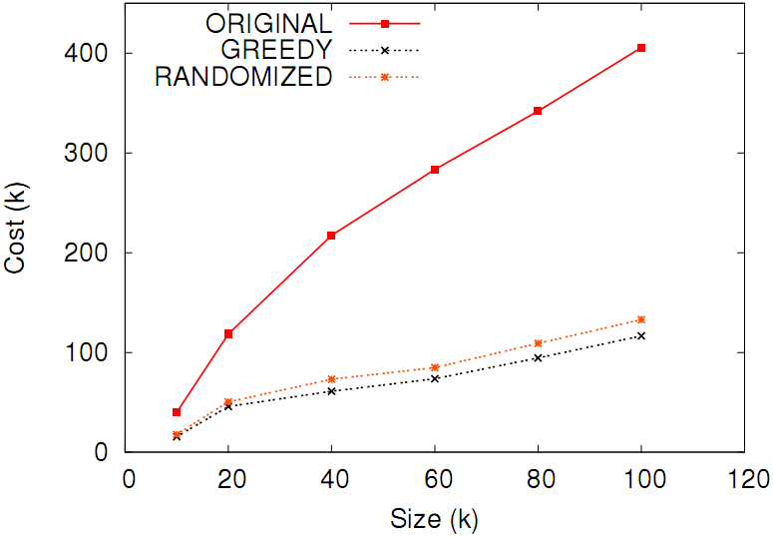
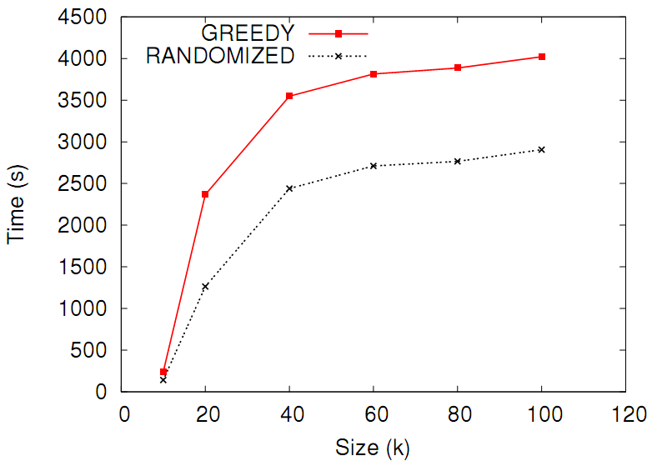
Reduces the cost down to 40%
Cost of GREEDY 20%
lower than RANDOMIZED
RANDOMIZED is 60%
faster than GREEDY
34/140

Slide 36
Summary
Original graph
Node partition
Adjacency matrix of the original graph
Expected adjacency matrix resulting from the summary
35/140

Slide 37
Query answering
Queries to the original graph can be approximated directly on the summary.
The expected adjacency matrix can be seen as a probabilistic (uncertain) graph.
Expected value sematics
Example:
Expected degree of node #2:
2/3 + 2/3 + 1/3 + 1/3 = 2
Other measures:
Expected eigenvector centrality
Expected number of triangles*
* [Riondato et al., ICDM’14, DMKD]
36/140

Slide 38
Minimize the reconstruction error
A summary is good when the expected adjacency matrix is close to the original adjacency matrix
Define reconstruction error as the difference between the two matrices.
Problem*: given an integer k find a k-partiton of the nodes s.t. the corresponding summary minimizes reconstruction error.
* LeFevre & Terzi also define a MDL-based variant with no k parameter.
37/140

Slide 39
Greedy algorithm
Greedy agglomerative hierarchical clustering:
1) Put each vertex in a separate supernode;
2) Until the number of supernodes is k:
  Merge the two supernodes whose merging minimizes the reconstruction error;
3) Output the resulting k supernodes;
Main limitations:
  no quality guarantees
  very slow
38/140

Slide 40
Riondato et al. ICDM’14
DMKD
Overcome GraSS limitations: fast algorithm with constant-factor approximation guarantee
Generalize reconstruction error to
Consider cut-norm error
Among the contributions: a practical use of extreme graph theory, with the cut-norm and the algorithmic version of Szemerédi’s Regularity Lemma.
39/140

Slide 41
Algorithm: just cluster the rows of the adjacency matrix!

Slide 42
41/140

Slide 43
Roadmap
Introduction
Summarizing Static Graphs
Summarizing Dynamic Graphs
Summarizing Heterogeneous Graphs
Summarizing Graph Streams
Domain-dependent Graph Summarization
Future Work and Conclusion
42/140

Slide 44
IEEE BigData 2016
Extends the GraSS framework to dynamic graphs
Dynamic graph = a tensor with one dimension increasing in time
Potentially infinite stream of static graphs
Define a sliding tensor window
Summarize the tensor within the tensor window
43/140

Slide 45
Overview and contributions
At each time-stamp :
A new adjacency matrix arrives
The sliding window is updated (one adjacency matrix exits the window)
Summary is created for the current window, by clustering nodes to creat supernodes (following Riondato et al.)
Output: one summary at every time-stamp
Contributions:
Two online algorithms for summarizing dynamic, large-scale graphs
Distributed, scalable algorithms, implemented in Apache Spark

Slide 46
Algorithms
Baseline:
Standard k-means clustering at each timestamp
N points each with wN values
Observation: (w-1)N² unchanged at every new timestamp
Two-level clustering:
adjacency matrix to micro-clusters
keep statistics in the micro-clusters
run maintenance algorithm
micro-clusters to supernodes

Slide 47
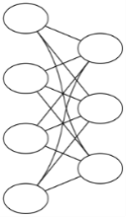
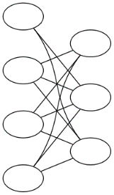
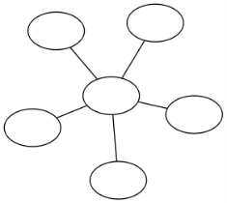
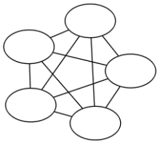
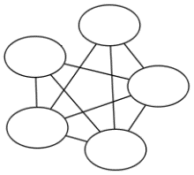

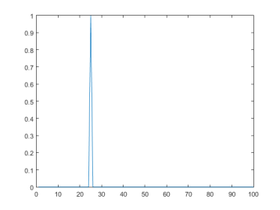
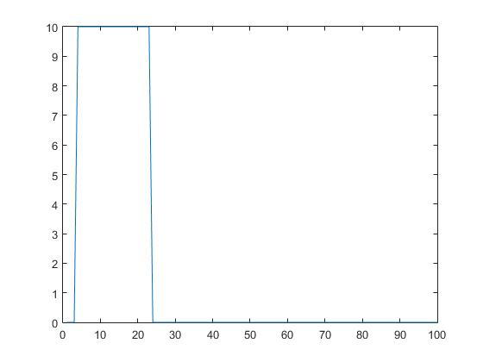
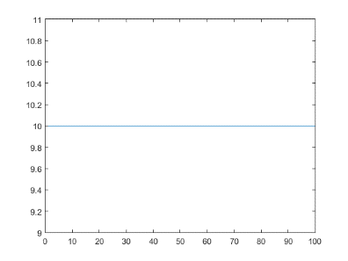
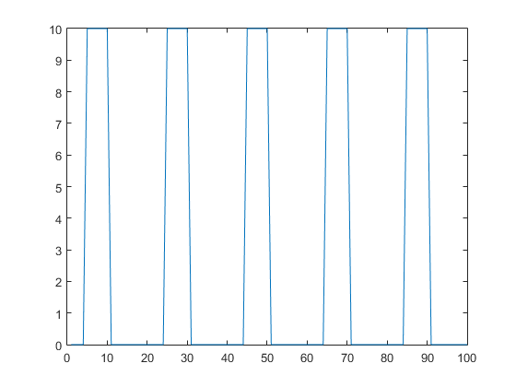
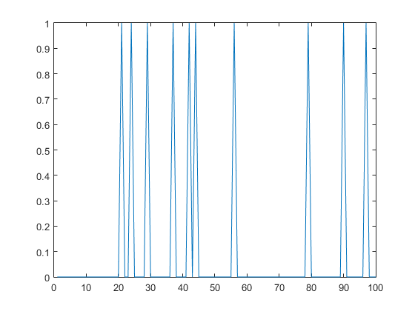
KDD’15
Use a dictionary of temporal templates:
- Static templates
- Temporal signatures
Get the shortest lossless description (MDL)
- Better compression → better summary
near clique
bip. core
chain
star
near bip. core
clique
oneshot
ranged
constant
periodic
flickering
x
x
x
x
46/140

Slide 48
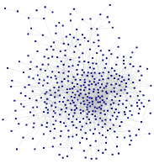
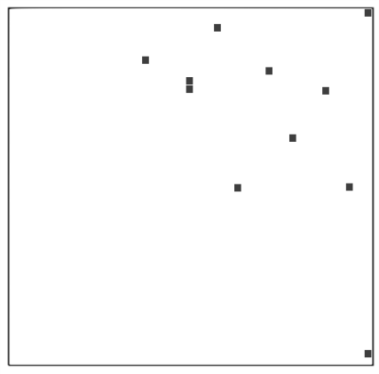
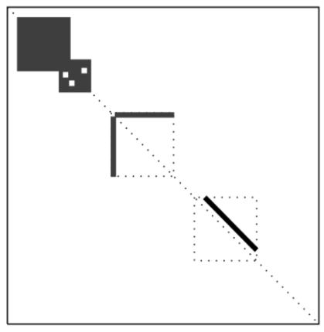
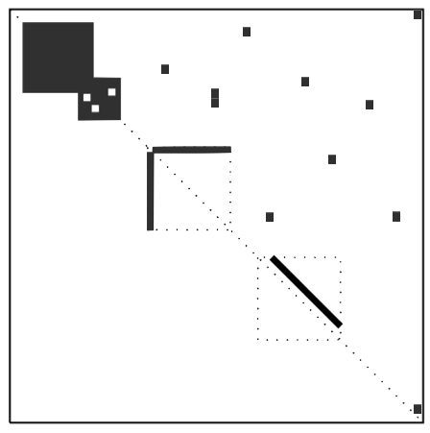
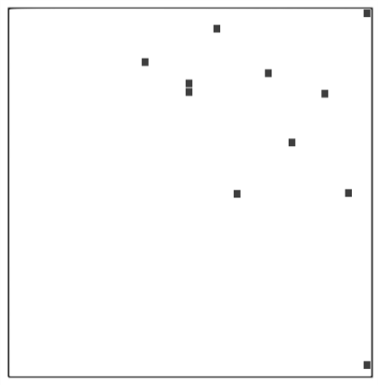
Formal goal
Given a dynamic graph G
temporal templates Φ,
Find the smallest model M
s.t. min L(G,M) = L(M) + L(E)
…
G₁
G₂
G_{n}
Adjacency A
Model M
Error E
time

Slide 49
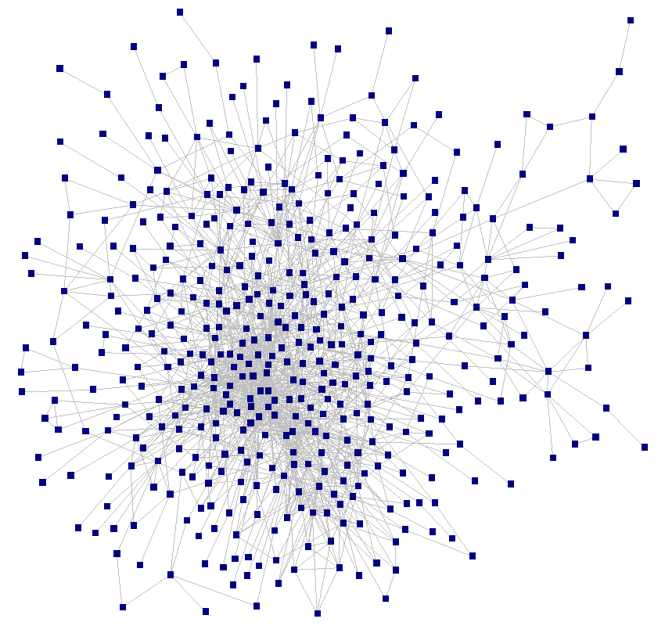

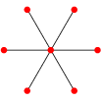

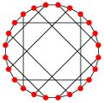
Proposed algorithm: TimeCrunch
Step 1: Generate static subgraph instances
G₁
G₂
G₃
bc
bc
bc
st
st
fc
fc
fc
48/140

Slide 50
Proposed algorithm: TimeCrunch
Step 1: Generate static subgraph instances
Step 2: Stitch static instances together to form temporal instances
G₁
G₂
G₃
bc
bc
bc
constant bc
st
st
flickering st
fc
fc
fc
constant fc
49/140

Slide 51

Proposed algorithm: TimeCrunch
Step 1: Generate static subgraph instances
Step 2: Stitch static instances together to form temporal instances
Step 3: Compose the dynamic graph summary
Temporal instances
MDL savings
Summary
constant bc
constant bc
flickering st
flickering st
constant fc
constant fc
50/140

Slide 52
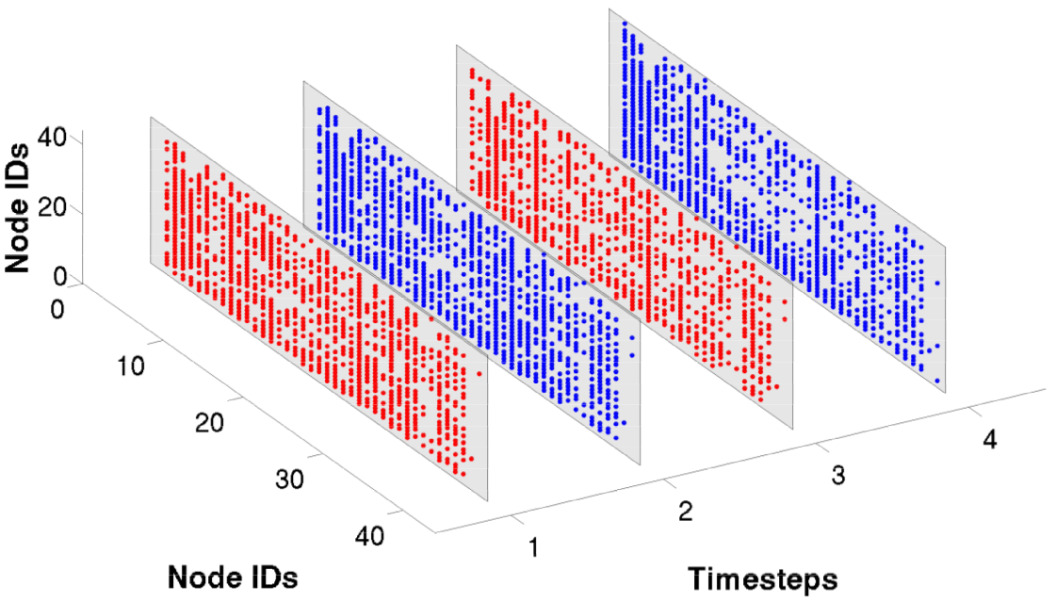
Application: Yahoo-IM
Communications between 100K users on Yahoo-IM over 4 weeks in April 2008
Constant near-clique of 40 users with 55% density
botnet?
large group chat?
51/140
Notes:
Ok so lets move to some more fun stuff
Red and blue in these pictures, again, is just for visual distinction. Each of these grey slices show adjacency matrix spyplots indicating edges and non-edges between nodes.

Slide 53
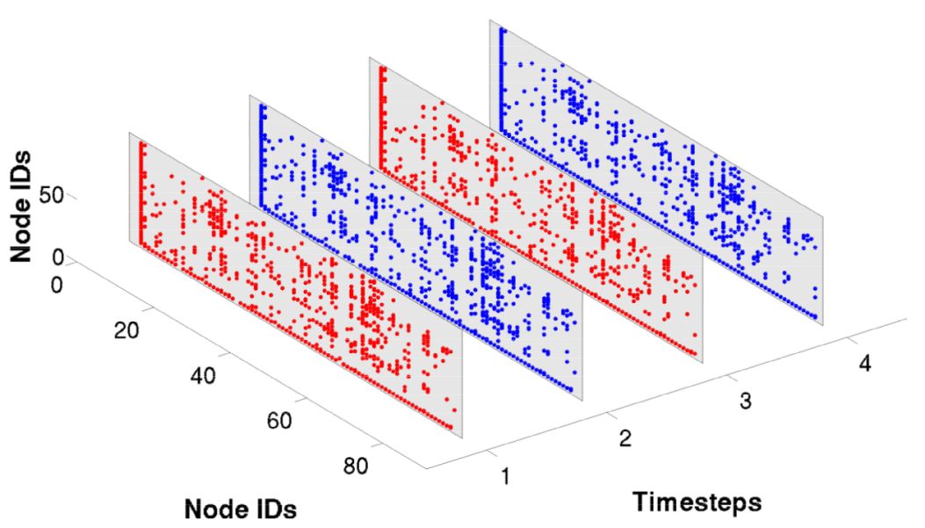
Application: Yahoo-IM
Communications between 100K users on Yahoo-IM over 4 weeks in April 2008
Constant star of 82 users
boss and employees?
52/140

Slide 54
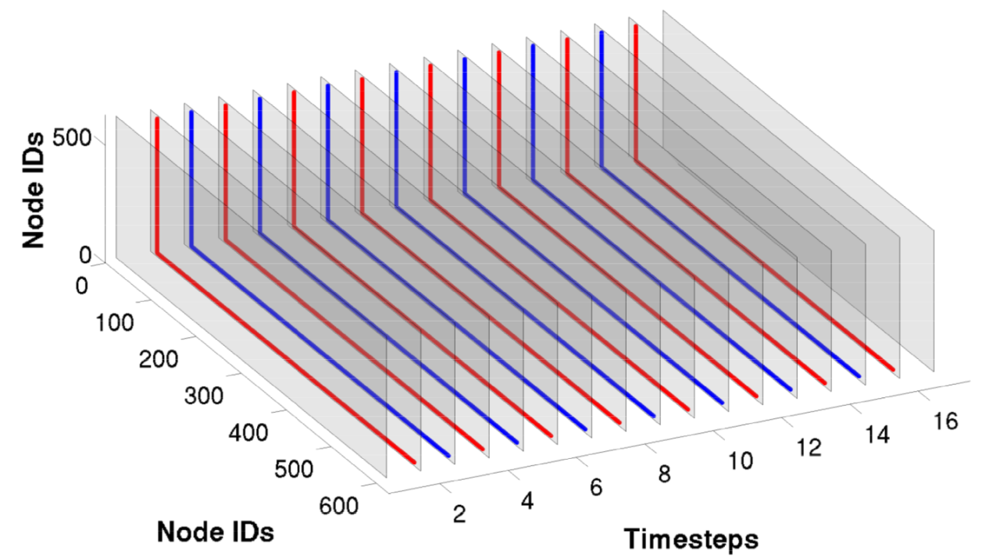
Application: Honeynet
Bipartite network of 372K attacker and victim nodes from Dec. 2013 – Jan. 2014
71% of attacks on Dec. 31 or Jan. 1st
Ranged star on 589 honeypot machines
attack lasting 2 weeks
53/140

Slide 55
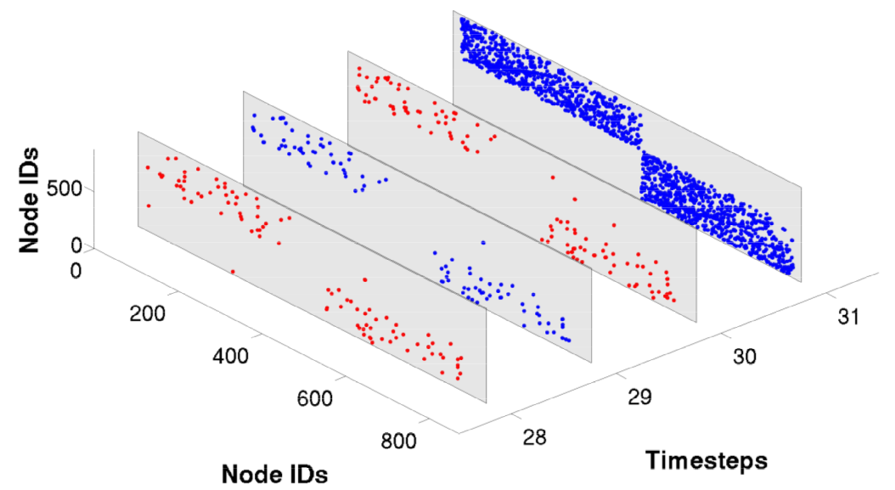
Application: Phonecall
Who-calls-whom activity of 6.3M inhabitants of a large Asian city in Dec. 2007
Oneshot near-bipartite core of 792 callers on Dec. 31
“handshake” calls between well-wishers and receivers?
54/140

Slide 56
Roadmap
Introduction
Summarizing Static Graphs
Summarizing Dynamic Graphs
Summarizing Heterogeneous Graphs
Summarizing Graph Streams
Domain-dependent Graph Summarization
Future Work and Conclusion
55/140

Slide 57
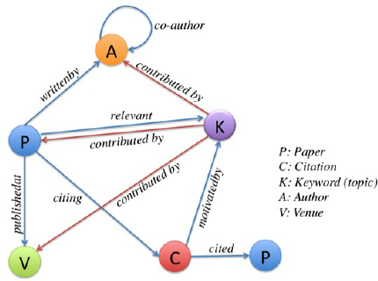
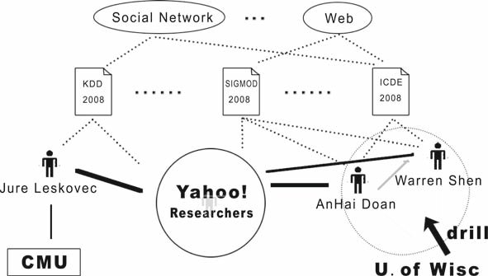
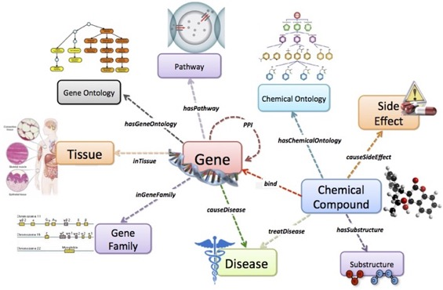
Heterogeneous Graphs
20
10
20
Collaboration Network
Collaboration Network
Biological Network
56/140

Slide 58
Roadmap
Summarizing Heterogeneous Graphs
      Graph OLAP
      SNAP
Graph OLAP: Towards Online Analytical Processing on Graphs:
[C. Chen, X. Yan, F. Zhu, J. Han, P. S. Yu, ICDM 2008]
[SNAP] Efficient Aggregation for Graph Summarization:
[Y. Tian, R. A. Hankins, J. M. Patel, SIGMOD 2008]
57/140

Slide 59
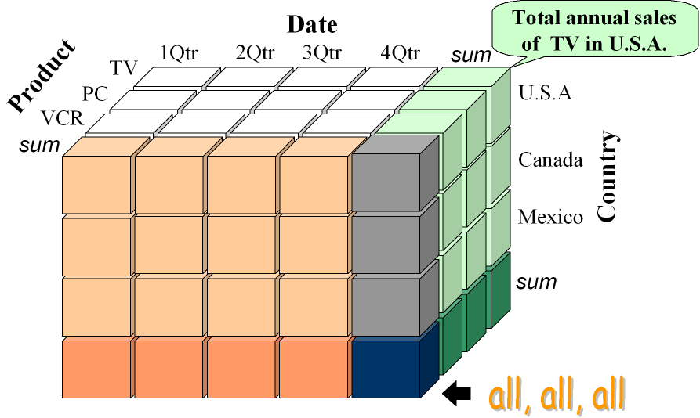
Graph OLAP
[C. Chen, X. Yan, F. Zhu, J. Han, P. S. Yu, ICDM 2008]
OLAP as a powerful analytical tool – Jim Gray, 1997
OLAP Cube
58/140

Slide 60
Graph OLAP
[C. Chen, X. Yan, F. Zhu, J. Han, P. S. Yu, ICDM 2008]
OLAP as a powerful analytical tool – Jim Gray, 1997
OLAP Cube
Multi-dimensional - Different perspectives
Multi-level - Different granularities
Roll-up/Drill-down and Slice/Dice
59/140

Slide 61
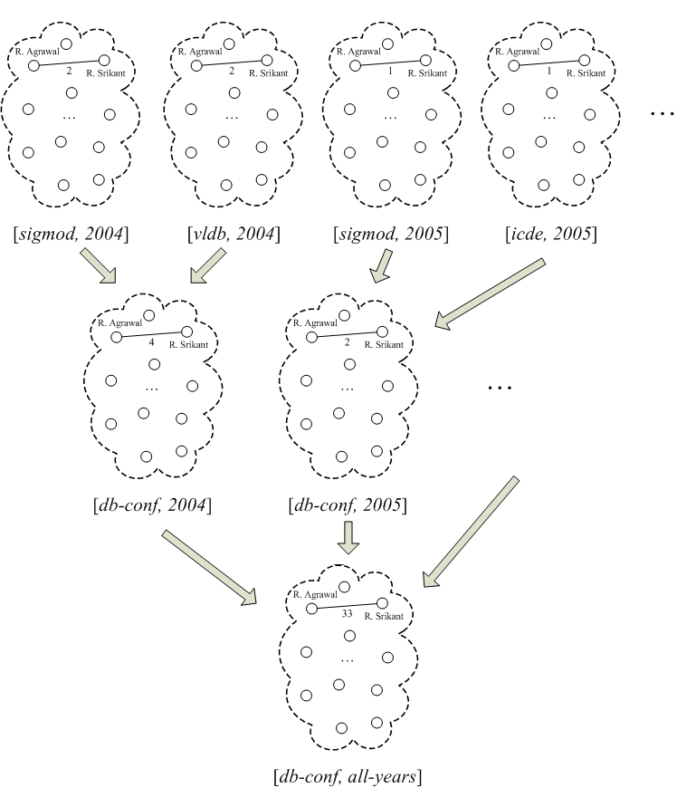
Graph OLAP
[C. Chen, X. Yan, F. Zhu, J. Han, P. S. Yu, ICDM 2008]
2
2
1
1
4
2
33
60/140

Slide 62
Graph OLAP
[C. Chen, X. Yan, F. Zhu, J. Han, P. S. Yu, ICDM 2008]
2
2
1
1
4
2
33
61/140

Slide 63
Graph OLAP
[C. Chen, X. Yan, F. Zhu, J. Han, P. S. Yu, ICDM 2008]
2
2
1
1
4
2
33
62/140

Slide 64
Graph OLAP
[C. Chen, X. Yan, F. Zhu, J. Han, P. S. Yu, ICDM 2008]
2
2
1
1
4
2
4
33
63/140

Slide 65
Graph OLAP
[C. Chen, X. Yan, F. Zhu, J. Han, P. S. Yu, ICDM 2008]
Collection of network snapshots
G = {G₁, G₂, . . . , G_{N}}
Each snapshot G_{i} = (I_{1,i}, I_{2,i}, . . . , I_{k,i}; G_{i})
I_{1,i}, I_{2,i}, . . . , I_{k,i} are k informational attributes describing the snapshot
G_{i} = (V_{i}, E_{i}) is an attributed graph, with attributes attached with its nodes V_{i} and edges E_{i}
Since G₁, G₂, . . . , G_{N} represent different observations of a network,
V₁, V₂, . . . , V_{N} correspond to the same set of objects
64/140

Slide 66
Graph OLAP
[C. Chen, X. Yan, F. Zhu, J. Han, P. S. Yu, ICDM 2008]
Two Types of OLAP
- Informational OLAP (I-OLAP)
- Topological OLAP (T-OLAP)
65/140

Slide 67
Graph OLAP
[C. Chen, X. Yan, F. Zhu, J. Han, P. S. Yu, ICDM 2008]
2
2
1
Dimensions come from informational attributes attached at the whole snapshot level, so-called Info-Dims
Overlay multiple pieces of information
Do not change the objects whose interactions are being looked at
In the underlying snapshots, each node is a researcher
In the summarized view, each node is still a researcher
1
4
2
33
I-OLAP (Informational OLAP)
66/140

Slide 68
Graph OLAP
[C. Chen, X. Yan, F. Zhu, J. Han, P. S. Yu, ICDM 2008]
Dimensions come from the node/edge attributes inside individual networks, so-called Topo-Dims
Zoom in/Zoom out
Network topology changed: “generalized” nodes and “generalized” edges
In the underlying network, each node is a researcher
In the summarized view, each node becomes an institute that comprises multiple researchers
4
T-OLAP (Topological OLAP)
67/140

Slide 69
Graph OLAP
[C. Chen, X. Yan, F. Zhu, J. Han, P. S. Yu, ICDM 2008]
Graph OLAP Measures
- Aggregated graph, node count, average degree, maximum flow, shortest
path, centrality, etc.
68/140

Slide 70
Graph OLAP
[C. Chen, X. Yan, F. Zhu, J. Han, P. S. Yu, ICDM 2008]
Graph OLAP Measures
- Aggregated graph, node count, average degree, maximum flow, shortest
path, centrality, etc.
Graph OLAP Operations
 | Graph I-OLAP | Graph T-OLAP
Roll-up | Overlay multiple snapshots to form a higher-level summary via I-aggregated graph | Shrink the topology and obtain a T-aggregated graph that represents a compressed view, whose topological elements (i.e., nodes and/or edges) have been merged and replaced by corresponding higher-level ones
Drill-down | Return to the set of lower-level snapshots from the higher-level overlaid (aggregated) graph | A reverse operation of roll-up
Slice/dice | Select a subset of qualifying snapshots based on Info-Dims | Select a subgraph of the network based on Topo-Dims

Slide 71
Graph OLAP
[C. Chen, X. Yan, F. Zhu, J. Han, P. S. Yu, ICDM 2008]
Graph OLAP Measures Classification – How to combine and leverage intermediate results?
Distributive
- The computation of high-level cells can be directly built on low-level cells
- collaboration frequency
Algebraic
- Not distributive, but can be easily derived from several distributive
measures
- maximum flow
Holistic
- Neither distributive nor algebraic
- centrality
70/140

Slide 72
Graph OLAP
[C. Chen, X. Yan, F. Zhu, J. Han, P. S. Yu, ICDM 2008]
Graph OLAP Measures Classification – How to combine and leverage intermediate results?
Distributive
- The computation of high-level cells can be directly built on low-level cells
- collaboration frequency
Algebraic
- Not distributive, but can be easily derived from several distributive
measures
- maximum flow
Holistic
- Neither distributive nor algebraic
- centrality
SUM, COUNT
AVG = f (SUM, COUNT)
MEDIAN, MODE, RANK
71/140

Slide 73
Graph OLAP
[C. Chen, X. Yan, F. Zhu, J. Han, P. S. Yu, ICDM 2008]
Optimal Computation of graph OLAP measures
- Bottom up
- Top down
72/140

Slide 74
Graph OLAP
[C. Chen, X. Yan, F. Zhu, J. Han, P. S. Yu, ICDM 2008]
Optimal Computation of graph OLAP measures
- Bottom up
- Top down
Distributive
- The computation of high-level cells can be directly built on low-level cells
- collaboration frequency
Algebraic
- Not distributive, but can be easily derived from several distributive
measures
- maximum flow
Holistic
- Neither distributive nor algebraic
- centrality
Localization
Attenuation
Constraint Pushing
73/140

Slide 75
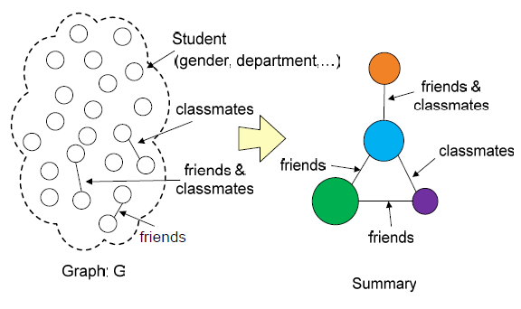
SNAP & k-SNAP
[Y. Tian, R. A. Hankins, J. M. Patel, SIGMOD 2008]
SNAP – Summarization by Grouping Nodes on Attributes and Pairwise Relationships
Similar to T-OLAP (Topological OLAP)
74/140

Slide 76
SNAP & k-SNAP
[Y. Tian, R. A. Hankins, J. M. Patel, SIGMOD 2008]
SNAP – Summarization by Grouping Nodes on Attributes and Pairwise Relationships
Similar to T-OLAP (Topological OLAP)
Group nodes by user-selected node attributes & relationships
Nodes in each group are homogenous
w.r.t. attributes
& relationships
The grouping with the minimum # groups
75/140

Slide 77
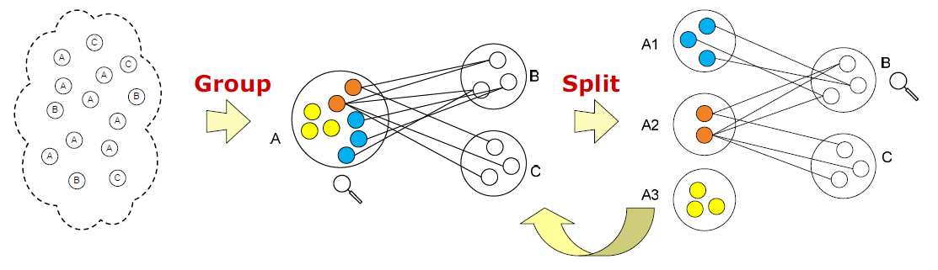
SNAP & k-SNAP
[Y. Tian, R. A. Hankins, J. M. Patel, SIGMOD 2008]
Algorithm for SNAP – Top-Down approach
Step 1: group nodes just based on user-selected attributes.
Iterative Step:
while a group breaks homogeneity requirement for relationships
split the group based on its relationships with other groups
76/140

Slide 78
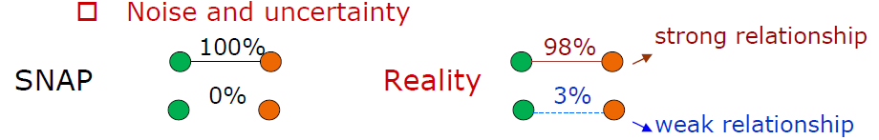
SNAP & k-SNAP
[Y. Tian, R. A. Hankins, J. M. Patel, SIGMOD 2008]
Problems with SNAP:
Homogeneity requirement for relationships
Users have no control over the resolutions of summaries
- Large number of small groups
77/140

Slide 79
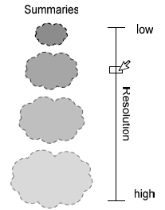
SNAP & k-SNAP
[Y. Tian, R. A. Hankins, J. M. Patel, SIGMOD 2008]
k-SNAP:
Relax the homogeneity requirement for relationships
- Maintain homogeneity requirement for node attributes
Let users control the resolutions of summaries
- Drill-down / Roll-up
- Input parameter
- What is a meaningful range for k?
k-SNAP (# groups in summary = k)
78/140

Slide 80
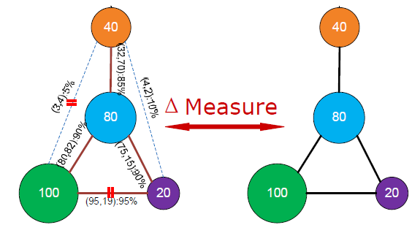
SNAP & k-SNAP
[Y. Tian, R. A. Hankins, J. M. Patel, SIGMOD 2008]
k-SNAP: Asses the quality of a summary
k-SNAP Objective: Find the summary of size k with the minimum Δ (best quality)
NP-hard – Heuristic algorithms
79/140

Slide 81
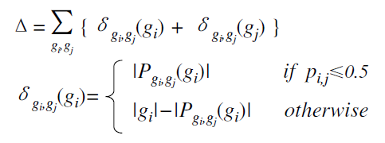
SNAP & k-SNAP
[Y. Tian, R. A. Hankins, J. M. Patel, SIGMOD 2008]
k-SNAP: Asses the quality of a summary
k-SNAP Objective: Find the summary of size k with the minimum Δ (best quality)
NP-hard – Heuristic algorithms
80/140

Slide 82
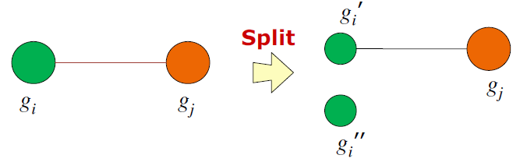
SNAP & k-SNAP
[Y. Tian, R. A. Hankins, J. M. Patel, SIGMOD 2008]
k-SNAP: Heuristic Algorithms
- Top-Down approach
- Bottom-Up approach
Top-Down Approach
Similar to the SNAP algorithm (coarse → fine)
(Difference) At each iteration, it needs to decide:
- which group to split?
- how to split the group?
Heuristics:
- Split a group g_{i} into two subgroups at each iteration
- Find gi (and a neighbor group g_{j}) with the maximum
contribution to Δ
- Split group g_{i} based on whether the nodes in g_{i}
connect to g_{j}
k-SNAP split
(Top-Down approach)
81/140

Slide 83
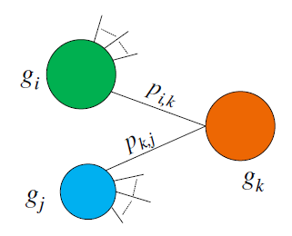

SNAP & k-SNAP
[Y. Tian, R. A. Hankins, J. M. Patel, SIGMOD 2008]
k-SNAP: Heuristic Algorithms
- Top-Down approach
- Bottom-Up approach
Bottom-Up Approach
Compute SNAP summary first (fine → coarse)
Iteratively merge two groups until the # groups is k
- which two groups to merge?
Heuristics:
- Same attribute values
- Similar neighbors
- Similar participation ratio
- Merge two groups with the minimum MergeDist
k-SNAP merge
(Bottom-Up approach)
82/140

Slide 84
More Graph Summaries
Discovery-Driven Graph Summarization:
[N. Zhang, Y. Tian, J. M. Patel, ICDE 2010]
- Numerical node attributes
- Automatic discovery of interesting summaries
Interestingness = (Diversity × Coverage) / Conciseness
Distributed Graph Summarization:
[X. Liu, Y. Tian, Q. He, W.-C. Lee, J. McPherson, CIKM 2014]
- Super-node + edge-correction
- Vertex-centric processing (e.g., Giraph, GraphLab)
We shall not discuss them ☹
Distributed Grouping of Property Graphs with GRADOOP:
[M. Junghanns, A. Petermann, E. Rahm, BTW 2017]
- Heterogeneous graphs, grouping based on node attributes and relations
- Apache Flink
83/140

Slide 85
More Graph Summaries
Set-based Unified Approach for Summarization of a multi-attributed Graph
[K. U. Khan, W. Nawaz, and Y.-K. Lee, WWW 2016]
Apolo: Interactive Large Graph Sense-making by Combining Machine Learning and Visualization
[D. H. Chau, A. Kittur, J. I. Hong, C. Faloutsos, KDD 2011]
OPAvion: Mining and Visualization in Large Graphs
[L. Akoglu, D. H. Chau, U. Kang, D. Koutra, C. Faloutsos, SIGMOD 2012]
VOG: Summarizing and Understanding Large Graphs
[D. Koutra, U. Kang, J. Vreeken, C. Faloutsos, SDM 2014]
We shall not discuss them ☹
Motif Simplification: Improving Network Visualization Readability with Fan, Connector, and Clique Glyphs
[C. Dunne and B. Shneiderman, CHI 2013]
Visual Analysis of Large Heterogeneous Social Networks by Semantic and Structural Abstraction
[Z. Shen, K.-L. Ma, and T. Eliassi-Rad, IEEE Transactions on Visualization and Computer
Graphics, 2006]
84/140

Slide 86
More Graph Summaries
Mining-based graph summarization
Set-based Unified Approach for Summarization of a multi-attributed Graph
[K. U. Khan, W. Nawaz, and Y.-K. Lee, WWW 2016]
Apolo: Interactive Large Graph Sense-making by Combining Machine Learning and Visualization
[D. H. Chau, A. Kittur, J. I. Hong, C. Faloutsos, KDD 2011]
OPAvion: Mining and Visualization in Large Graphs
[L. Akoglu, D. H. Chau, U. Kang, D. Koutra, C. Faloutsos, SIGMOD 2012]
VOG: Summarizing and Understanding Large Graphs
[D. Koutra, U. Kang, J. Vreeken, C. Faloutsos, SDM 2014]
We shall not discuss them ☹
Motif Simplification: Improving Network Visualization Readability with Fan, Connector, and Clique Glyphs
[C. Dunne and B. Shneiderman, CHI 2013]
Visual Analysis of Large Heterogeneous Social Networks by Semantic and Structural Abstraction
[Z. Shen, K.-L. Ma, and T. Eliassi-Rad, IEEE Transactions on Visualization and Computer
Graphics, 2006]
85/140

Slide 87
Roadmap
Introduction
Summarizing Static Graphs
Summarizing Dynamic Graphs
Summarizing Heterogeneous Graphs
Summarizing Graph Streams
Domain-dependent Graph Summarization
Future Work and Conclusion
86/140

Slide 88
Roadmap
Summarizing Graph Streams
      gSketch
      GMatrix
      TCM
gSketch: On Query Estimation in Graph Streams:
[P. Zhao, C. Aggarwal, M. Wang, VLDB 2012]
[GMatrix] Toward Query-Friendly Compression of Rapid Graph Streams:
[A. Khan, C. Aggarwal, Social Network Analysis and Mining Journal 2017]
[TCM] Graph Stream Summarization: From Big Bang to Big Crunch:
[N. Tang, Q. Chen, P. Mitra, SIGMOD 2016]
87/140

Slide 89
Graph Streams
Graph Stream: Continuous stream of graph edges → Telephone network, communication network, social media data, IP traffic
Massive volume and high speed
Construct summary to support future queries
[A. Khan, C. Aggarwal, SNAM 2017]
88/140

Slide 90
Challenges in Data Streams Summarization and Querying
Trade-off among Space, Accuracy, and Efficiency:
-- Increasing space increases accuracy, but reduces throughput
Other requirements:
-- Build summary in one pass over the stream
-- Incremental updates in summary
[A. Khan, C. Aggarwal, SNAM 2017]
89/140

Slide 91
Additional Challenges in Graph Streams
Querying: Query Expressibility
Compute reachability formed by heavy-hitter edges
e₁
e₂
e₄
e₃
….
e₂
e₁
e₅
e₉
e₅
e₁₁
e₆
e₈
e₉
e₁₀
e₁₁
e₁₅
e₁₃
Edge Stream
e₁₂
e₁₆
Graph Data:
Red Edges are heavy-hitter edges
[A. Khan, C. Aggarwal, SNAM 2017]
90/140

Slide 92
Additional Challenges in Graph Streams
Querying: Query Expressibility
Compute reachability formed by heavy-hitter edges
e₁
V₁
e₂
e₄
e₃
….
e₂
e₁
e₅
e₉
e₅
e₁₁
e₆
e₈
e₉
e₁₀
e₁₁
e₁₅
e₁₃
Edge Stream
V₂
e₁₂
e₁₆
Graph Data:
Red Edges are heavy-hitter edges
[A. Khan, C. Aggarwal, SNAM 2017]
91/140

Slide 93
Additional Challenges in Graph Streams
Querying: Query Expressibility
Compute reachability formed by heavy-hitter edges
e₁
V₁
e₂
e₄
e₃
….
e₂
e₁
e₅
e₉
e₅
e₁₁
e₆
e₈
e₉
e₁₀
e₁₁
e₁₅
e₁₃
Edge Stream
V₂
e₁₂
e₁₆
Graph Data:
Red Edges are heavy-hitter edges
Need to preserve connectivity information of the edges in the graph
[A. Khan, C. Aggarwal, SNAM 2017]
92/140

Slide 94
Related Work
Graph Summarization:
- Query Preserving Graph Compression (SIGMOD 2012)
- Graph Summarization with Bounded Error (SIGMOD 2008)
- Representing Web Graphs (ICDE 2003)
- The Transitive Reduction of a Directed Graph (SIGCOMP 1972)
Data Stream Summarization:
- Sketches (SIGMOD 2002, VLDB 2002, SIGMOD 2004)
- Histograms (SIGMOD 1996, VLDB 1998)
- Wavelets (SIAM Rev. 1996)
- Space Saving (ICDT 2005)
Graph Streams Querying:
- gSketches (VLDB 2012)
- Analyzing Graph Structure via Linear Measurements (SODA 2012)
- Graph Sketches: Sparsification, Spanners, and Subgraphs (PODS 2012)
93/140

Slide 95
Related Work
Graph Summarization:
- Query Preserving Graph Compression (SIGMOD 2012)
- Graph Summarization with Bounded Error (SIGMOD 2008)
- Representing Web Graphs (ICDE 2003)
- The Transitive Reduction of a Directed Graph (SIGCOMP 1972)
Data Stream Summarization:
- Sketches (SIGMOD 2002, VLDB 2002, SIGMOD 2004)
- Histograms (SIGMOD 1996)
- Wavelets (SIAM Rev. 1996)
- Space Saving (ICDT 2005)
Graph Streams Querying:
- gSketches (VLDB 2012)
- Analyzing Graph Structure via Linear Measurements (SODA 2012)
- Graph Sketches: Sparsification, Spanners, and Subgraphs (PODS 2012)
Not for stream setting
Does not preserve graph structural information
Cannot answer a combination of frequency and structure-based queries, e.g., find all connected components defined by heavy-hitter edges
94/140

Slide 96
Count-Min Sketch
h
H₁(e)
+ f
( e, f )
+ f
w
H_{w}(e)
+ f
“h” much smaller than total no of edges
Estimate frequency of an edge, find heavy-hitter edges
Cannot answer structural queries: are these two nodes connected by only high-frequency edges?
95/140

Slide 97
Our Solution: GMatrix Synopsis
incoming edge: e = (i,j)
H₄^{(.)}
H₃^{(.)}
w
“h” much smaller than
total no of nodes
H₂^{(.)}
H₁^{(.)}
h
k-th Hash Function hashes into
( H_{k}(i), H_{k}(j))
(H₁(i), H₁(j))
h
[A. Khan, C. Aggarwal, SNAM 2017]
96/140

Slide 98
GMatrix Compression
Contract nodes into a total of h super-nodes
Different hash functions create different contractions ⇒ Holds key to effective query processing
A graph with 10⁸ nodes, 10¹⁰ edges ⇒ Storage 40 GB
GMatrix with h = 10³ and w = 10 ⇒ Storage 40 MB
[A. Khan, C. Aggarwal, SNAM 2017]
97/140

Slide 99
Choice of Hash Functions
Pair-wise independent, e.g., modular hash function
P is a prime number larger than any node id: (1, 2, … , n)
a, b chosen uniformly from (1, P-1)
[A. Khan, C. Aggarwal, SNAM 2017]
98/140

Slide 100
Reverse Hash Mapping
7x mod 9 = 1
x= 4
7*4 = 3*9 + 1
Reverse hash mapping ⇒ small size and computed efficiently
Modular hash function: reverse hash mapping size ⌊P/h⌋
Can be computed in time O(⌊P/h⌋ log P) using extended Euclidean algorithm
99/140

Slide 101
Queries supported by GMatrix
(not a comprehensive list)
Edge Frequency Query
Heavy-hitter Edge Query
Node Frequency Query
Heavy-hitter Node Query
Sub-graph Edge Frequency Query
Reachability Query over High-frequency Edges
[A. Khan, C. Aggarwal, SNAM 2017]
100/140

Slide 102
Queries supported by GMatrix
(not a comprehensive list)
Edge Frequency Query
Heavy-hitter Edge Query
Node Frequency Query
Heavy-hitter Node Query
Sub-graph Edge Frequency Query
Reachability Query over High-frequency Edges
• Count-Min Sketch over edge-streams
• Count-Min Sketch over node-streams
[A. Khan, C. Aggarwal, SNAM 2017]
101/140

Slide 103
Queries supported by GMatrix
(not a comprehensive list)
Edge Frequency Query
Heavy-hitter Edge Query
Node Frequency Query
Heavy-hitter Node Query
Sub-graph Edge Frequency Query
Reachability Query over High-frequency Edges
• Last two queries combine graph structure with edge frequency
• Possible to define analogous graph mining algorithms, e.g., frequent sub-graphs mining
[A. Khan, C. Aggarwal, SNAM 2017]
102/140

Slide 104
Edge-Frequency Estimation Query
For edge (i, j), compute the frequencies of w different cells: (H_{k}(i), H_{k}(j), k)
The minimum of these values is returned as the estimated frequency
Estimation is good for high-frequency edges
If true frequency is significant fraction of total stream size, then relative error is small
[A. Khan, C. Aggarwal, SNAM 2017]
103/140

Slide 105
Heavy-Hitter Edge Query
Find all edges with frequency greater than F
No false negative, but false positive
Find all hash-edges with frequency at least F
Reverse hash mapping to find real edges
Intersection of edge sets
104/140

Slide 106
Heavy-Hitter Edge Query: Optimization
First Optimization
If a node does not appear as the source node of some potential frequent edge in at least one of the w hash functions, that node and its outgoing edges can be safely eliminated.
Second Optimization
[A. Khan, C. Aggarwal, SNAM 2017]
105/140

Slide 107
Reachability Query
Find if two query nodes are connected by a path with edges having frequency at least F
Determine all edges for which frequency is at least F using heavy-hitter edge query
Answer reachability query with these edges
[A. Khan, C. Aggarwal, SNAM 2017]
106/140

Slide 108
Experimental Results
#Nodes | #Edges | Agg. Edge Freq. | Max. Edge Freq. | Flat Stream Size | Compressed Stream Size
66M | 3612M | 10¹⁰ | 4.43 × 10⁸ | 80GB | 16.47 GB
 |  |  |  |  | 2.37 GB
 |  |  | 1.81 × 10⁹
 |  |  |  |  | 250 MB
 |  |  | 3.22 × 10⁹
Skew 1.0
Skew 1.2
Skew 1.4
Friendster Stream (Zipf Frequency Distribution with Varying Skew)
GMatrix Size | 40MB (h=1000, w=10)
GMatrix Update Time | 10⁻⁶ sec
Experiments performed on a single core of 16GB, 2.4GHz Xeon server
20MB CM-Sketch over EDGE-streams
Comparison with Count-Min (CM)
20MB CM-Sketch over NODE-streams
107/140

Slide 109
Heavy Hitter Edge Query
Frequency Threshold
= 0.01% of Total Stream Size
Frequency Threshold (% of Total Stream Size) | GMatrix | Count-Min Sketch
1 | 28 sec | 1 sec
0.1 | 149 sec | 2 sec
0.01 | 771 sec | 7 sec
Query Answering Time
108/140

Slide 110
Reachability Query
Skew (ZipF) | Reachability Error
1.0 | 0.012
1.2 | 0.008
1.4 | 0.004
Frequency Threshold
= 0.01% of Total Stream Size
Each reachability query can be processed in 0.1 sec
109/140

Slide 111
GMatrix Summary
GMatrix synopsis for summarizing rapid graph streams
Can be leveraged for a variety of frequency and structural queries
[A. Khan, C. Aggarwal, SNAM 2017]
110/140

Slide 112
gSketch [P. Zhao, C. Aggarwal, M. Wang, VLDB 2012]
The vulnerabilities of a global sketch (e.g., Count-Min)
Estimation error can be extremely high
Edge frequencies of a graph stream are distributed quite unevenly
“Low-frequency" edges may show up repeatedly in the workload
Relative error proportional to L/ Q(i, j)
111/140

Slide 113
gSketch [P. Zhao, C. Aggarwal, M. Wang, VLDB 2012]
The vulnerabilities of a global sketch (e.g., Count-Min)
Estimation error can be extremely high
Edge frequencies of a graph stream are distributed quite unevenly
“Low-frequency" edges may show up repeatedly in the workload
Relative error proportional to L/ Q(i, j)
Solution: Partition a global sketch into local sketches
Partitioning the global sketch, so that edges with similar frequencies are maintained and queried in localized sketches in order to achieve better estimation accuracy
112/140

Slide 114
gSketch [P. Zhao, C. Aggarwal, M. Wang, VLDB 2012]
Assumptions
Common characteristics of real graph streams
- Global Heterogeneity and Skews: the relative frequencies of
different edges are very uneven
- Local Similarity: within structurally localized regions of the graph,
relative frequencies of edges are often correlated
Data/workload samples are always available
Supported Queries
Individual edge frequency
Aggregated frequency of a set of edges
113/140

Slide 115
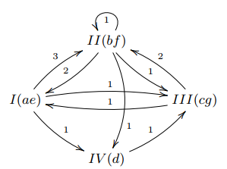
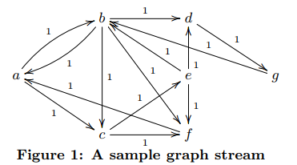
TCM [N. Tang, Q. Chen, P. Mitra, SIGMOD 2016]
Graph Stream
TCM Sketch
Different Sketch Sizes: H × H
- H/4 × 4H
- H/2 × 2H
- 2H × H/2
- 4H × H/4
114/140

Slide 116
Roadmap
Introduction
Summarizing Static Graphs
Summarizing Dynamic Graphs
Summarizing Heterogeneous Graphs
Summarizing Graph Streams
Domain-dependent Graph Summarization
Future Work and Conclusion
115/140

Slide 117
Summarization for Graph Workloads
Graph summarization for efficient query answering and pattern mining
Reachability, shortest path, and pattern matching queries
– Fan et al., SIGMOD 2016; Toivonen et al., KDD 2011; Zhou et al., ICDM 2010
Keyword search – Wu et al., VLDB 2013
Distributed graph computation – Kang et al., KDD 2011
Graph mining
– Chen et al., VLDB 2009; [SUBDUE] Cook et al., J. Artif. Int. Res 1994; Maserrat et al., ICDM 2012
Neighborhood query
- Maserrat et al., KDD 2010
Information cascade and influential node discovery
- Mehmood et al., PKDD 2013; Purohit et al., KDD 2014; Qu et al., PKDD 2014; Shi et al., ICDE 2016
Not an exhaustive list!
We shall not discuss them ☹
116/140

Slide 118
Roadmap
Introduction
Summarizing Static Graphs
Summarizing Dynamic Graphs
Summarizing Heterogeneous Graphs
Summarizing Graph Streams
Domain-dependent Graph Summarization
Future Work and Conclusion
117/140

Slide 119
Summary Revisited
Main points
Brief
Clear
Cambridge Dictionary
A short, clear description that gives the main facts or ideas about something
Oxford Dictionary
A brief statement or account of the main points or something
Not including needless details or formalities; brief
118/140

Slide 120
Issues to a Good Summary
Identify “main points” (information)
User-controlled summarize size
Minimize redundancy between main points
Cover the data as much as possible
119/140

Slide 121
Overview
Pattern Summary for Data-driven Visual Graph Query Interfaces
Functional Summarization of PPI Networks
Differential Functional Summarization of Gene Interaction Networks
120/140

Slide 122
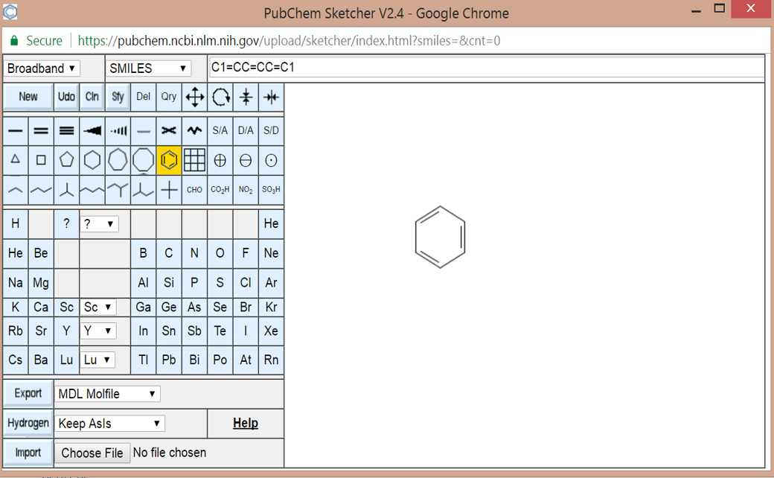
Manual Visual Graph Query Interfaces
Summary of Patterns
121/140

Slide 123


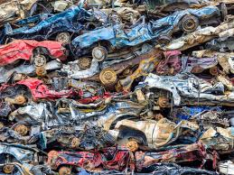

Classical Approach of Construction
Social Net
Chemical compounds
Hardcoded labels, patterns
Limited variety
Manual maintenance
Not portable

Slide 124

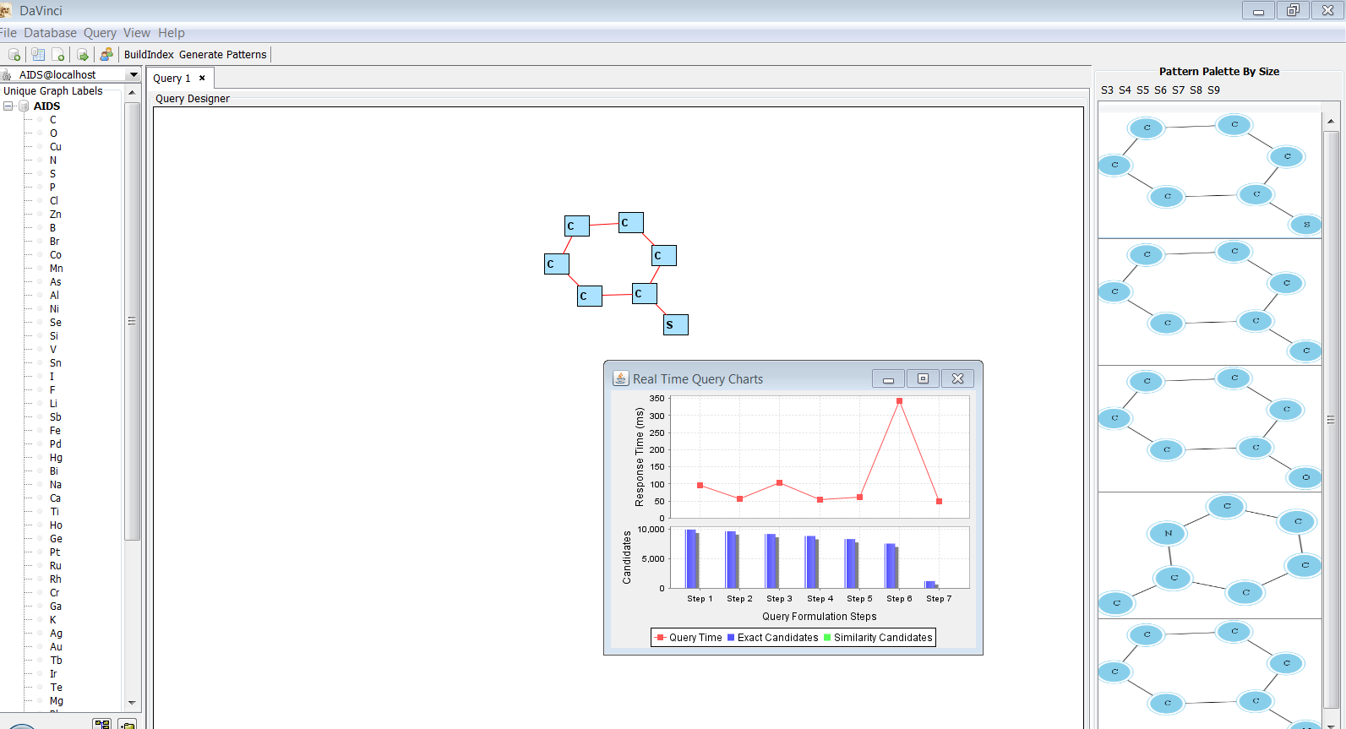

Data-driven Construction & Maintenance
Graph Repository
Diverse content
Portable
Auto maintenance
123/140

Slide 125

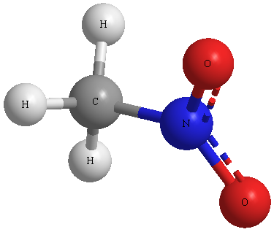









DAVINCI: Initial Effort
[ICDE 15, VLDB 16]
Online
Canned
patterns
Closure graphs
Offline
GraphDB
C
C
C
C
C
Graph set clustering
Closure graph set generation
Large set of small/medium sized graphs
Topologically-similar partitions

Slide 126
Graph Clustering as Summarizing Biological Networks
125/140

Slide 127
Limitations
Graph clustering methods do not constrain the attributes of the clusters.
Structure does not imply function.
Most graph clustering approaches do not integrate functional attributes of the proteins during the clustering process.
Methods that utilize attributes are designed for low dimensional attributes
126/140

Slide 128
FUSE: Functional Summarization of PPI Networks [BMC Bioinfo 12, BCB 11]
FUSE Approach
.Given a PPI network G, a functional summary is represented as an undirected k-node functional summary graph (FSG) to model the set of functional clusters and their interactions
Generated by maximizing “information proﬁt” under a speciﬁed budget constraint.
Constraints
It must be at a speciﬁc level of detail speciﬁed by the parameter k
For a given k the FSG must be “best” representative summary of G
Redundancies are minimized
127/140

Slide 129
Functional Clusters
3-cluster
5-cluster
128/140

Slide 130
FUSE: Functional Summarization of PPI Networks
How to optimally decompose the network into k functional subgraphs?
FUSE: systematically summarizes a protein-protein interaction (PPI) network in a multi-resolution fashion.

Slide 131
The Main Idea
Every vertex in G is given a positive information budget, which represents the information contained by the protein
A penalty cost is introduced to tackle redundancy among clusters so that repeated representation of a protein will diminish the associated information gain.
A functional cluster is added to the summary greedily.
For every protein, a fragment of the budget is subtracted and included in summary information gain, which intuitively represents addition of new information
A complexity cost is associated with each chosen cluster by penalizing clusters that are too large or too small (less likely to be selected).
130/140

Slide 132
FUSE: Functional Summarization of PPI Networks
131/140

Slide 133
Case Study: DNA Polymerase
132/140

Slide 134
Case Study: Alzheimer’s Disease Network (k=30)
133/140

Slide 135
Epistasis Mini Array Profiles (E-MAPs)

Slide 136
DE-MAP Network
E-Map network: G = (V,E,w), where V -> genes and E-> pairwise interactions
w is a function that assigns each pairwise interaction representing its interaction strength (S-Score).
A positive S-score indicates the degree of alleviating interaction between the two genes
A negative S-score indicates the degree of aggravating interaction.
Two E-Map networks for the treated condition (G_{t}) and the untreated condition (G_{c}).
Share the same set of vertices and pairwise interactions.
The diﬀerential network is a graph G_{d} = (V,E,w_{d}) s.t.:

Slide 137
DiffNet: Automatic Functional Summarization of Differential Networks [Methods 14]
Most graph clustering algorithms assume nonnegative edge weights (unsigned weights)
Consistency with prior functional knowledge is ignored

Slide 138

References
J. Zhang, S. S. Bhowmick, H. H. Nguyen, B. Choi, F. Zhu. DAVINCI: Data-driven Visual Interface Construction for Subgraph Search in Graph Databases. IEEE ICDE, 2015 (Demo).
Boon-Siew Seah, Sourav S Bhowmick, C F Dewey, Jr, Hanry Yu. FUSE: Towards Multi-Level Functional Summarization of Protein Interaction Networks. ACM BCB (SIGBio), 2011 (Best Paper Award).
B.-S. Seah, S. S. Bhowmick, C. F. Dewey Jr, and H. Yu, FUSE: A Proﬁt Maximization Approach for Functional Summarization of Biological Networks. BMC Bioinformatics, 13, 2012.
B.-S. Seah, S. S. Bhowmick, and C. F. Dewey Jr, DiffNet: Automatic Differential Functional Summarization of dE-MAP Networks. Methods, 69(3), 2014.

Slide 139
Roadmap
Introduction
Summarizing Static Graphs
Summarizing Dynamic Graphs
Summarizing Heterogeneous Graphs
Summarizing Graph Streams
Domain-dependent Graph Summarization
Future Work and Conclusion
139/140

Slide 140
Open Research Problems
Scalable, high quality attribute-aware summaries
Summarizing a set of graphs
Differential summaries on massive networks
Application-driven summarization
Summarization of uncertain graphs
Summary maintenance
140/140

Slide 141

Final Words
Graph summaries have wide ranging applications
Various definitions and techniques of graph summaries
Summarizing static graphs, dynamic graphs and graph streams
Domain-specific graph summarization (visual graph querying, bioinformatics)

Slide 142

Thank You!

